Slide 1
Measurement of Ecosystem Services
Marialuisa Tamborra
Ioanna Grammatikopoulou
Alessandra La Notte
DG ECFIN-OGWG workshop on natural capital measurement and modelling
Brussels, 30 November 2023

Slide 2
© 2023 Marialuisa Tamborra, Ioanna Grammatikopoulou, Alessandra La Notte

Slide 3
Outline
The INCA approach: assessing ecosystem services
The LISBETH initiative: using ecosystem services
The way forward

Slide 4


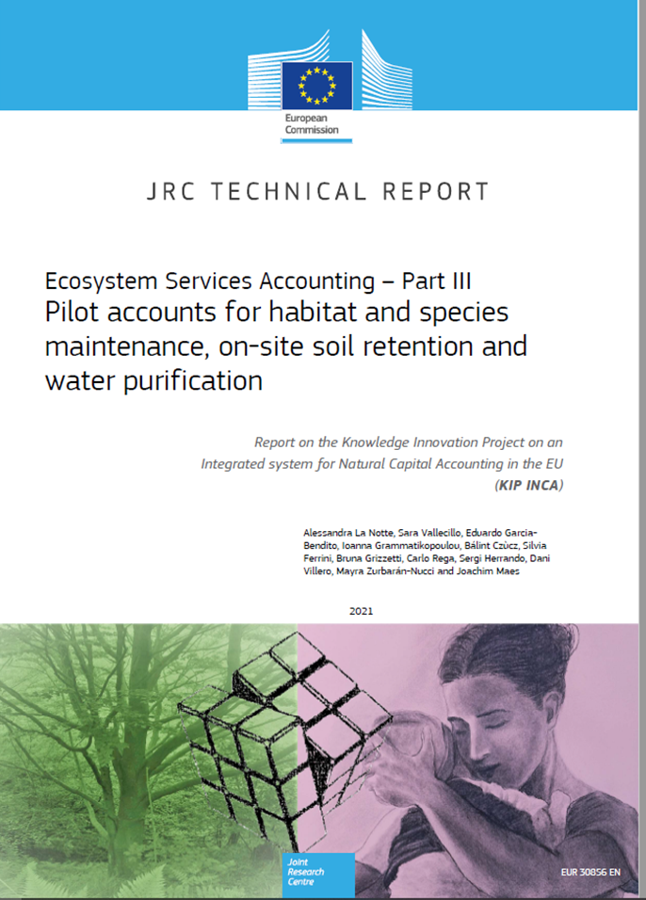
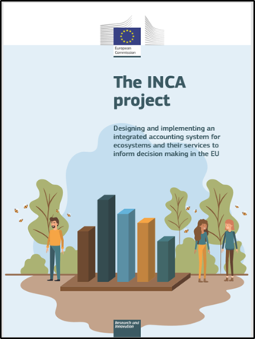
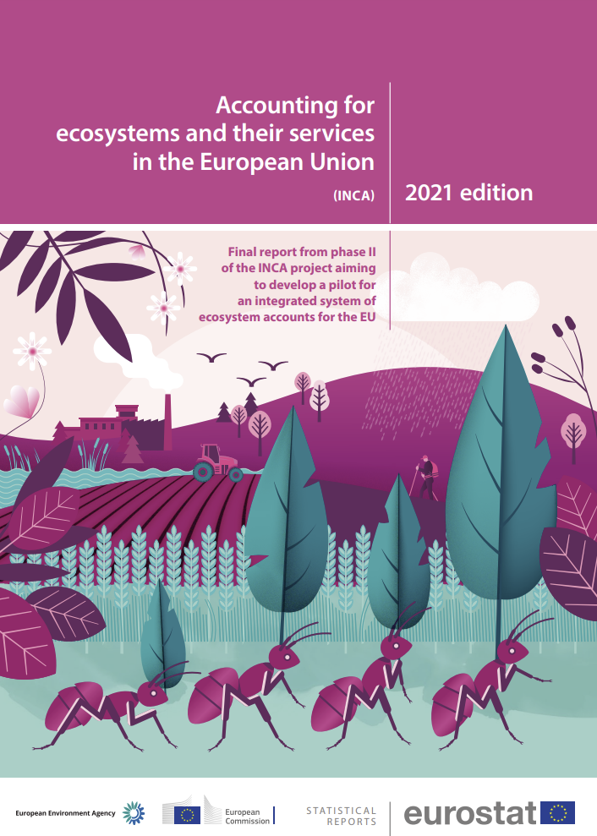
The INCA approach

Slide 5







…
…
Ecosystems
Socio-economic systems

Slide 6
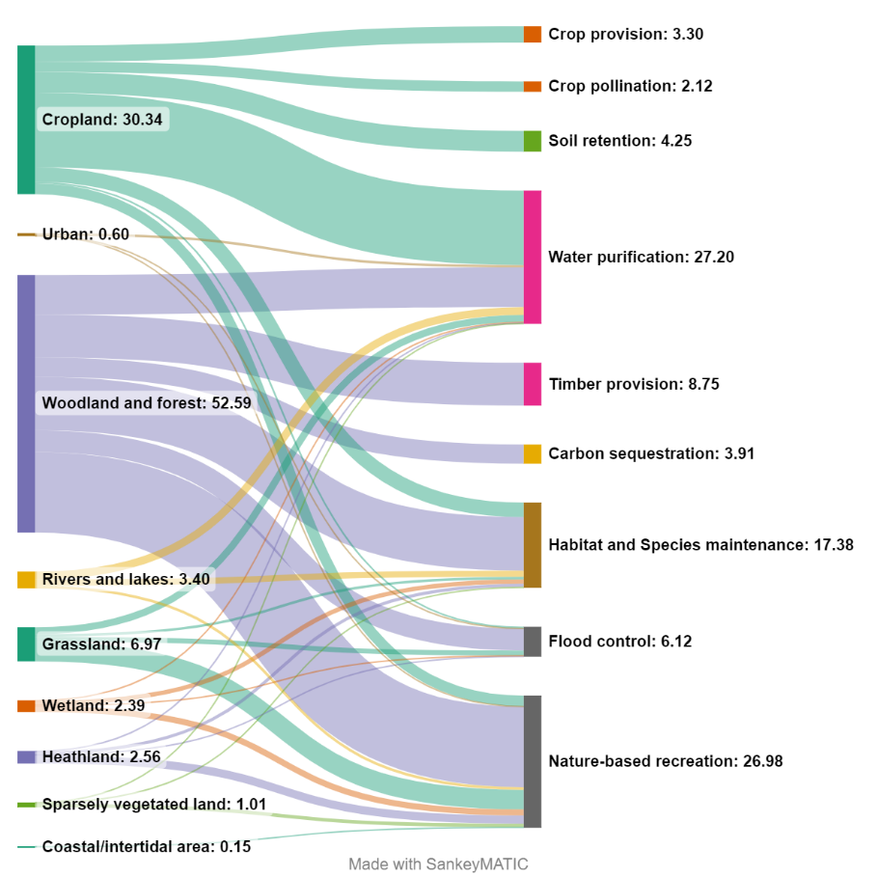
…
…
Ecosystems
Services
Socio-economic systems

Slide 7
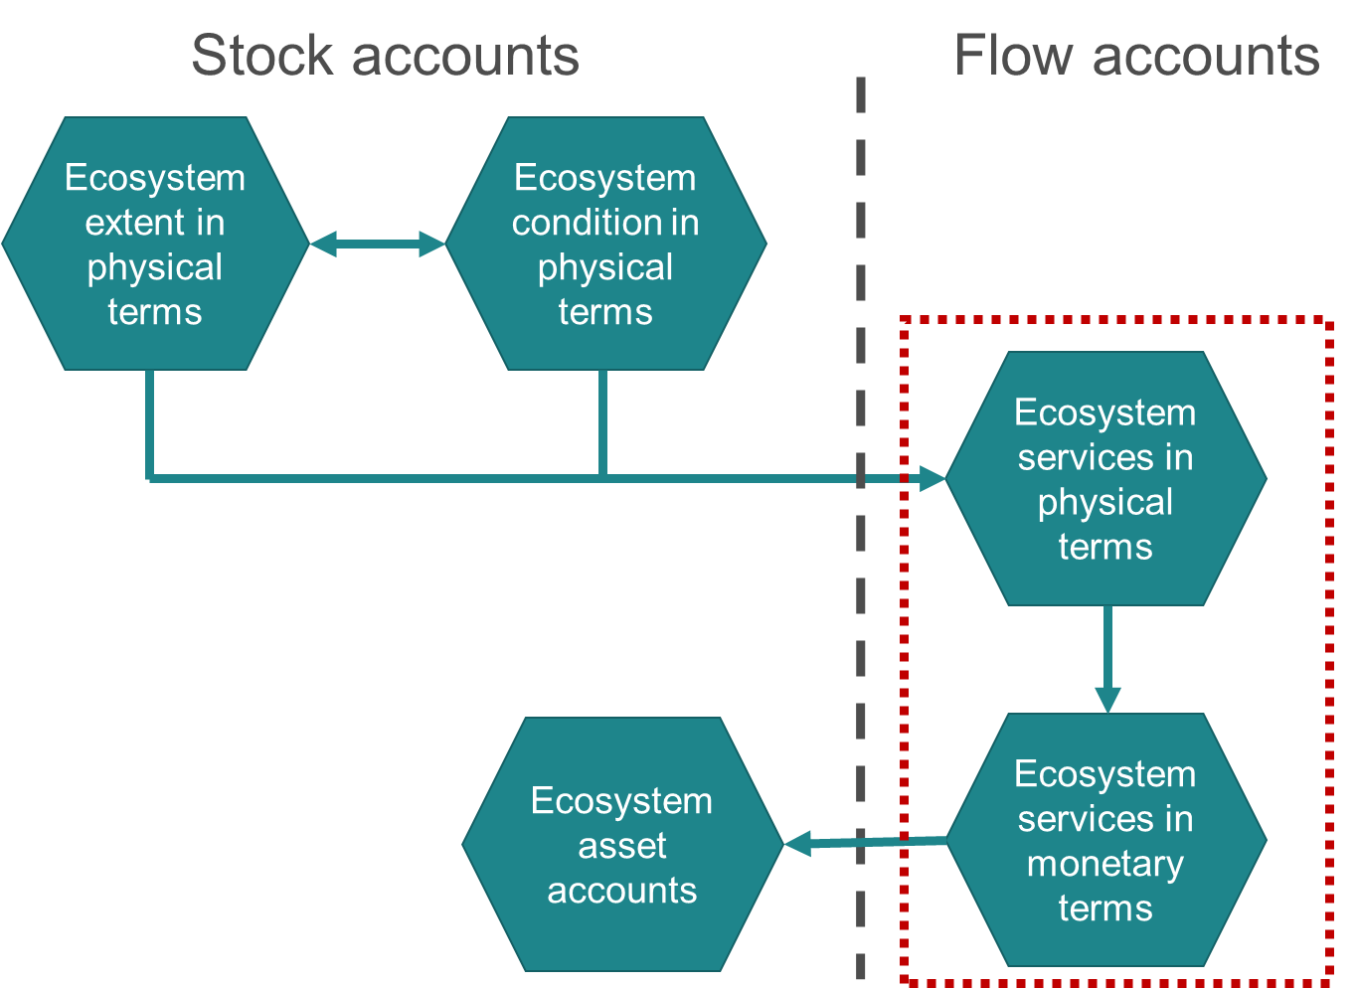
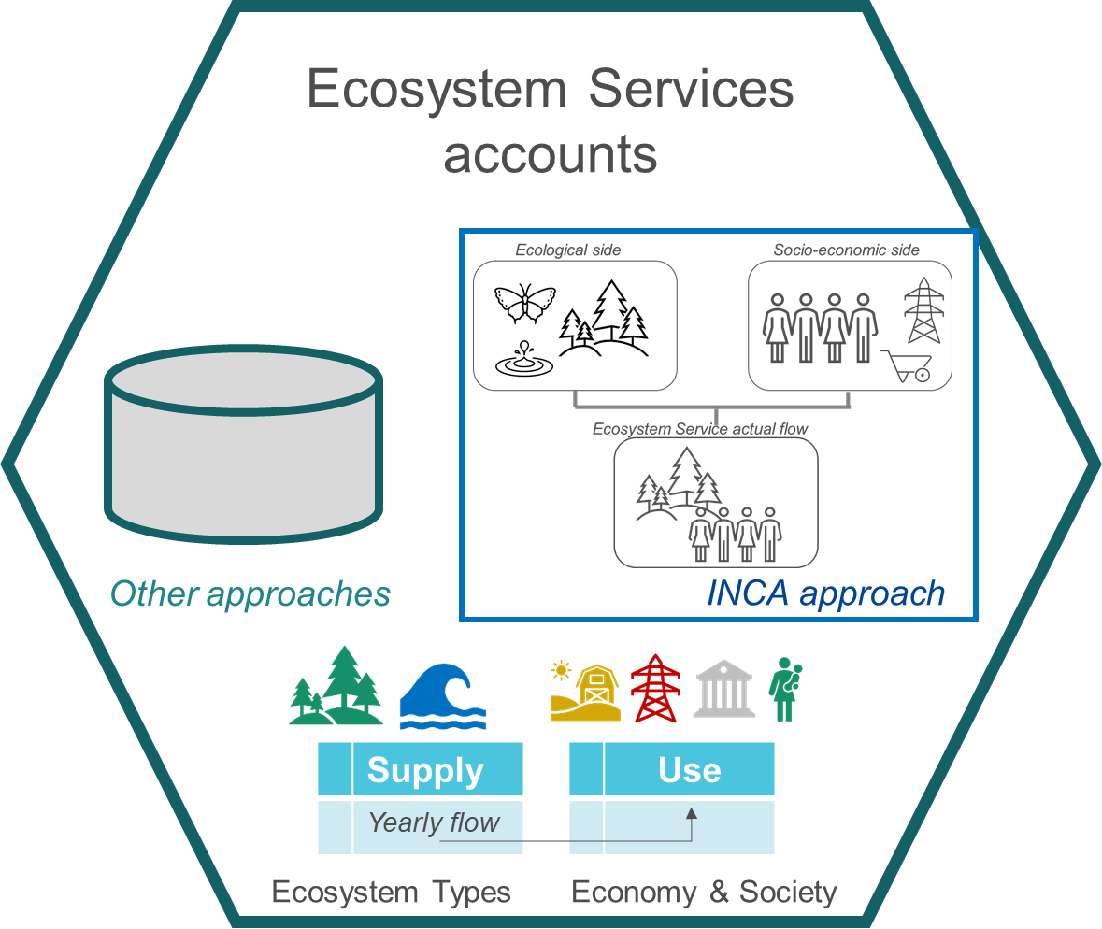
It is an operational procedure
SEEA EA: it is a general framework

Slide 8



The match between Ecosystem supply and Socio-economic demand generates the Ecosystem Services on which human activities depends

Slide 9
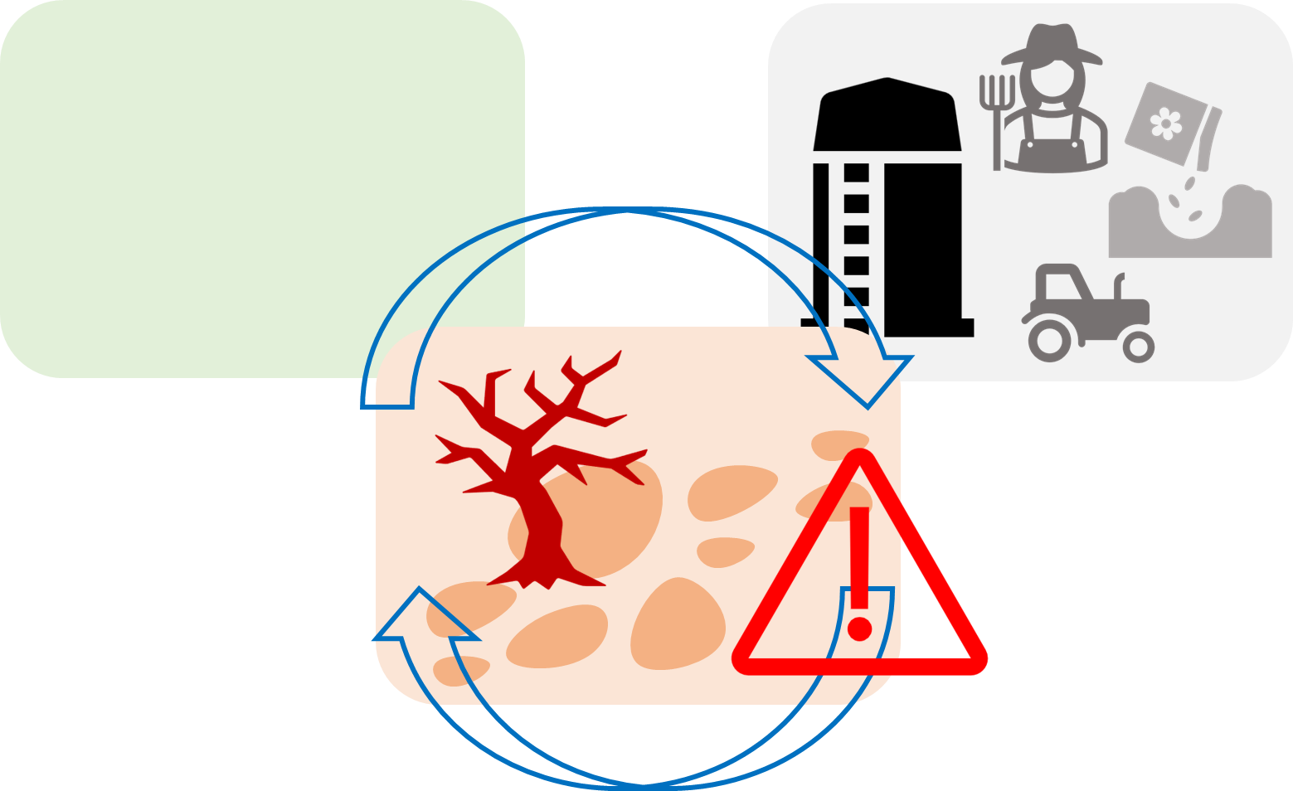
The mismatch between Ecosystem supply and Socio-economic demand generates the Ecosystem Service Vulnerability

Slide 10

Procedure
Assessment
Translation in monetary terms
Accounting in physical and monetary terms
Physical terms
Monetary terms

Slide 11
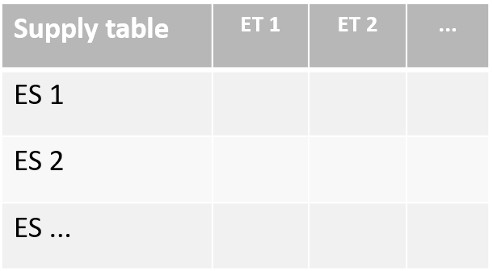
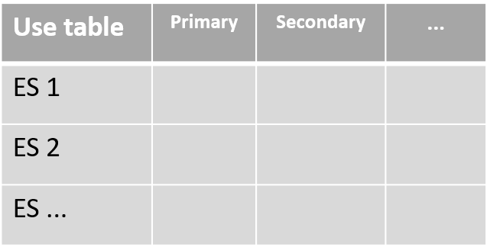
The assessment
data extraction
(tout court or «modified»)

Slide 12
The assessment
biophysical modelling

Slide 13













Translation in monetary terms
timber provision and carbon sequestration
market price-based
soil retention
replacement costs
water purification
replacement costs
crop provision and pollination
market price-based
flood control
avoided damage costs
…
nature-based recreation
travel-cost method
habitat and species maintenance
choice experiment

Slide 14
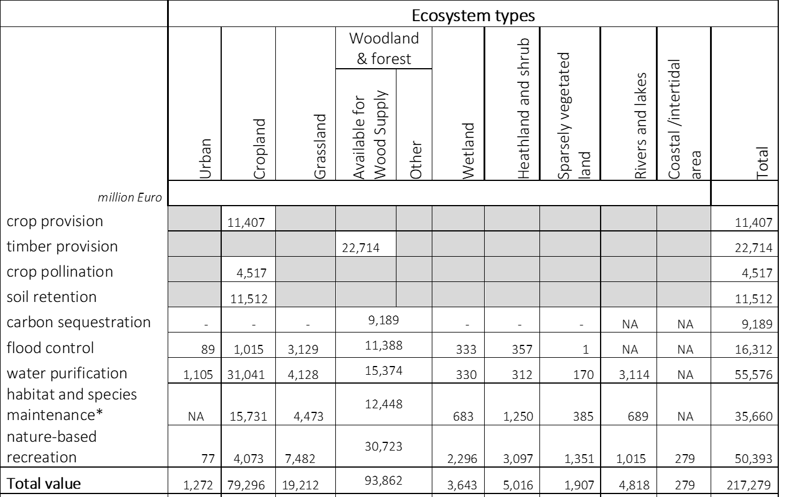
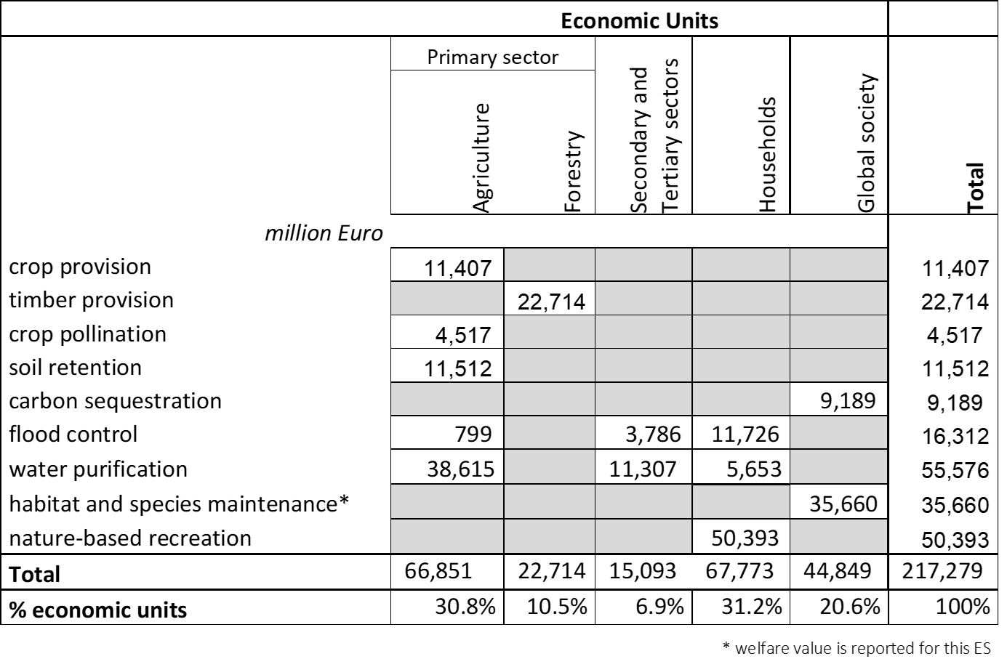


The Supply and Use tables in monetary terms
0.6% | 37.9% | 9.2% | 48.7%
30.8% | 6.9% | 31.2% | 20.6%

Slide 15
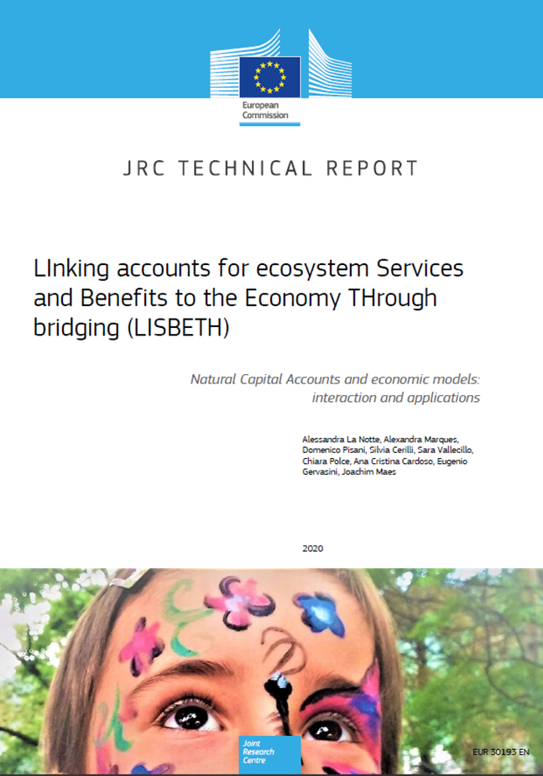
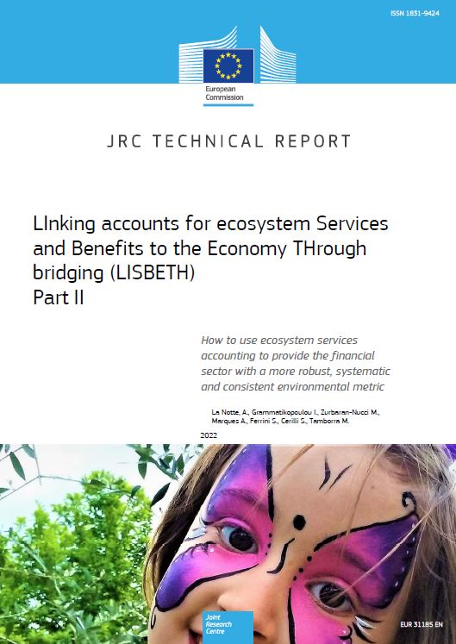
From INCA to LISBETH

Slide 16
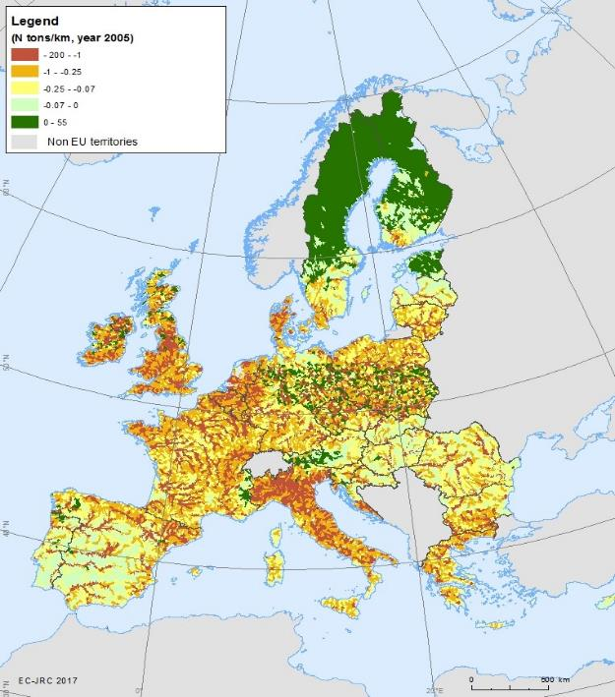
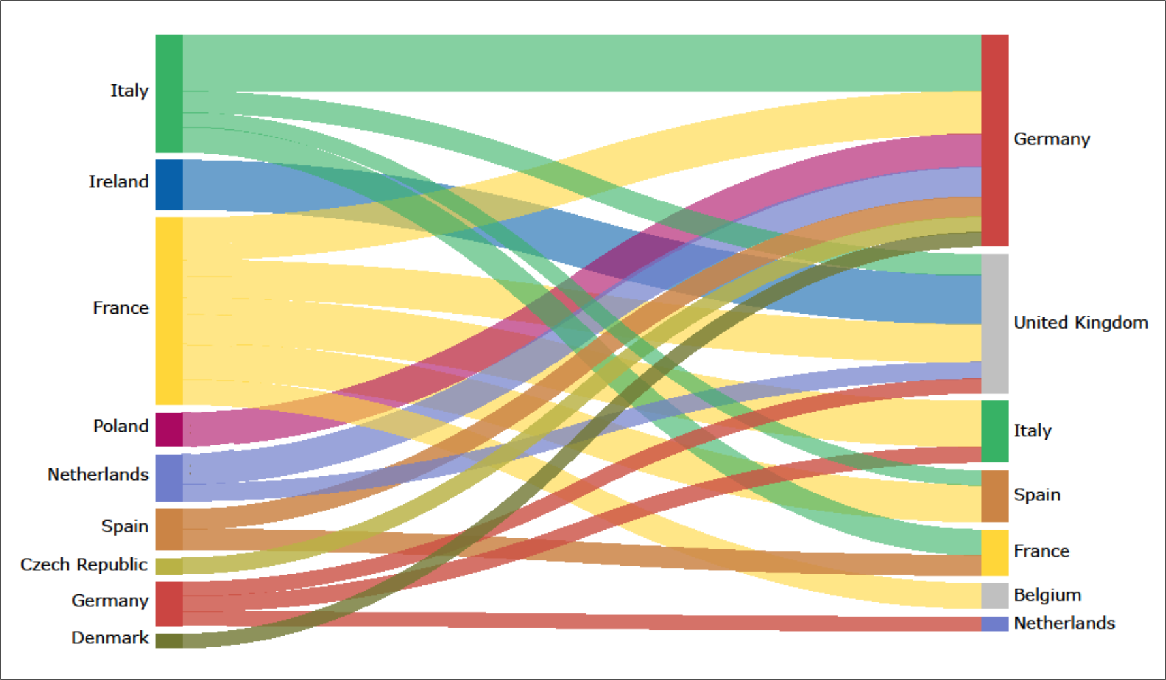
ES Actual flow: from producers to consumers
Water purification embedded in agricultural products traded within Europe Multi-Regional Input Output analysis

Slide 17
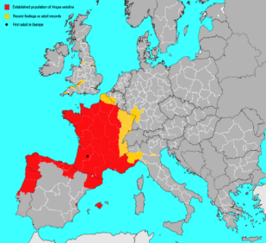
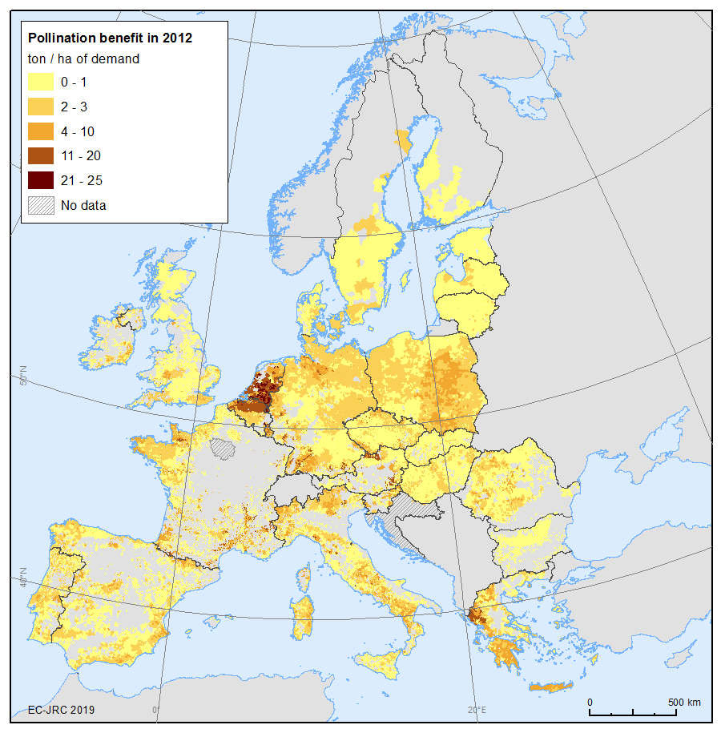

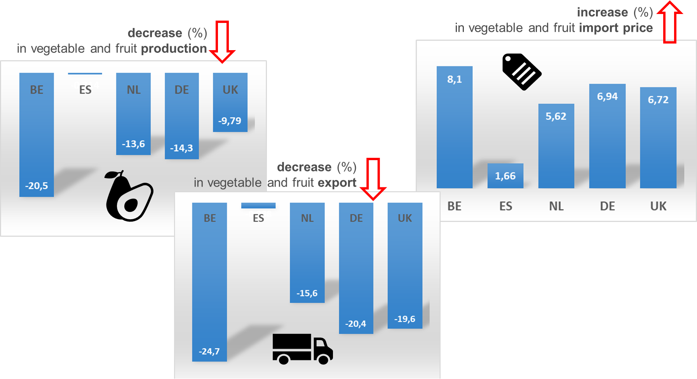
ES Actual flow: measuring the economic impacts
Economic impact of invasive alien species: INCA through GTAP

Slide 18







The different roles of Ecosystem Services
biotic
This is what matters in production function
Ecological input
e.g. soil retention and pollination
abiotic
Pollution removal
e.g. water purification
physical threats
Protection
biological threats
e.g. flood control
other threats
Target compliance
e.g. carbon sequestration

Slide 19
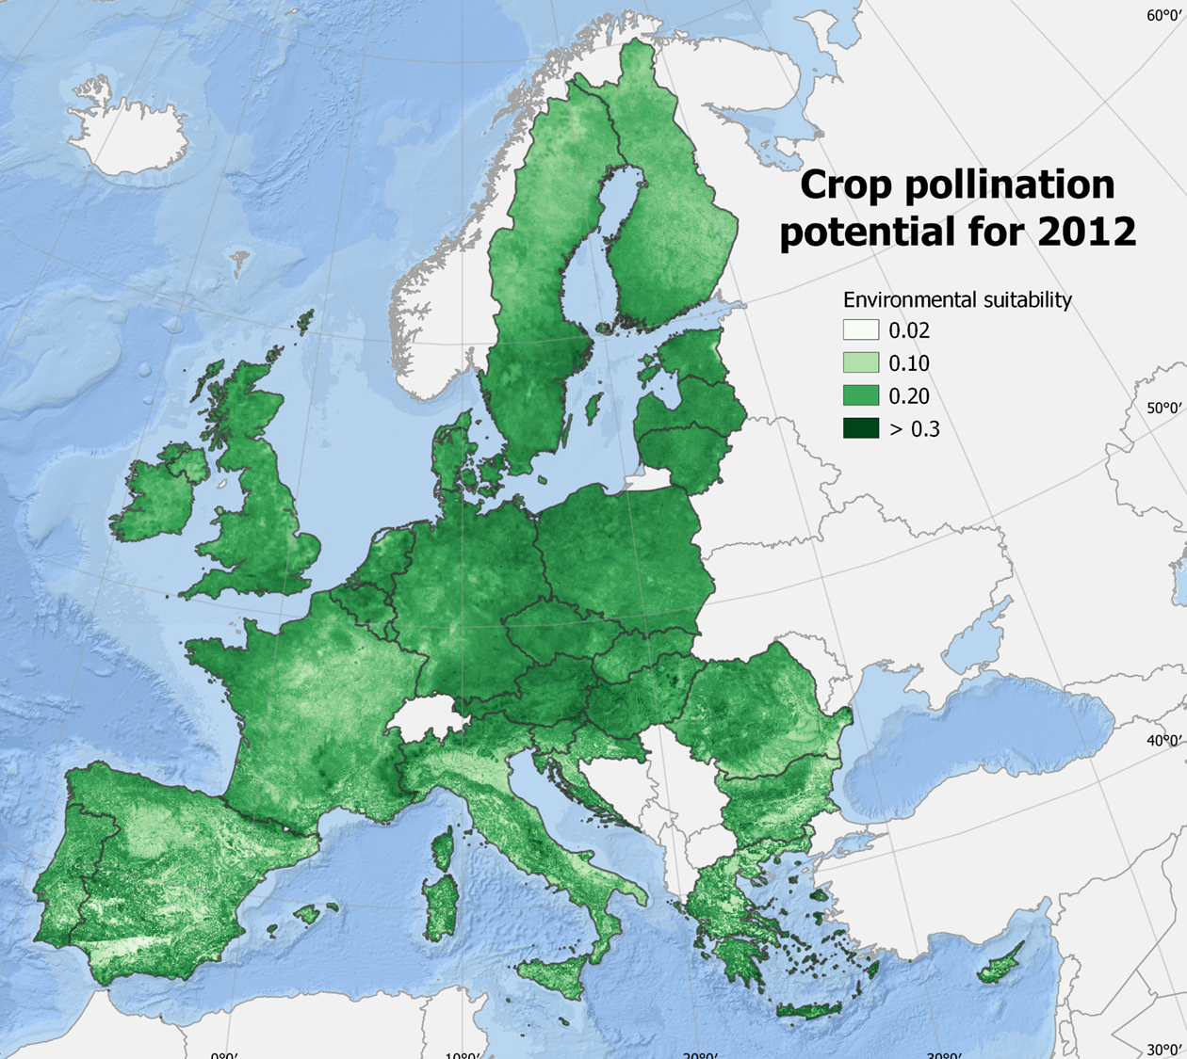
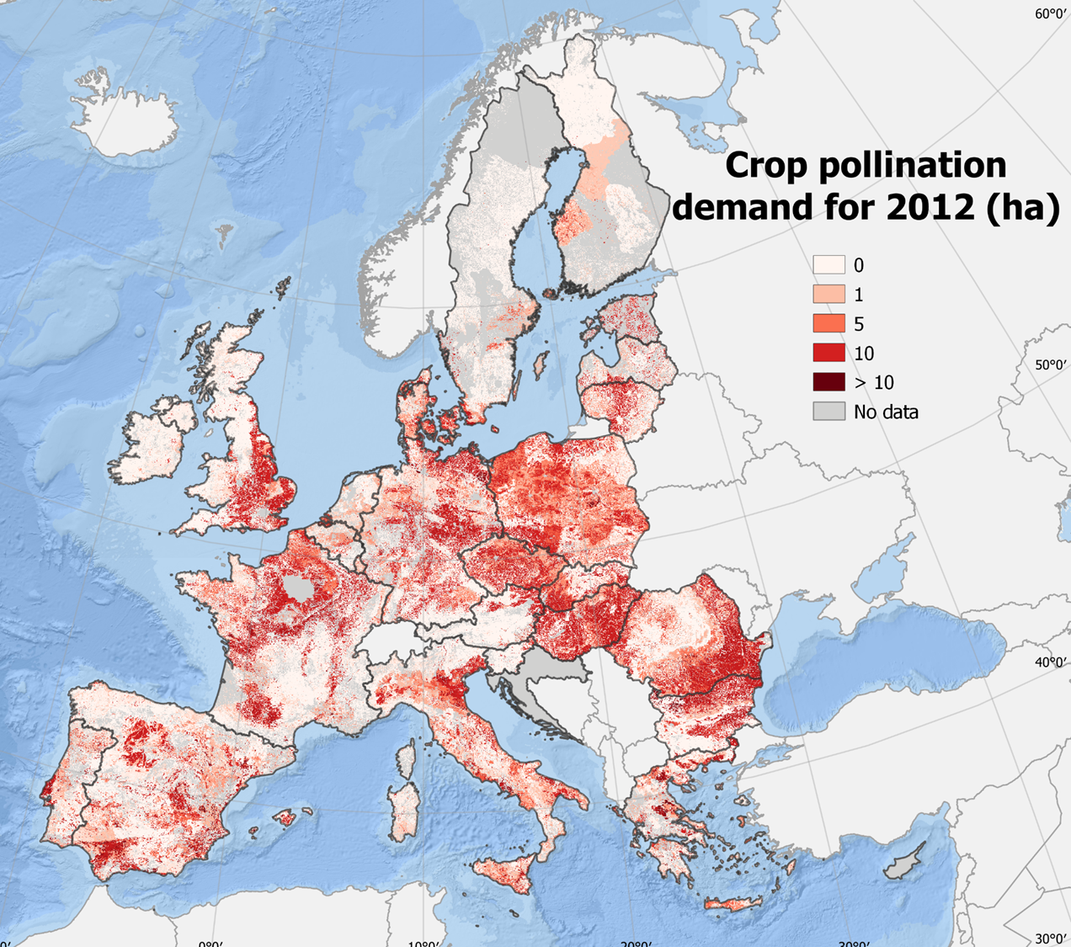
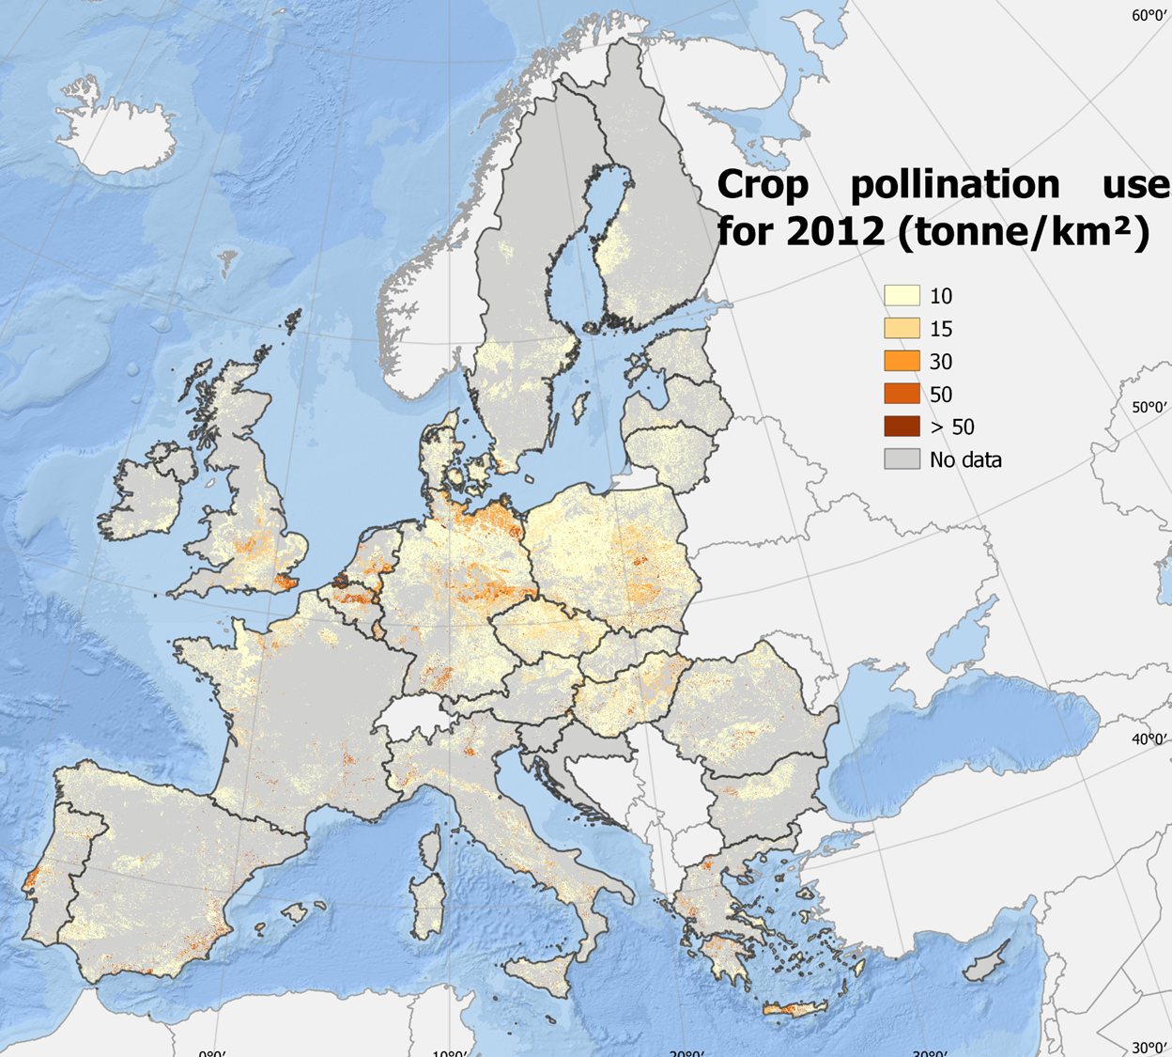
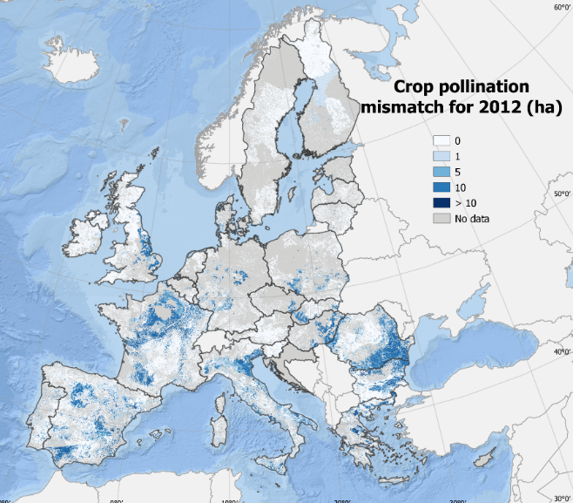

ES Vulnerabilities related to ecological inputs
Crop pollination

Slide 20
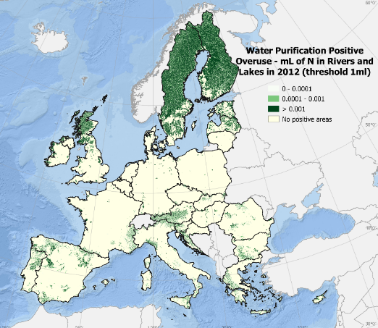
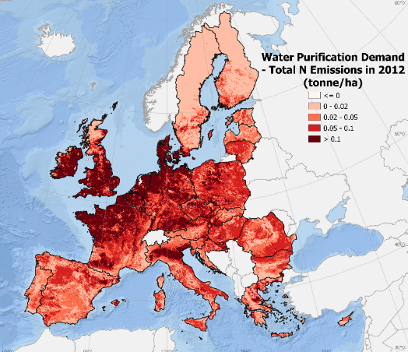
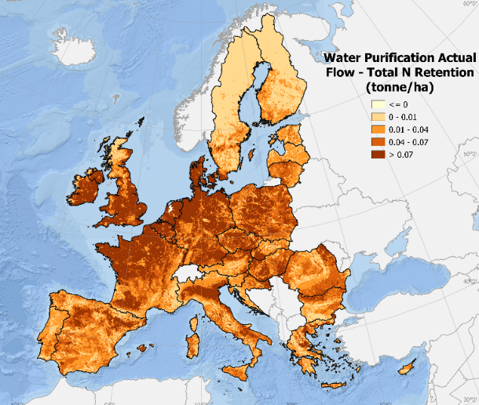
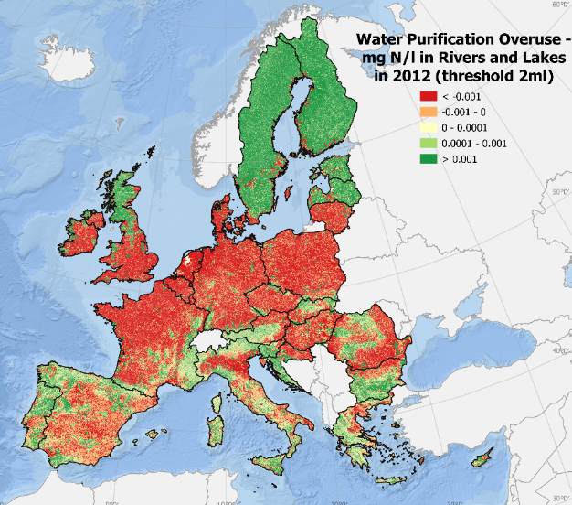
ES Vulnerabilities related to pollution removal
Water purification

Slide 21
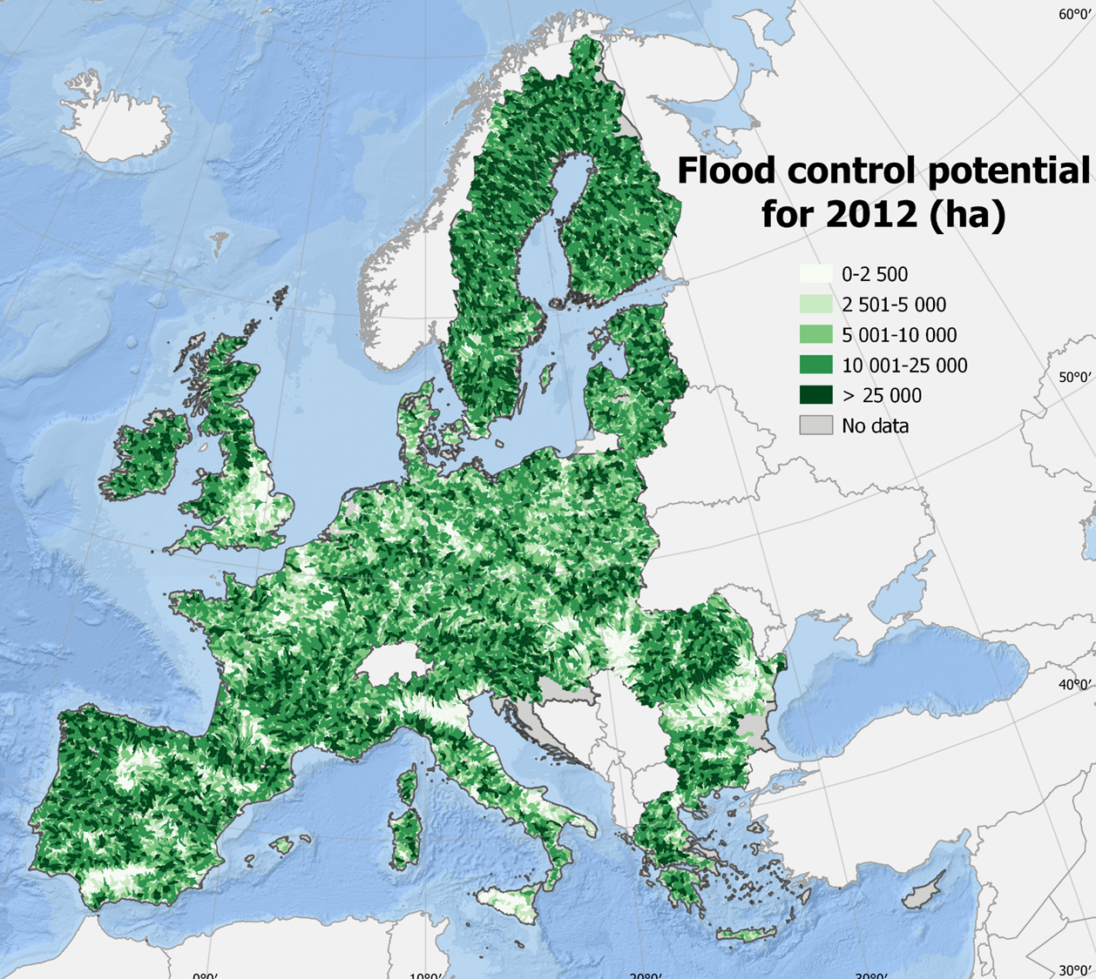
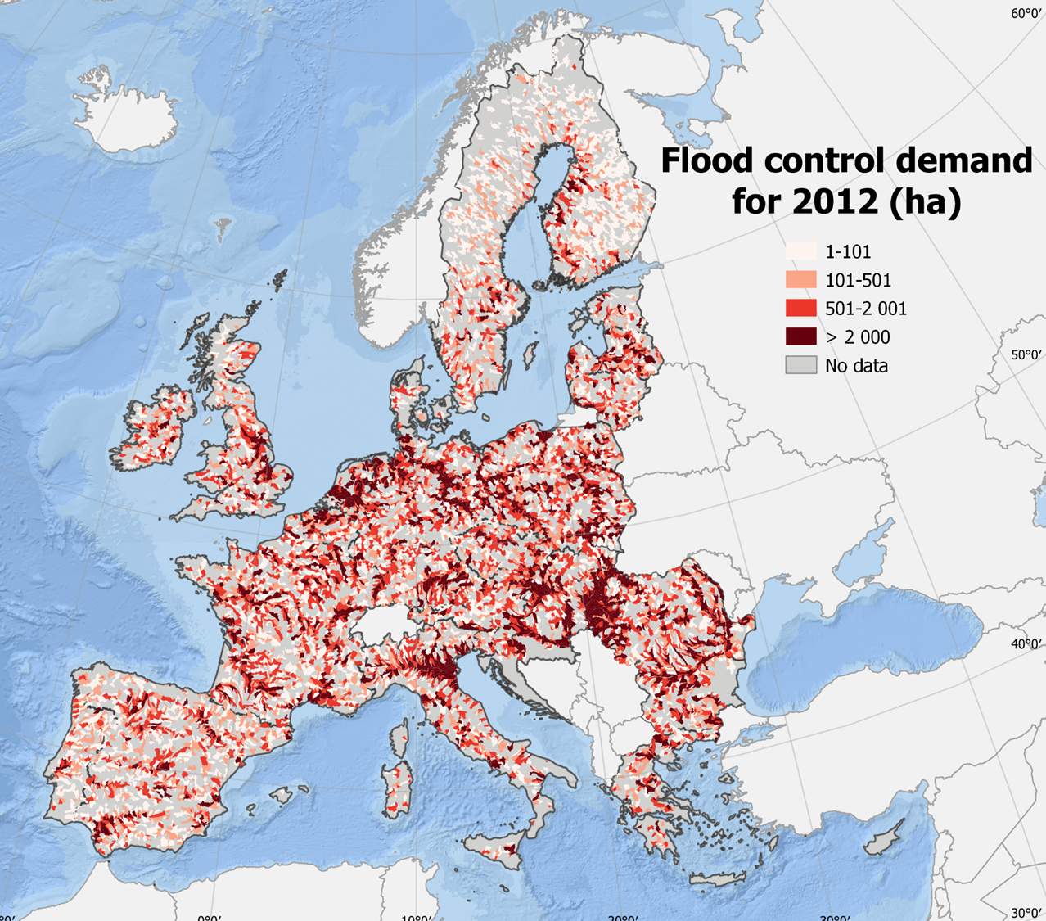
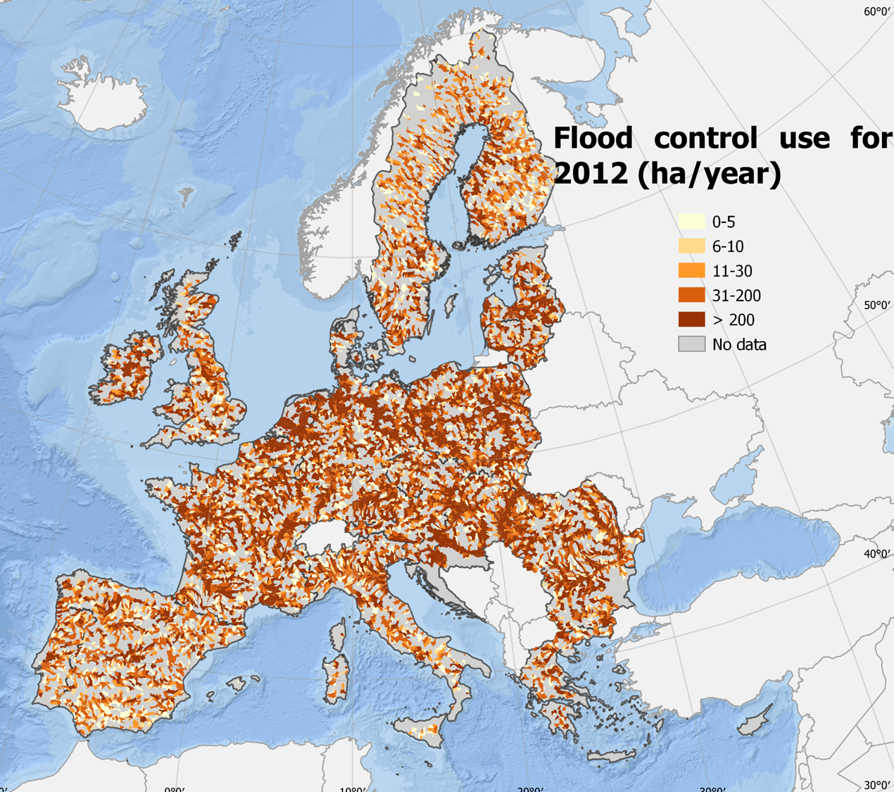
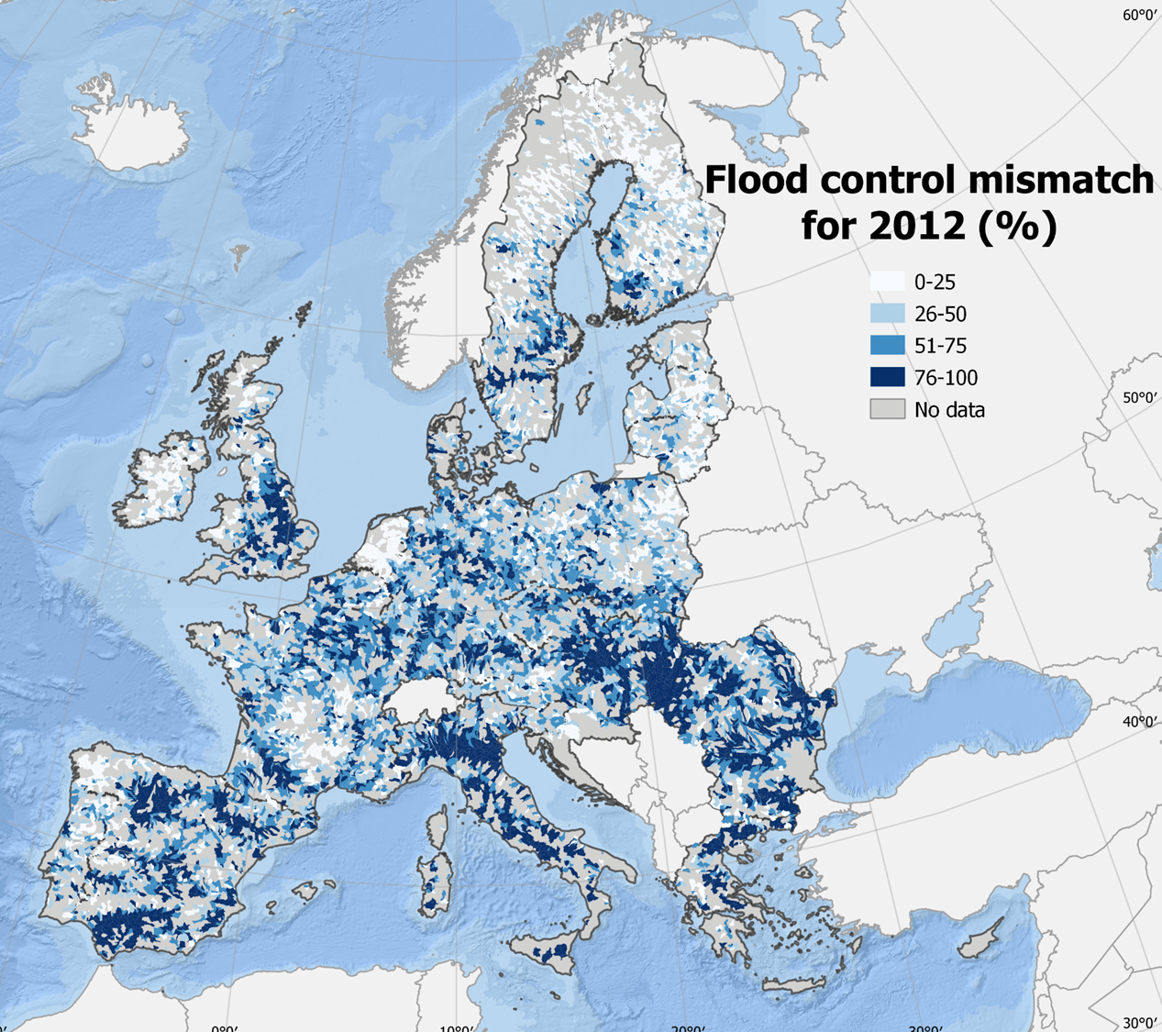
ES Vulnerabilities related to protection
Flood control

Slide 22
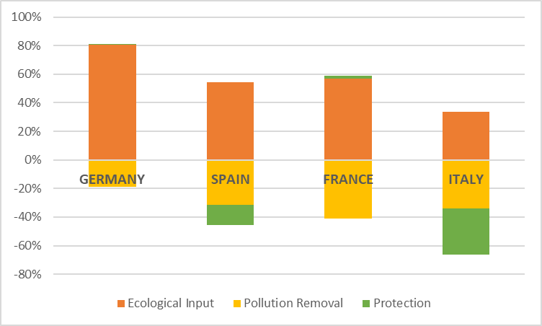
Countries with the highest Gross Value Added and Exports for agricultural products

Slide 23

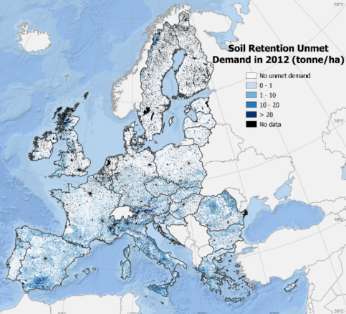
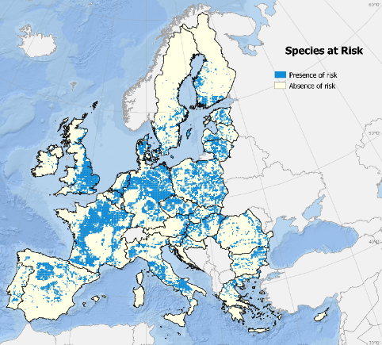
Where to restore
, why to to restore ….
1. to move toward resilient agricultural practices
Examples:
crop pollination and soil retention
2. to adapt to CC extreme events
Example:
flood control
3. to stop biodiversity loss
Example:
habitat and species maintenance

Slide 24
Where to restore, why to to restore,
…and how much do we lose if we don’t
million euro | Ecosystem Service provided | Ecosystem Service not provided
Pollination and soil retention | 16,029 | 3,630
Flood control | 16,312 | 27,932
Habitat and species maintenance | 35,660 | 55,915
Carbon sequestration | 9,189 | 4,585
(mil Euro/year)

Slide 25
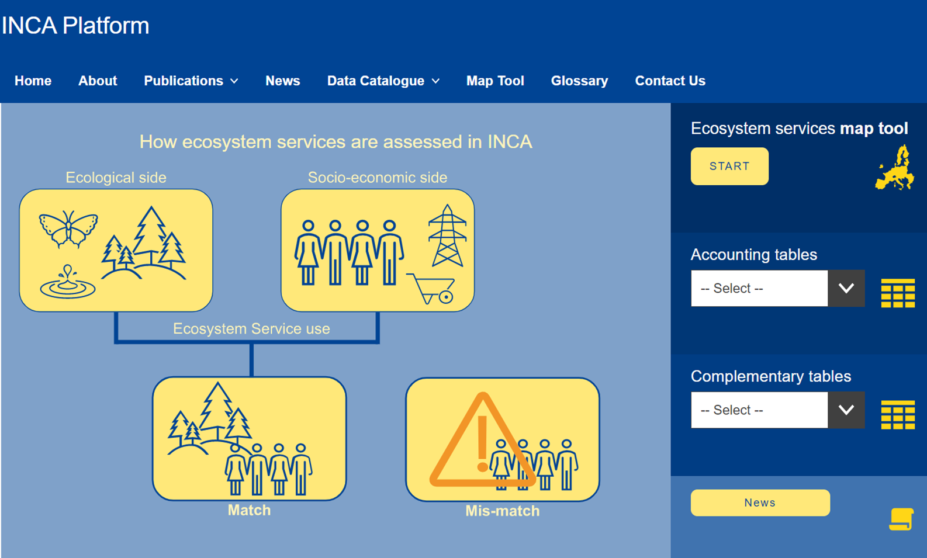
The way forward

Slide 26
Current and future developments of accounts
Nine ecosystem services are reported in ecosystem services accounts for four accounting periods (i.e. 2000, 2006, 2012 and 2018)
A QGIS tool is available for facilitating the automation of ecosystem services accounting data (https://ecosystem-accounts.jrc.ec.europa.eu/inca-tool)
Develop new ecosystem services, especially for marine ecosystems
Disaggregate economic sectors into finer classifications
Explore economic valuation methods aligned with the scope and objective of accounts

Slide 27
From piloting to policy applications
Explore policy uses by
  collaborating with other Commission services within the JRC (B.1, D.4) and outside the JRC (DG REGIO, DG AGRI, DG ENV)
  playing an active role in the UN SEEA Technical Committee, specifically on Ecosystem Services
  interacting with connected initiatives (EU Taxonomy) and practitioners in other countries (EU-US collaboration)
  Expanding the scope of ecosystem services and policy applications to other policy domains

Slide 28

Thank you and keep in touch
marialuisa.tamborra@ec.europa.eu
ioanna.grammatikopoulou@ec.europa.eu
alessandra.la-notte@ext.ec.europa.eu
© European Union 2023
Unless otherwise noted the reuse of this presentation is authorised under
the CC BY 4.0 license. For any use or reproduction of elements that are not
owned by the EU, permission may need to be sought directly from
the respective right holders

