Slide 1
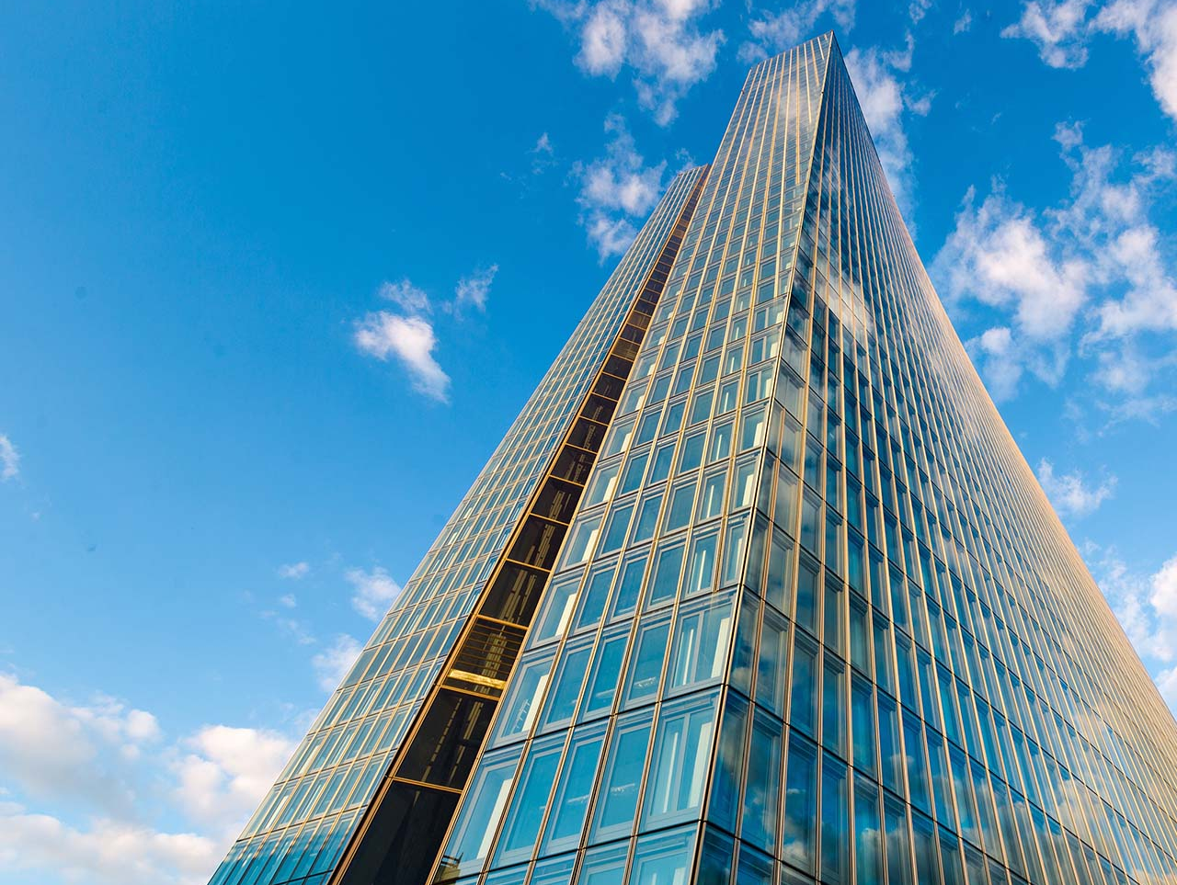
Climate change, potential output and nature-related risks
Natural Capital Workshop
European Commission
01/12/2023
Andrej Ceglar & Miles Parker
European Central Bank

Slide 2
Disclaimer
Views expressed here are those of the speakers and not necessarily those of the European Central Bank or of its Governing Council.

Slide 3
1
Climate change and potential output

Slide 4
Three categories, three components*, many channels
Climate impact type | Capital | Labour supply | Total factor productivity
Extreme weather and climate events | Destruction of capital Opportunity to replace old, destroyed capital with new technology Greater uncertainty reduces willingness to invest over long run | Higher mortality / sickness Disaster-induced migration Loss of education and skills | Bankruptcies / lack of finance cause reallocation, for better or worse Rebuild distracts management
Long-run climate change | Sectoral impacts e.g. agriculture, tourism Regional impacts (heat, coastal) | Higher mortality / sickness Climate-induced migration | Adaptation capital less productive, diverts resources from innovation Reduced labour efficiency
Climate policies and green transition | Increase in stranded assets Higher energy costs from carbon taxes reduce funds for investment | Skill mismatches increasing structural unemployment | Reallocation of output between firms within sectors may prove more or less efficient Environmental regulations reduce productivity; offset by innovation?
Source: Parker (2023), “How climate change affects potential output”, ECB Economic Bulletin, 2023/6.

Slide 5
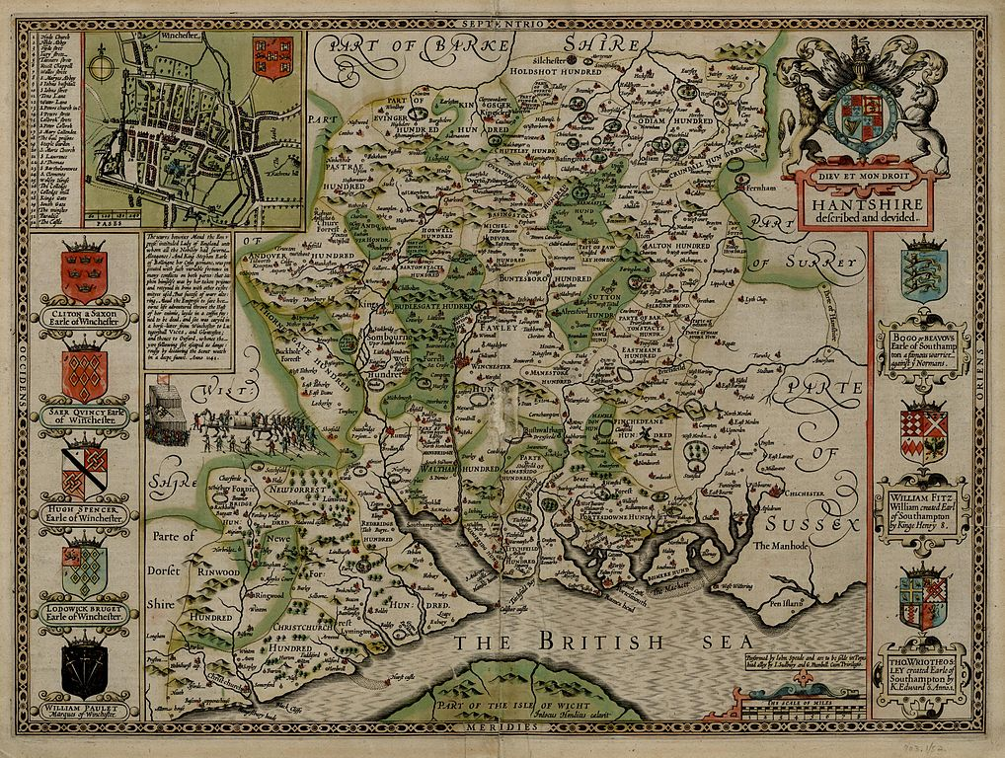
Nature: a new old component of potential
Hampshire
Source: Speed, J. (1611), The Theatre of the Empire of Great Britaine
Notes:
The literature points to a substantial role for external financial support for activity and reconstruction – be it from international aid or domestic fiscal transfers – in reducing the overall impact of catastrophes (McDermott et al., 2014).
This is also why insurance can play a protective role. Insurance payouts can help households and businesses better endure the post-catastrophe disruption and underpin the reconstruction phase. Von Peter et al. (2012) find that the recovery from catastrophes is faster and more complete when the share of damages covered by insurance is higher. Indeed, aggregate GDP losses appear related to the uninsured component of damages rather than to the total amount. And firm-level evidence also demonstrates the protective value of insurance (Poontirakul and Noy, 2017).

Slide 6

Nature: a new old component of potential output
The air is temperate, though somewhat thick by reason of the Seas, and many Rivers that through the Shire do fall, whose plenty of fish and fruitful increase, do manifoldly redeem the harms which they make.
The Soil is rich for corn and cattle, pleasant for pasturage, and plenteous for woods; in a word, in all commodities either for Sea or Land, blessed and happy.

Slide 7
Types of nature capital affected by climate change
Renewable provision of intermediate input
  Can “consume” at a certain rate indefinitely. Can also consume > renewable rate, leading to lower output in future
  Example: fish stocks
Productive “capital”
  E.g. fresh water, precipitation, temperature
  Some can be produced, but not all
Adaptation capital
  Provides protection against extremes: flood plains, wetlands
  Can also be created through investment

Slide 8
Impact of acute events on potential output
Short-term impact on GDP: negative (supply AND demand)
Long-term impact on GDP: it depends
  Destruction of capital.
  Institutions / insurance coverage / fiscal space / development matter
  Migration
  More adaptation, (less productive innovation?)
Also a distribution of outcomes
Uncertainty vs capital replacement costs – impacts on r*
National versus regional

Slide 9
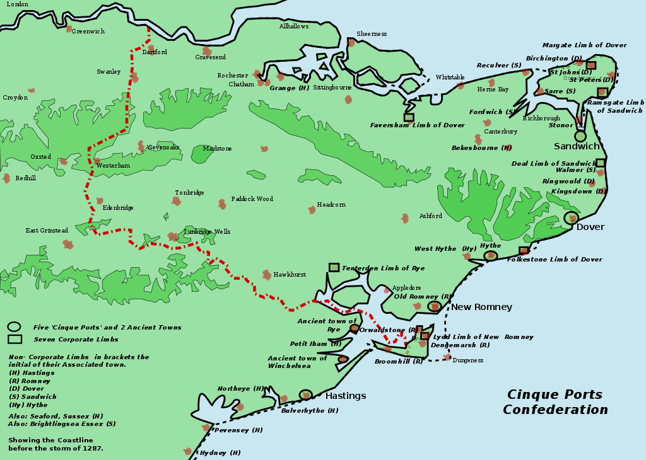
Long-run impact of catastrophes: storms of 1287
Cinque ports
Cinque Ports:
Hastings
New Romney
Hythe
Dover
Sandwich
Antient towns:
Winchelsea
Notes:
The literature points to a substantial role for external financial support for activity and reconstruction – be it from international aid or domestic fiscal transfers – in reducing the overall impact of catastrophes (McDermott et al., 2014).
This is also why insurance can play a protective role. Insurance payouts can help households and businesses better endure the post-catastrophe disruption and underpin the reconstruction phase. Von Peter et al. (2012) find that the recovery from catastrophes is faster and more complete when the share of damages covered by insurance is higher. Indeed, aggregate GDP losses appear related to the uninsured component of damages rather than to the total amount. And firm-level evidence also demonstrates the protective value of insurance (Poontirakul and Noy, 2017).

Slide 10
Long-run impact of catastrophes: storms of 1287
Cinque ports
Cinque Ports:
Hastings
New Romney
Hythe
Dover
Sandwich
Antient towns:
Winchelsea
Rye
Notes:
The literature points to a substantial role for external financial support for activity and reconstruction – be it from international aid or domestic fiscal transfers – in reducing the overall impact of catastrophes (McDermott et al., 2014).
This is also why insurance can play a protective role. Insurance payouts can help households and businesses better endure the post-catastrophe disruption and underpin the reconstruction phase. Von Peter et al. (2012) find that the recovery from catastrophes is faster and more complete when the share of damages covered by insurance is higher. Indeed, aggregate GDP losses appear related to the uninsured component of damages rather than to the total amount. And firm-level evidence also demonstrates the protective value of insurance (Poontirakul and Noy, 2017).

Slide 11
Nature capital, climate change and potential
Access to sea quite important for ports!
Question of economic geography. Need to think about spatial impacts.
Tourism suitability – temperature, water stress, wildfires
Agricultural suitability – heat stress, water stress
River flow: Rhine, Panama Canal, hydro & nuclear power
Non-linear impact on labour productivity & migration
Value of nature adaptive capital increases

Slide 12
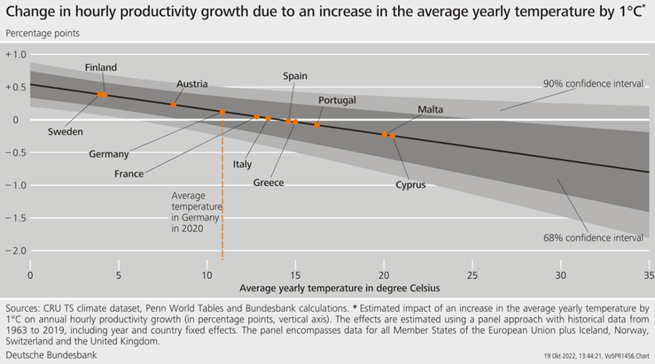
Labour productivity (growth!) reduced outside of comfort range
Output of individual workers is reduced outside of ‘comfort range’ of 19-21C.
Some evidence of adaptation through air conditioning.
Impact non-linear, particularly for physical exertion.

Slide 13
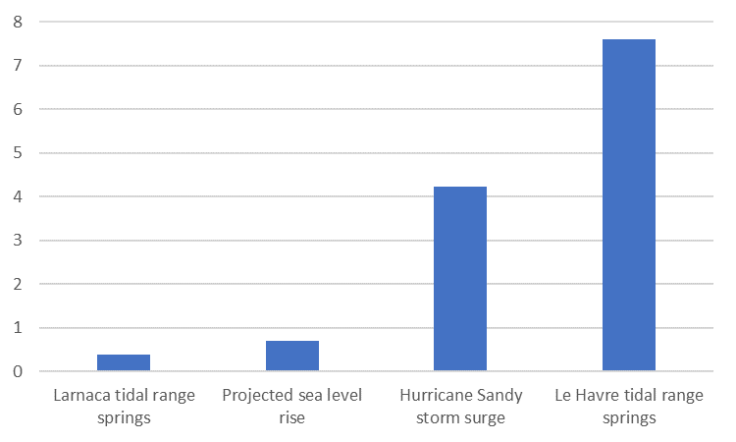
Compounding risks: sea level rise
Increased risk of storm surges, compounds with higher sea levels
Additional impact from nature capital loss (wetlands help reduce impact of storm surges)
5m Europeans at risk of a 1 in 100 year event, by 2050 that event will occur every 11 years.
For Eastern Med, 1 in 1000 year events will occur roughly once every three years by 2100
Tides, sea level rise and storm surges (m)

Slide 14
2
Nature-related risks

Slide 15


Nature related risks for economy and banks
Physical Risk
Transition Risk
Physical risk may be acute risks, like severe natural disasters, or chronic risks
Regulations or change in preferences can transition the economy towards less impactful activities
More than 1677 European species threatened
1677+
70%
Global biodiversity declined by 70% since 1970
Over half of Europe's endemic trees are at risk
50%
Numerous protection policies have been adopted
Nature-related
risks
Kunming-Montreal agr.
Nature-restoration law
Habitats Directive
Biodiversity strategy
Water and Birds Directives
13 % of soils in EU suffer from high level of erosion
13%
Pollinators are declining

Slide 16
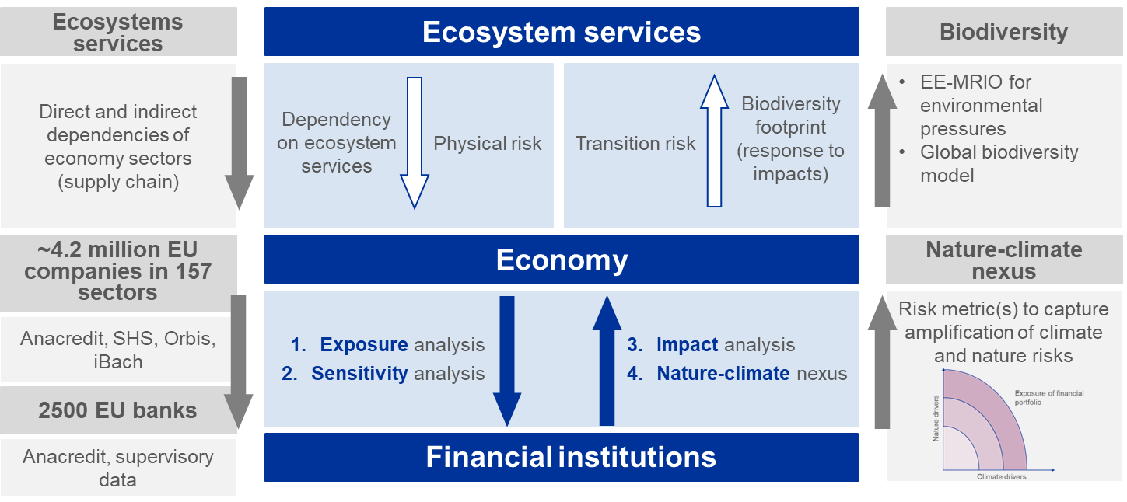
Nature related risks for economy and banks

Slide 17
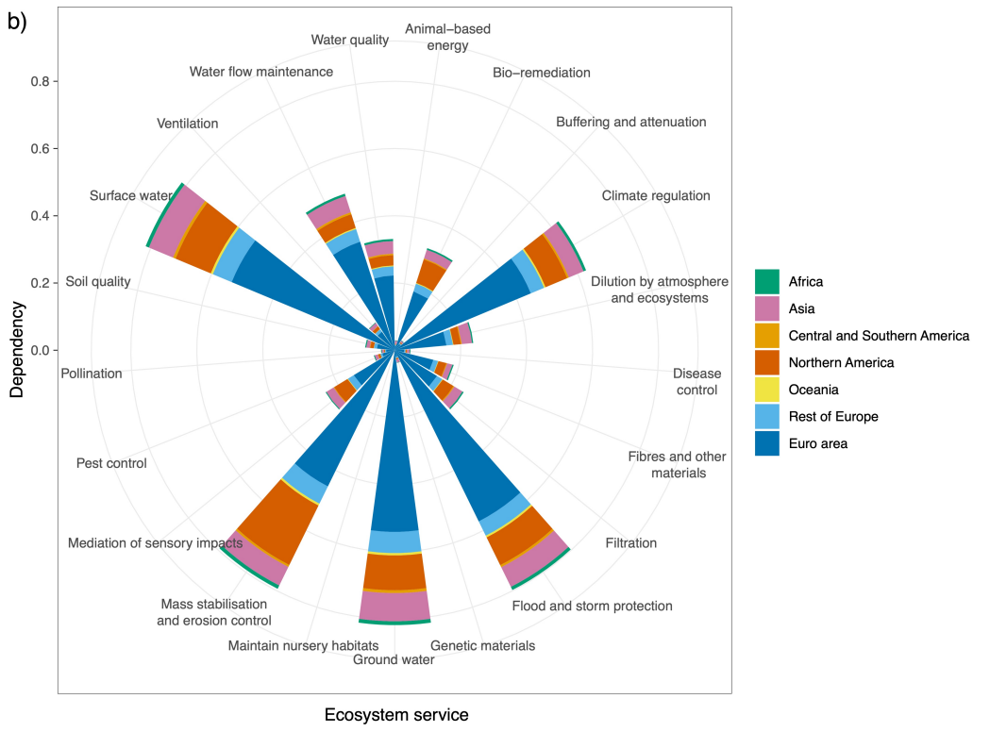
Nature related risks for economy and banks
For each firm we assess which ecosystem services are necessary for their economic activity. We consider also the dependency on supply chain.
The most important ecosystem services: surface water, mass stabilization and erosion control, ground water, climate regulation, flood protection
Ceglar et al., The relationship between the European banks and nature, submitted to Nature Sustainability

Slide 18
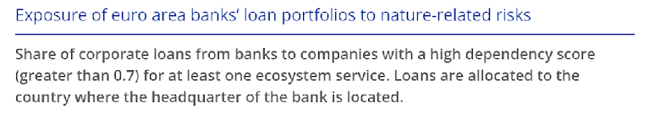
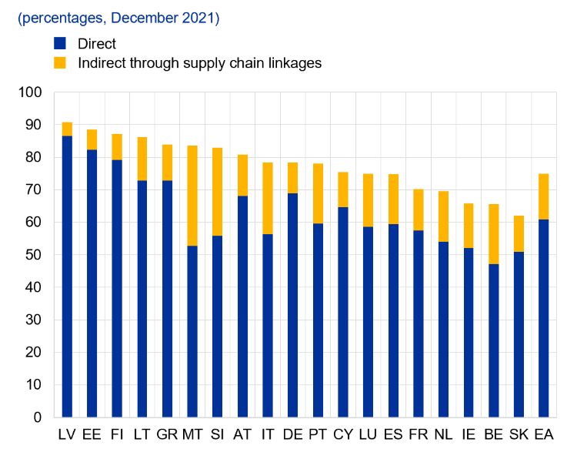
Nature related risks for economy and banks
72 % of NFCs (nearly 3 million) highly depend on at least one ecosystem service
75 % of corporate loans are given to NFCs with high dependency on ecosystems
Boldrini et al., 2023. Living in a world of disappearing nature: physical risk. ECB OP 333

Slide 19
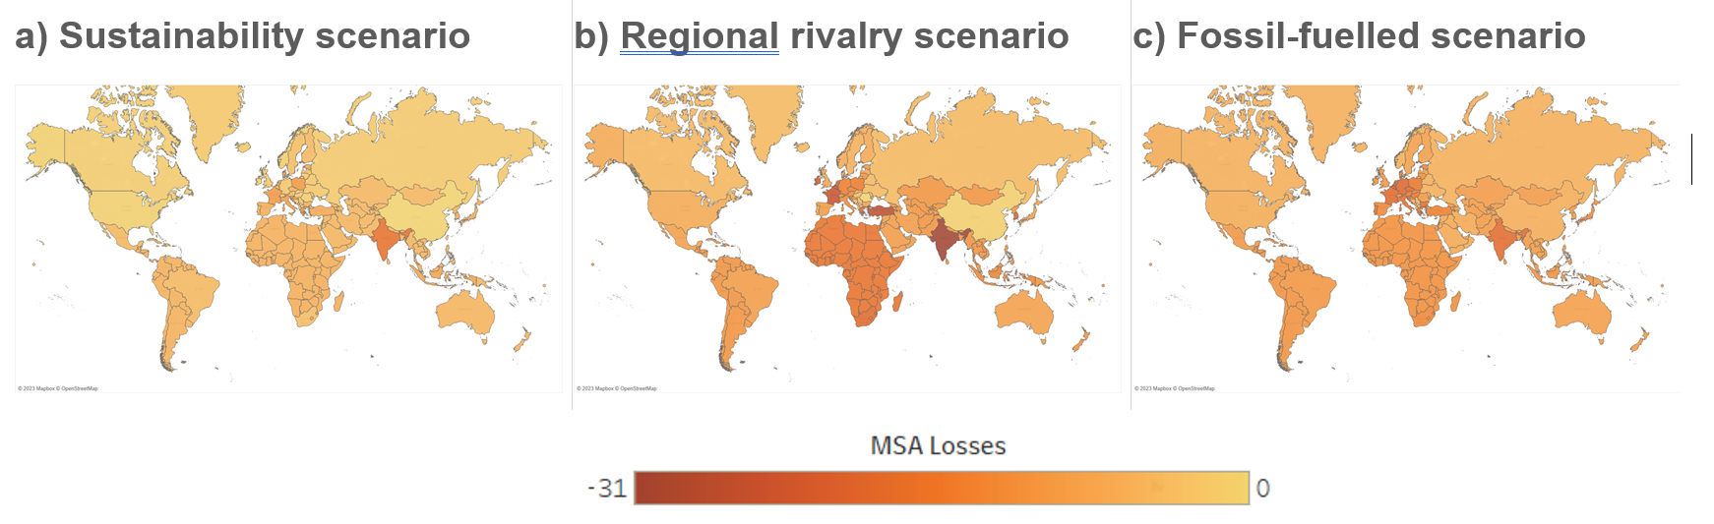
Nature related risks for economy and banks
How does biodiversity loss affect banks losses?
Schipper et al., 2020. Projecting terrestrial biodiversity intactness with GLOBIO 4, Global Change Biology

Slide 20
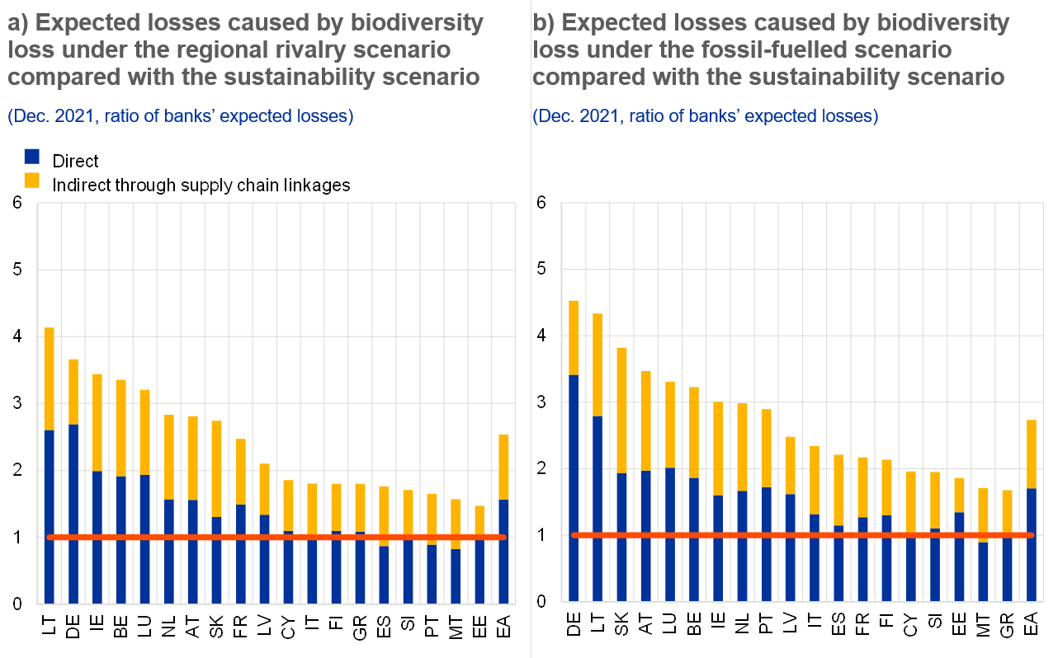
Nature related risks for economy and banks
How does biodiversity loss affect banks losses?

Slide 21
Nature related risks for economy and banks
- Euro area NFCs generate an impact comparable to the loss of more than 580 million hectares of pristine nature worldwide
a) EA NFCs impact by debtor country
(Million MSA. ha. yr, percentages)
b) Banks’ financed impact by headquarter country
(Million MSA. ha. yr, percentages)
Ceglar et al., 2023. The impact of the euro area economy and banks on biodiversity. Accepted for publication

Slide 22
Compound shocks from climate change and biodiversity loss
  Nature and climate related risks are interconnected
  Biodiversity and ecosystem services play essential role for climate regulation
  The loss of biodiversity will further accelerate climate change if ecosystems are not effectively protected
  Climate change contributes to the loss of biodiversity and ecosystems (ecological regime shifts, disruption of critical ecosystem services, irreversible impacts)

Slide 23
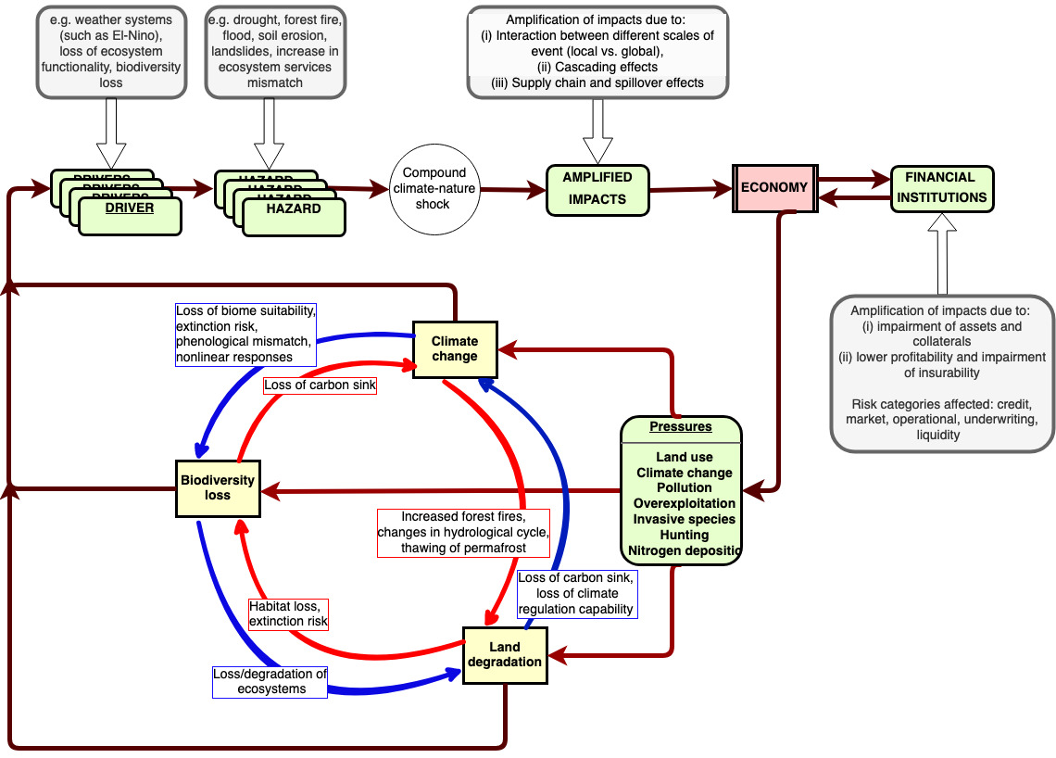
Compound shocks from climate change and biodiversity loss
Ceglar et al., The relationship between the European banks and nature, submitted to Nature Sustainability

Slide 24
Compound shocks from climate change and biodiversity loss
  Forests and their sustainable management is important for atmospheric CO2 uptake and storage, mitigate climate hazards such as droughts, heat waves and floods
    Deforestation and unsustainable forest management reduces their capability to mitigate climate extremes
    Climate change is increasing the risk of forest fires, insect and disease outbreaks, windstorms
    Example: compound event in August 2023 flooding in Slovenia caused direct damage of around 5 % of national GDP (European Commission, 2023)
Extreme precipitation
Preceding saturated soils
Events leading to high economic damage
Forest disturbances

Slide 25
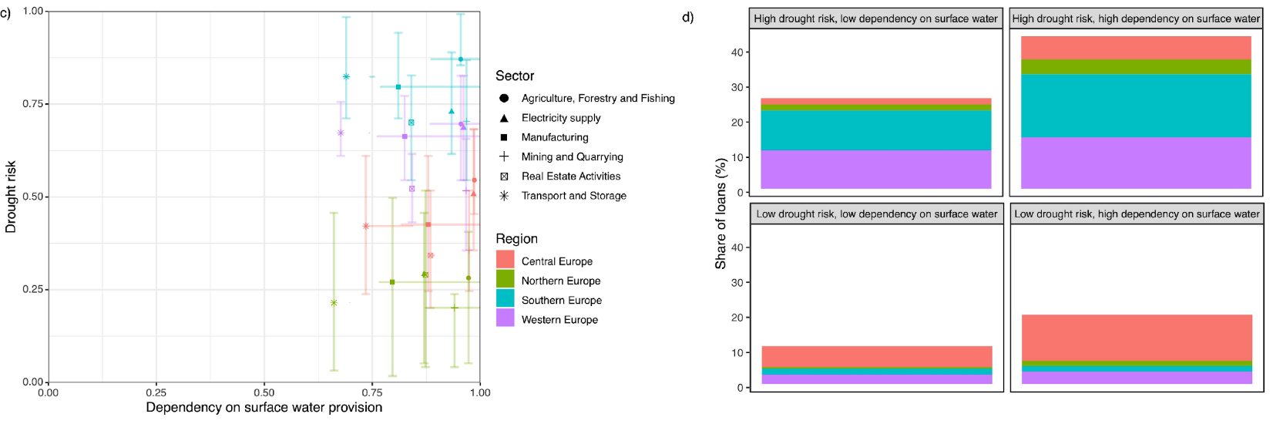
Compound shocks from climate change and biodiversity loss
How can climate hazards and ecosystem degradation compound to amplify the risks?
  Case study: droughts and dependency of economic activities on surface water provision
Ceglar et al., The relationship between the European banks and nature, submitted to Nature Sustainability

Slide 26
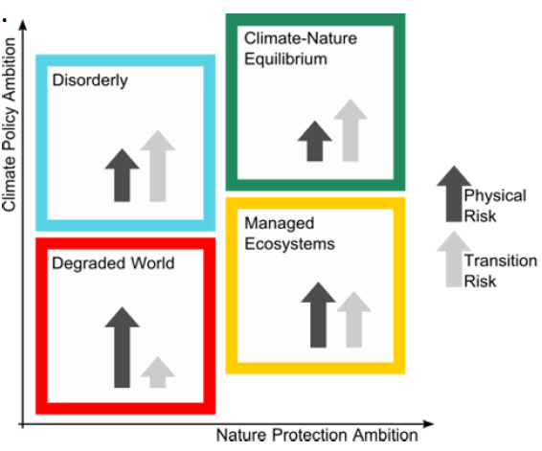
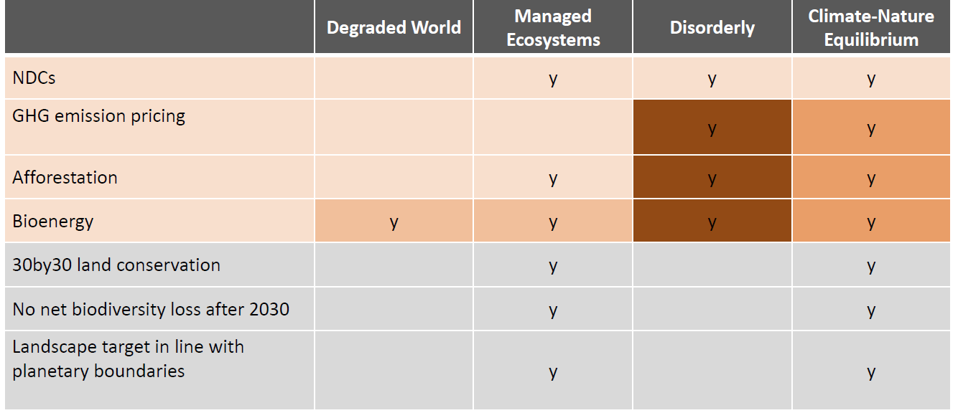
Materialization of shocks – integrated climate-nature scenarios
Materialization of shocks depend on the region of analysis
Incorporating shocks into scenario analysis:
    Develop the narratives
    Work with scientific community to add quantification to these scenarios
    Incorporate these scenarios into existing toolbox of financial institutions
Stevanovic et al., Integrated climate-nature scenarios for financial risk assessment. In preparation

Slide 27
Some final thoughts
High dependence of economy and banks on nature, as well as high impact on biodiversity
The highest impact on economy in the future will likely materialize through a compound effect of climate change and nature degradation (and/or other types of compound events)
The risk can spread to the financial system, potentially triggering instability
We need to better understand the cascading effects of nature degradation and climate change on the economy and financial stability
  impacts, non-linearities, tipping points and irreversibility
An integrated approach is necessary (i.e. nature-climate nexus)

Slide 28

Thank you for your attention!
ECB blog on nature: https://www.ecb.europa.eu/press/blog/date/2023/html/ecb.blog230608~5cffb7c349.en.html
Financial Times article: https://www.ft.com/content/d83602d0-1296-4928-b58a-21cf2a6d2a0f
Economic bulletin article: https://www.ecb.europa.eu/pub/economic-bulletin/articles/2023/html/ecb.ebart202306_02~0535282388.en.html
Occasional paper: https://www.ecb.europa.eu/pub/pdf/scpops/ecb.op333~1b97e436be.en.pdf?90e7aaae4ef927f887a787587a22adba
https://scholar.google.com/citations?user=mh5HwKYAAAAJ&hl=en
https://www.researchgate.net/profile/Andrej-Ceglar

