Slide 1
Environmental economic accounts and their integration with National Accounts
Arturo de la Fuente, Eurostat
Workshop NCA measurement & modelling
30 Nov - 1 Dec 2023

Slide 2
© 2023 Arturo de la Fuente

Slide 3
1. Environmental-economic accounting 2. Environmental-economic accounts in the EU 3. Ecosystem accounts
Overview
Notes:
Satellites to the national accounts
Conceptual framework and
system of tables
Consistent with national accounts
Integrates existing data in a coherent system
(economic & environmental data )
Provide data on the environmental impact of economic activity
Facilitate environmental-economic analyses

Slide 4
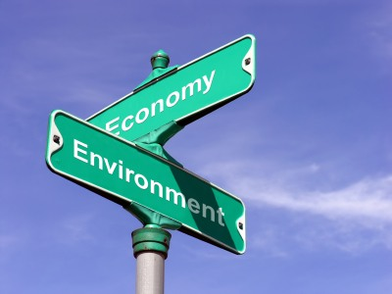
1. Environmental-economic accounts
Notes:
Satellites to the national accounts
Conceptual framework and
system of tables
Consistent with national accounts
Integrates existing data in a coherent system
(economic & environmental data )
Provide data on the environmental impact of economic activity
Facilitate environmental-economic analyses

Slide 5
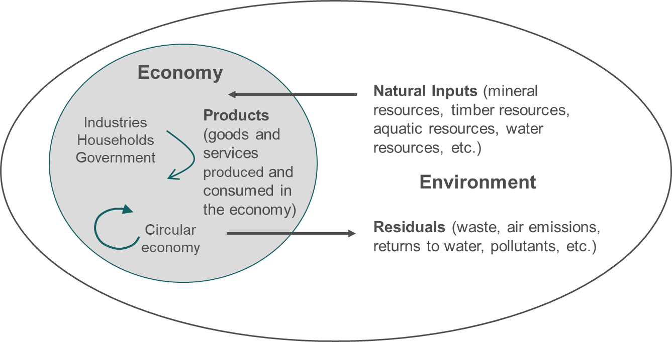
Interrelations between the economy and the environment
Notes:
SEEA allow integrating economic and environmental aspects to complete the economic accounts. This is achieved with three different, complementary types of SEEA accounts:
A first type (‘monetary environmental accounts’) produces statistics on the part of the SNA economy related to the environment, in particular regarding production, consumption and government interventions. Those are already included in SNA statistics but not identified as ‘environmental’ nor disentangled from ‘non-environmental’. The SEEA accounts disentangle them. Examples are: environmental taxes and subsidies, green jobs, the costs of environmental protection and green investments. Those transactions are a sub-set of the SNA economy.
A second type (‘physical environmental accounts’) produces statistics about the interaction points between the environment and the economy, in particular before and after economic products are created and used up. This concerns mostly the extractions of natural inputs that are fed into the economy (materials, energy products, etc.) and the discharge of residuals in the environment as a result of production or at the end of consumption (waste, emissions of greenhouse gases, pollutants to air, water and soil, etc.). Statistics in this category also quantify the flows of materials and energy through the economy, which allow deriving environmental footprints. These statistics follow the boundaries of the economy as established in the SNA, but show more explicitly the border of the economy with the environment sustaining it. For instance, the value of a forest is measured on the basis of the forest’s contribution to the economy as in SNA, which is restricted to timber. They are expressed in physical units (e.g. tonnes, terajoule).
A third type (‘ecosystem accounts’) produces statistics that go beyond the SNA production and asset boundaries. In particular, ecosystems are recognised to produce a range of services (‘ecosystem services’), some of which are within the SNA boundaries (e.g. crop and timber production) but others are beyond (e.g. climate regulation, pollination, flood protection are not economic production in SNA nor in the GDP). This also extends the SNA asset boundary to give recognition to natural capital: e.g. a forest’s asset is value higher than if we only considered their timber, because they also regulate climate, etc. The amounts of ecosystem services produced in turn depend on the extension of the ecosystems and their condition status, which are also quantified in these statistics. The statistical framework also establishes the ecosystem assets producing those services.

Slide 6
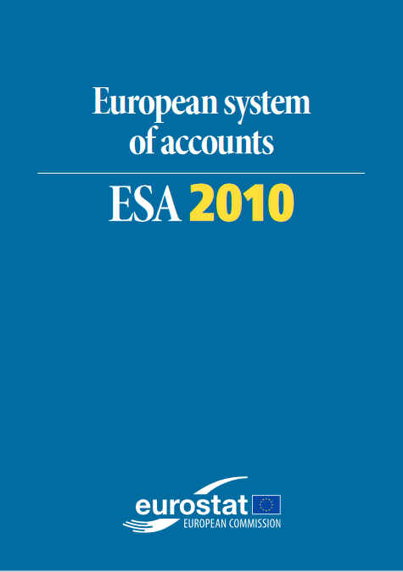
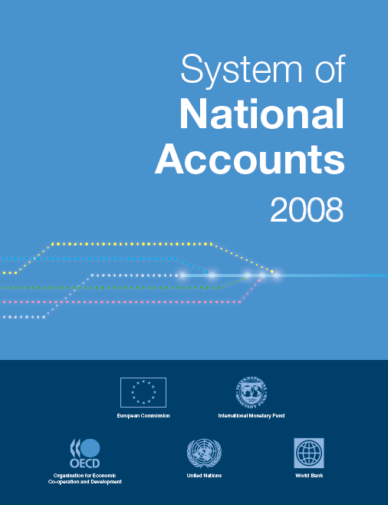
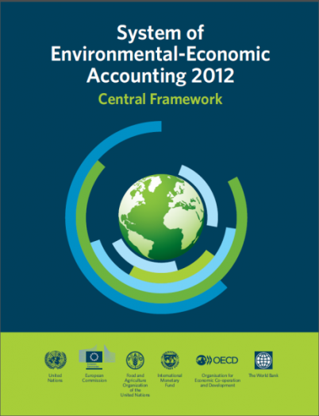
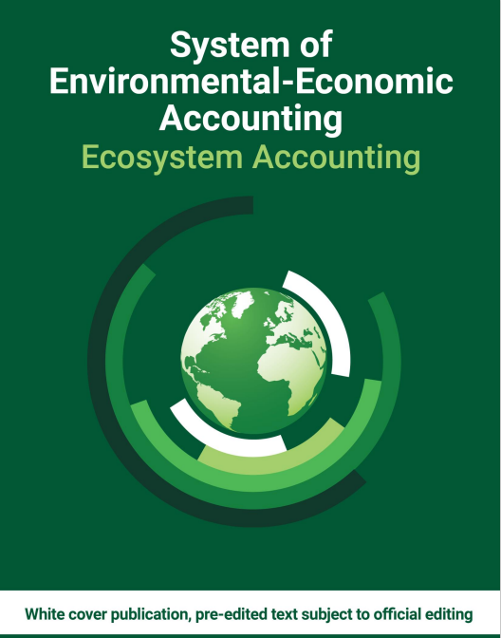
System of Environmental Economic Accounts International statistical standard
https://seea.un.org/
Notes:
Two types of accounts (CF, EA) with different level of maturity.
Both integrated with SNA. Same basic concepts, definitions, valuation rules.

Slide 7
How does SEEA align to ESA?
Same asset & production boundary^{(*)}
Same economic actors: institutional sectors, NACE,…
Same definitions: subsidies, investment, gross value added,…
Data sources are adjusted and aligned across environmental domains
Scope of the country economy as in GDP
Results from accounts are not identical to data sources on which they are based (e.g. energy accounts vs energy statistics)
But accounts can be used in new ways

Slide 8
Integration of information
GHG emissions
Energy use
Taxes on fossil fuels
Jobs in renewables
…
Notes:
Environmental accounting is about integration. Integration is necessary to understand trade-offs. It is also good to enhance quality of estimates
The article in the previous slide is like one of the forms in this slide. You need more forms to get the full picture. You need the forms to be able to fit with each other. In complex systems, such as the economy, or ecosystems, there are many interrelations at different levels.
Studying just one ecosystem at one single level provides answers but they may be the wrong ones if isolated from the rest of the system.

Slide 9
2. European environmental accounts

Slide 10
SEEA in the EU
We have 2 pillars
European Strategy on Environmental Accounts
High level agreement Eurostat with producers in Member States
Establishes objectives and priorities
Regulation (EU) No 691/2011 on European environmental accounts
EU law for Member States to compile data, transmit to Eurostat and sets quality standards
Establishes 6 environmental accounts + 3 new ones coming

Slide 11
Environmental accounts in the EU: what do we have achieved?
Almost 3 decades of experience
This is mainstreamed official statistics
Databases for +30 European countries
Thematic accounts (x6 by EU law) and more coming (x3)
Annual mandatory accounts
Handbooks and compilation tools available for all
Contributing to global SEEA databases
Europe is at the frontline of world developments
We work with UN, OECD and IMF and many others

Slide 12
National Accounts
Monetary modules
Physical modules
Ecosystem module
Environmental taxes
GHG + air pollutants emissions
Ecosystem accounts
(coming soon)
Env subsidies
(coming soon)
Energy flows
Env protection expenditure
Material flows
Environmental growth & jobs
Forest accounts
(coming soon)

Slide 13
Trends of GHG emissions and GDP

Slide 14
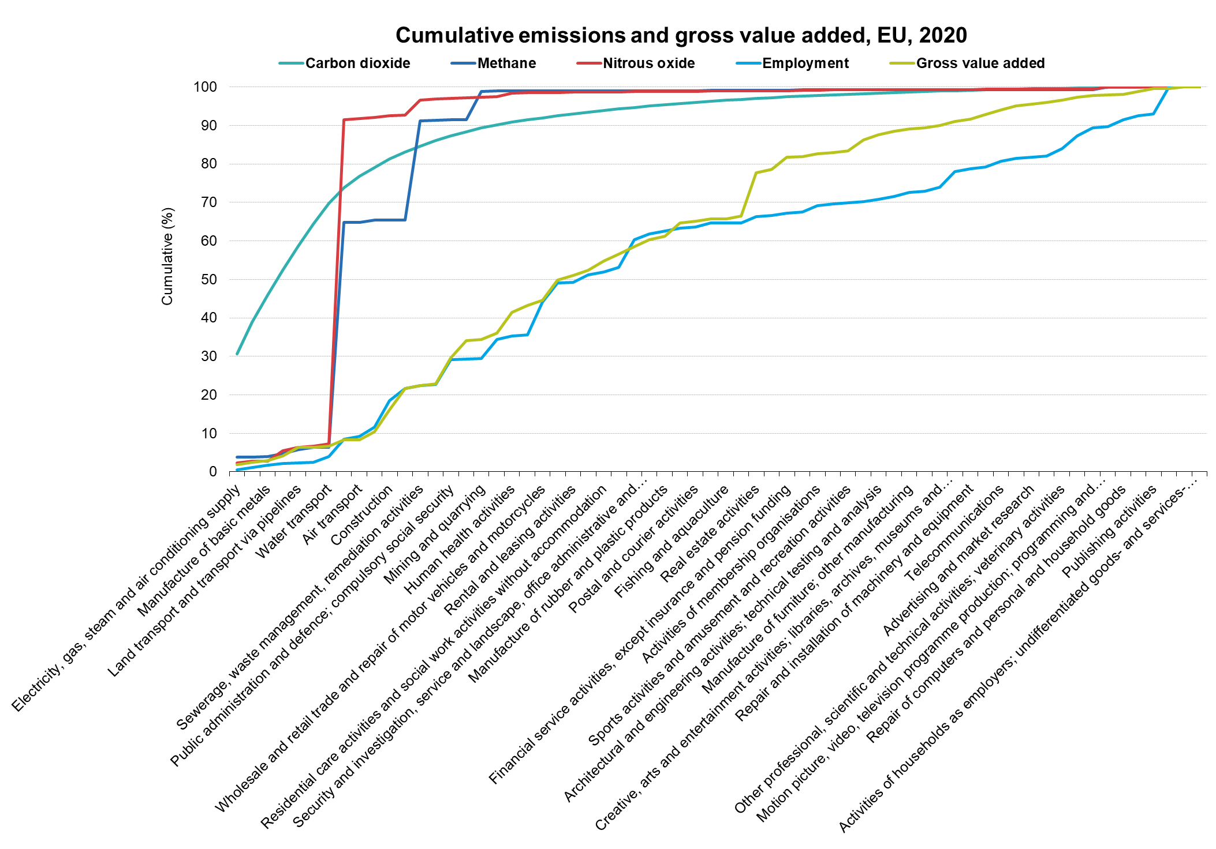
Environmental-economic industry profiles
4 industries are responsible for >70% CO2 emissions but <10% of gross value added

Slide 15
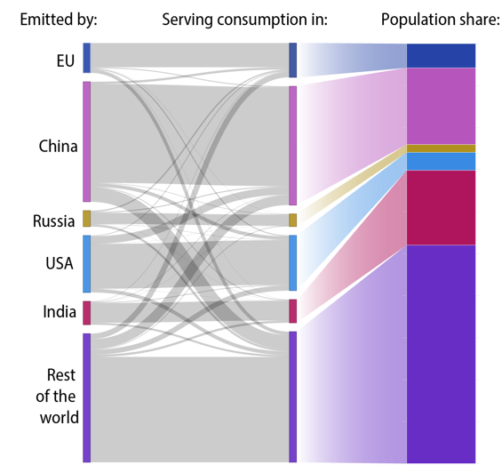
Carbon footprints/leakage
- The bulk of domestic emissions is from domestic consumption - The main economies in the world except India trigger more CO2 emissions than their population share

Slide 16
Resource intensity/productivity

Slide 17
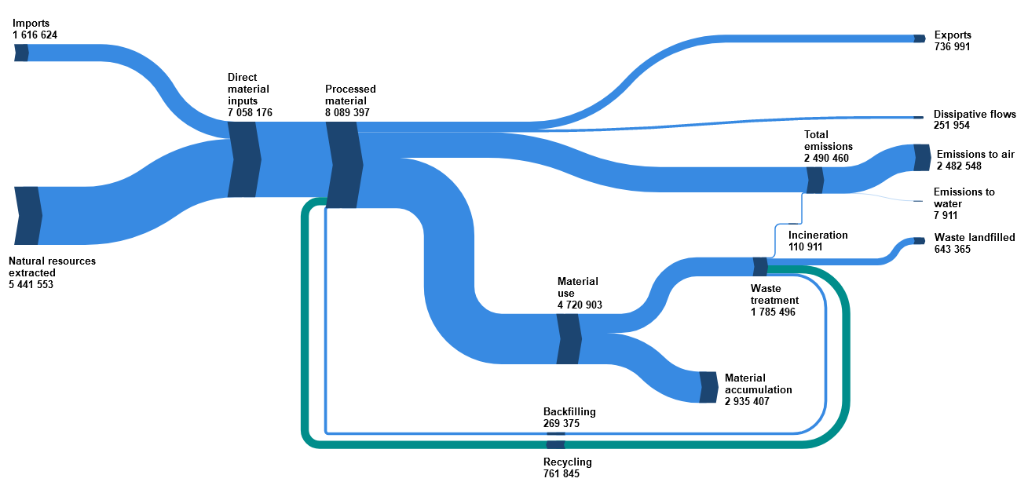
Material flows in circular economy

Slide 18
3. Ecosystem accounts
Notes:
Satellites to the national accounts
Conceptual framework and
system of tables
Consistent with national accounts
Integrates existing data in a coherent system
(economic & environmental data )
Provide data on the environmental impact of economic activity
Facilitate environmental-economic analyses

Slide 19
Going beyond capital in ESA
What if…
…we extended the ESA production boundary to include natural capital and services of ecosystems?
e.g. carbon sequestration
Notes:
Types of services: provisioning (nutrition, materials, energy), regulation (carbon sequestration, water conditions, disease control), cultural (enjoy landscape, trekking, spiritual)

Slide 20
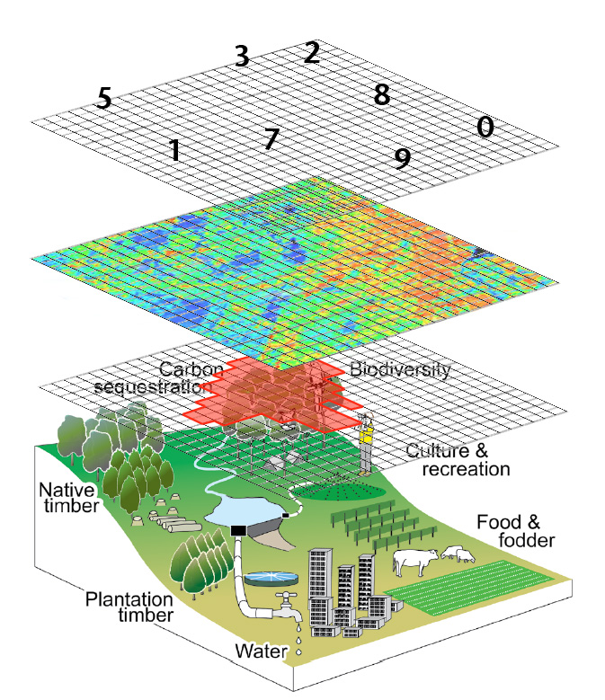
Ecosystem accounts: 3 layers of information
Ecosystem services accts
Ecosystem condition acct
Ecosystem extent acct
Notes:
Asset boundaries beyond SNA. Including biological resources (both cultivated and natural), water resources, etc. they produce services for us, e.g. carbon sequestration by forests, flood protection, crops pollination, etc.
These assets provide ecosystem services and benefits used in economic and other human activity, a rather euphemistic formulation for services on which human and other life depends. In SEEA-EEA, three main types of services are distinguished: (i) provisioning services (for example timber from forests); (ii) regulating services (for example forests proving carbon sinks); and (iii) cultural services (for example the pleasure of visiting a national park).
Ecosystem services measured in physical terms and monetary terms.
There are also other SEEA EEA accounts not shown here, such as thematic accounts. This is a simplified picture.

Slide 21
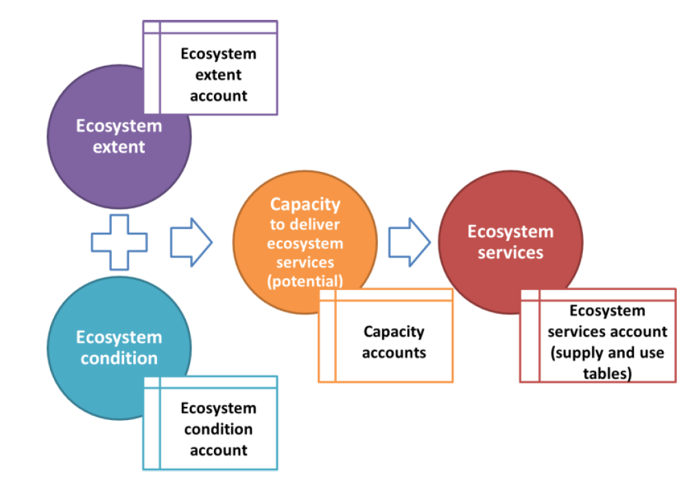

Slide 22
Proposal ecosystem accounts for Regulation (EU) Regulation 691/2011
Ecosystem extent: 12 ecosystem types categories
Ecosystem condition: 9 indicators about
Ecosystem services: 7 services
crop provision, pollination, wood provision (provisioning)
air filtration, global climate regulation, local climate regulation (regulating and maintenance)
nature-based tourism (cultural)
settlements and other artificial areas cropland grassland | cropland and grassland forest and woodland coastal beaches, dunes and wetlands

Slide 23
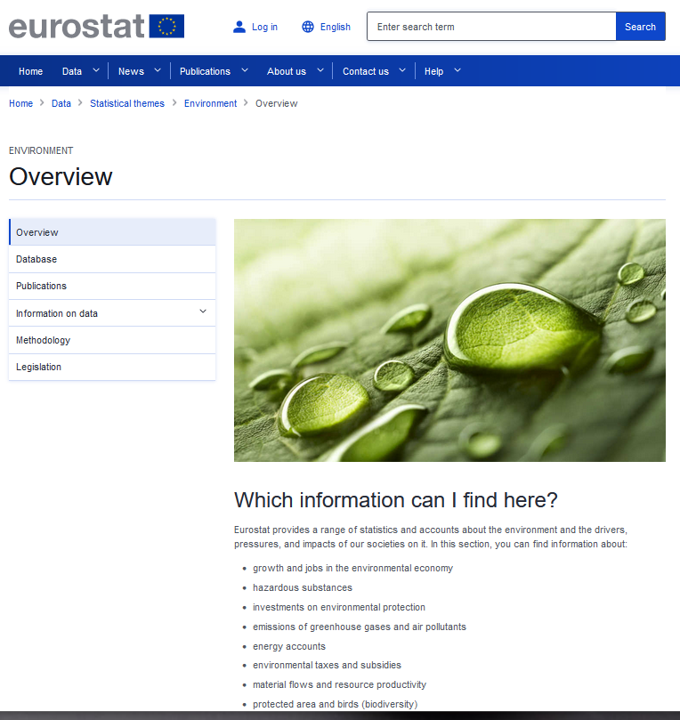
Where to know more?
Online article: Environmental accounts - establishing the links between the environment and the economy
Online article: Ecosystem accounts - measuring the contribution of nature to the economy and human wellbeing
Eurostat website: environment
Eurostat online database
Eurostat methodology

Slide 24
Thank you
arturo.de-la-fuente@ec.europa.eu
© European Union 2023
Notes:
Update/add/delete parts of the copy right notice where appropriate.
More information: https://myintracomm.ec.europa.eu/corp/intellectual-property/Documents/2019_Reuse-guidelines%28CC-BY%29.pdf

