Slide 1
Integrated Assessment Modeling with Natural Capital Depletion Based on: Johnson, Justin Andrew, Uris Lantz Baldos, Erwin Corong, Thomas Hertel, Stephen Polasky, Raffaello Cervigni, et. al., “Investing in Nature Can Improve Equity and Economic Returns.” Proceedings of the National Academy of Sciences 120, no. 27 (July 4, 2023): e2220401120. https://doi.org/10.1073/pnas.2220401120.
Justin Andrew Johnson
Asst. Professor in Applied Economics
University of Minnesota

Slide 2
© 2023 Justin Andrew Johnson

Slide 3
Overview
Context in sustainability and economics
Introduce our new model: GTAP-InVEST
Four methodological advances necessary to make it work
Results from paper
Broader conclusion on Earth-Economy modeling

Slide 4
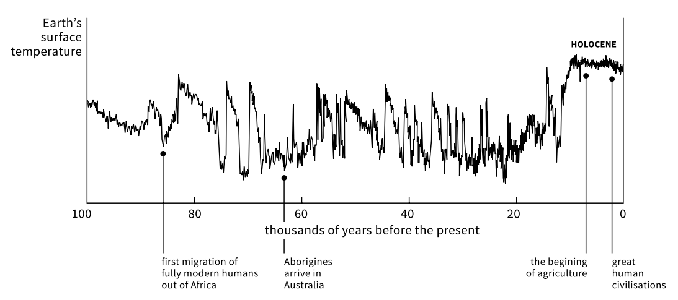
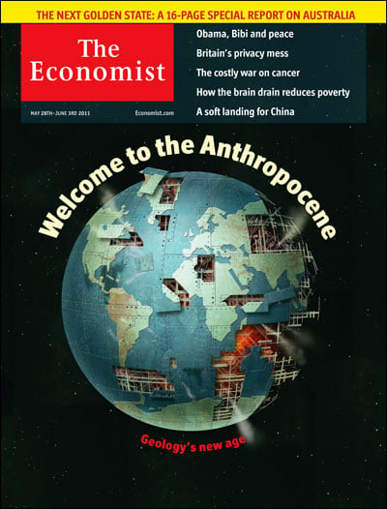
Going from the Holocene into the Anthropocene
The Holocene (and all of agriculture) happened here

Slide 5
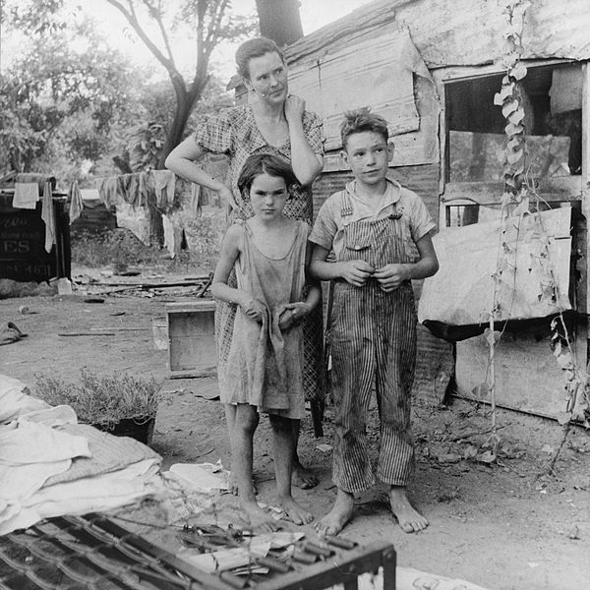
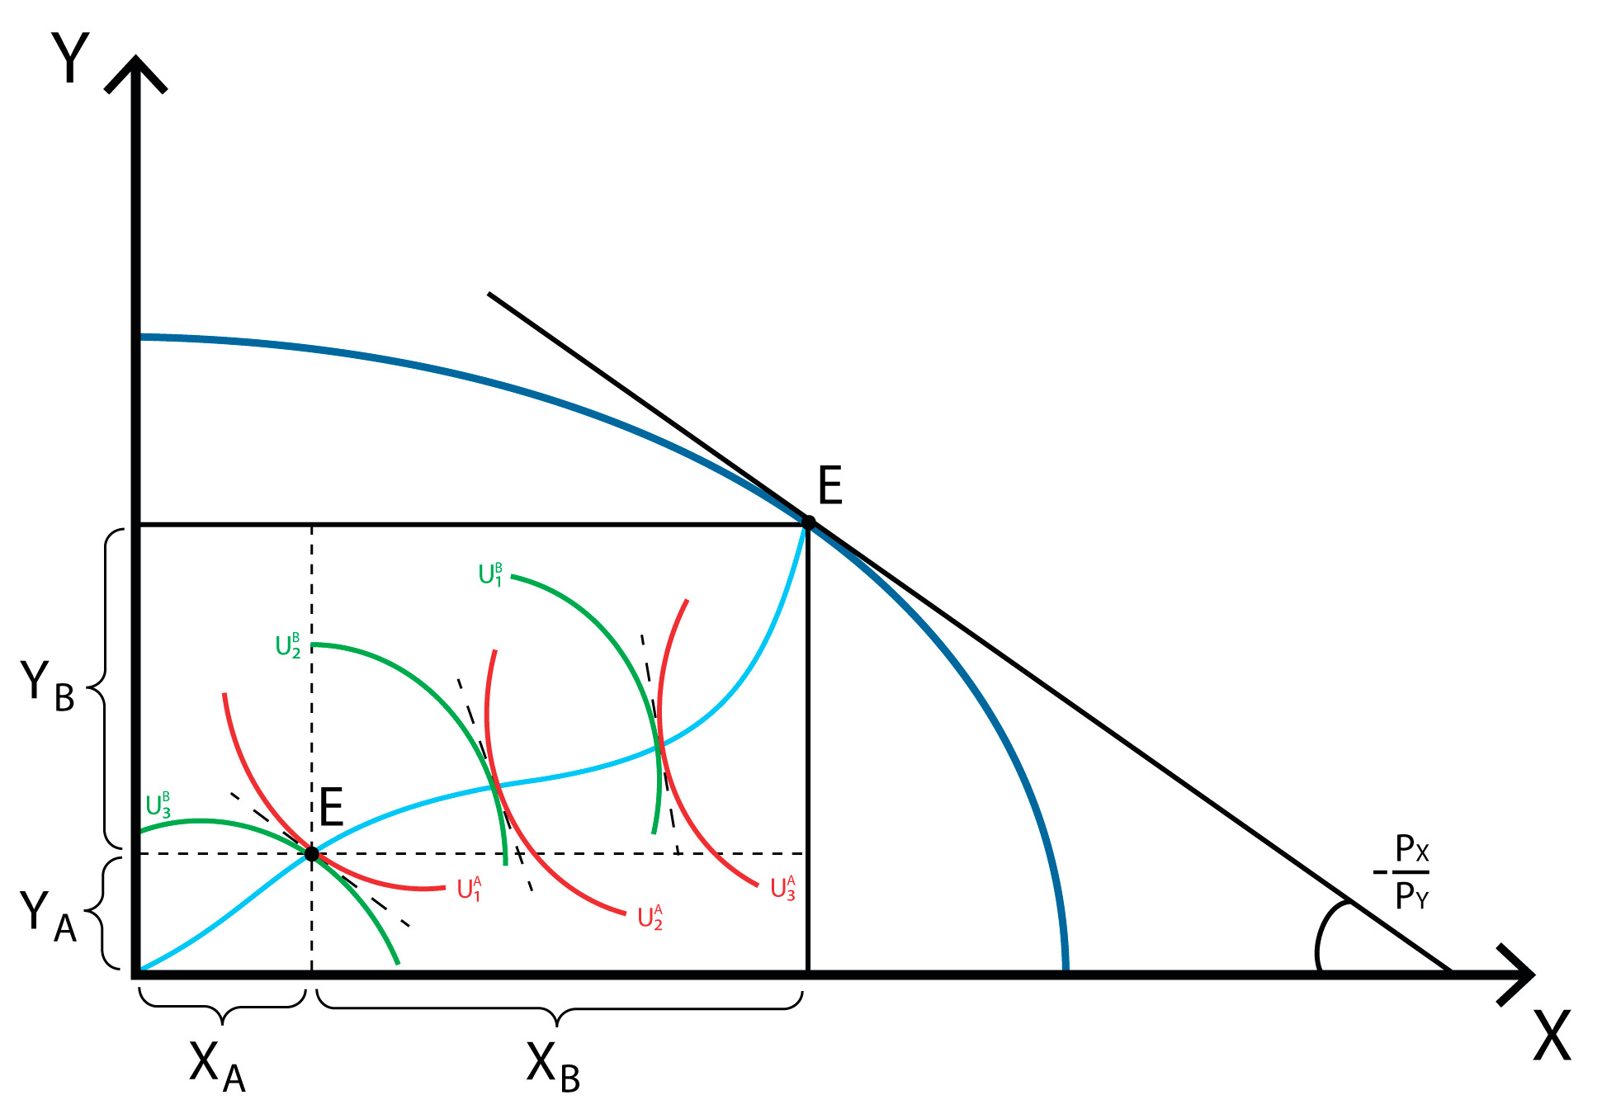
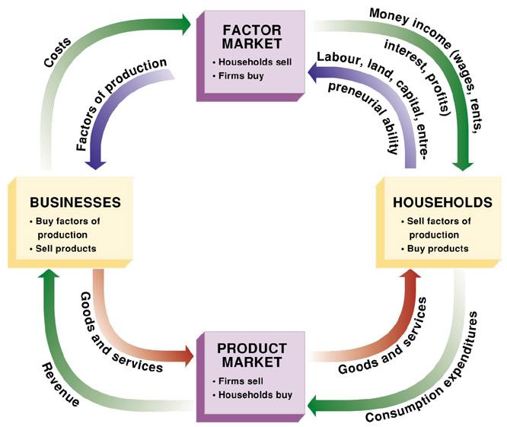
Economics has been wildly successful at what it is good at
Economics did phenomenally well at improving physical consumption and the wellbeing that comes from that.
Provided the “Navigational tools” to make it through the great depression.
General equilibrium (whole economy models); understanding capital accumulation; the basics of the economic consensus…
Huge poverty reductions worldwide
But success here raised new challenges
Switched from the problem of under-consumption turned to that of over-consumption
Economics has a massive blind spot – the economy is embedded in the biosphere
Challenges now are global, interconnected and based on common resources.
To navigate the Anthropocene, we need a more general general equilibrium.

Slide 6
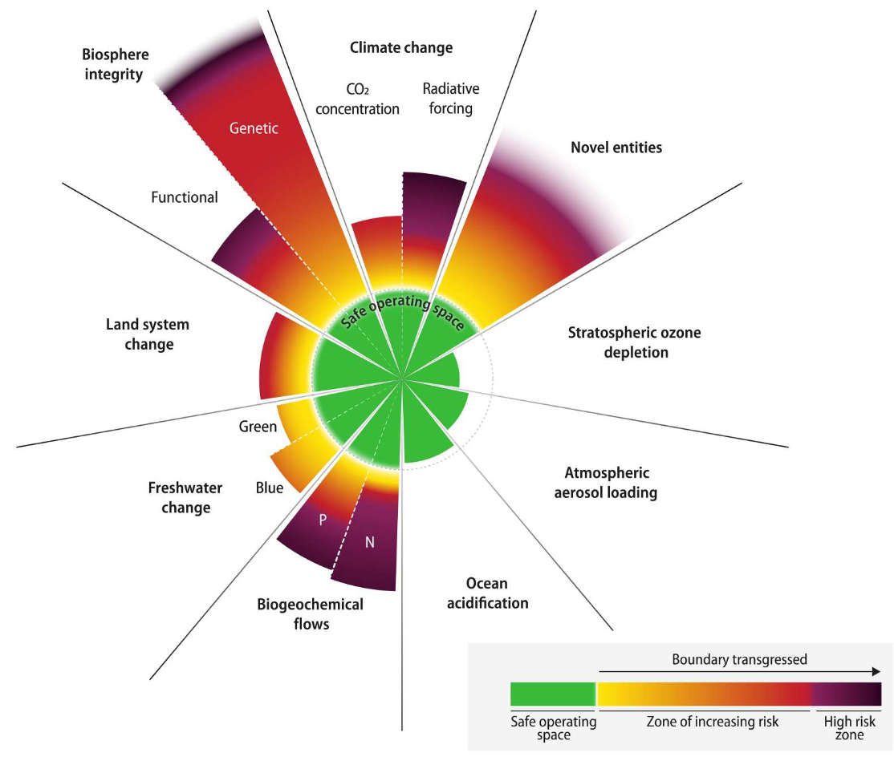
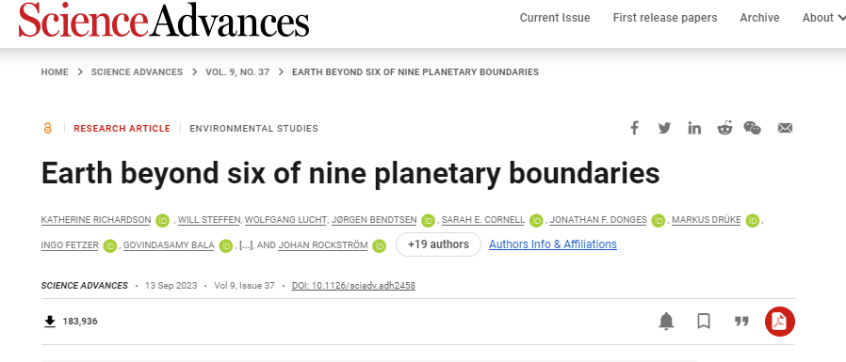
Why do we need earth-economy modeling? Planetary Boundaries
There are biophysical boundaries that should not be crossed.
Climate change
Biodiversity loss
Air pollution
These are massive externalities with system-wide impacts
Ignoring them is very suboptimal

Slide 7
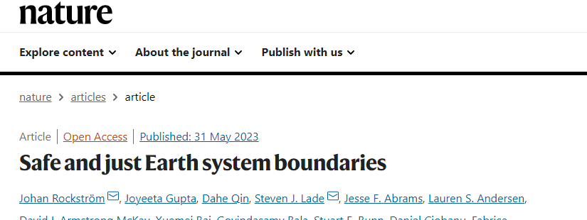
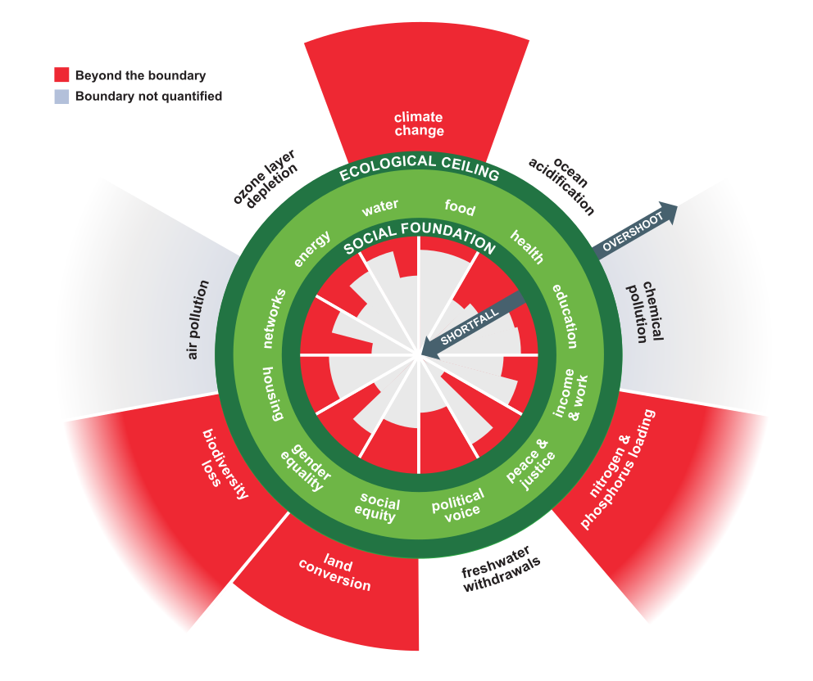
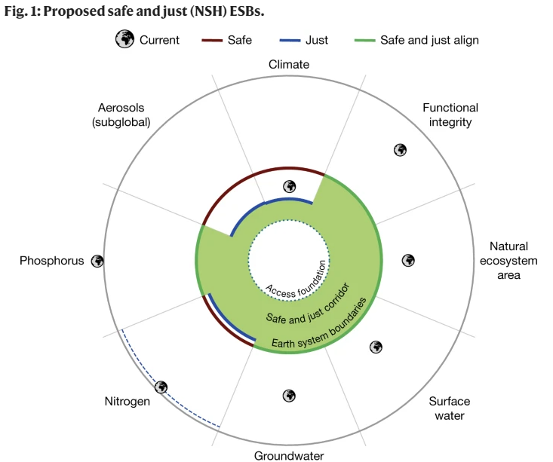
Doughnuts and the “Safe and Just Corridor”
So we know planetary boundaries exist and we should not surpass the “ecological ceiling”
But we also need to stay above the “social floor,” providing sufficient access to foundational goods and services
Wonderful but limited framework
Doesn’t answer key questions, like “What policies we should pursue?”
Doughnut Economics (Raworth 2017)
Or more recently, the “Safe and Just corridor” (Rockström et al. 2023, Nature)

Slide 8
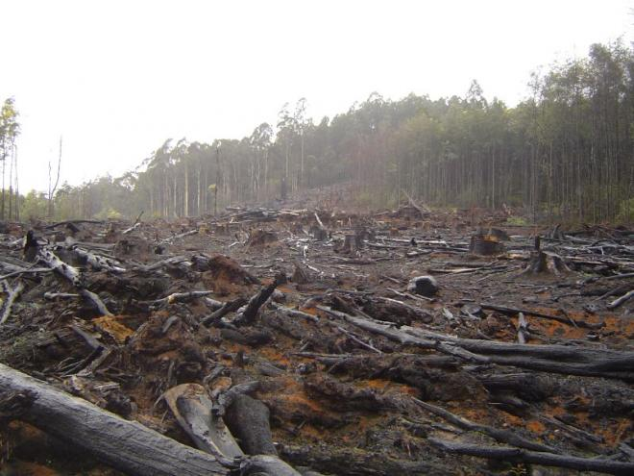
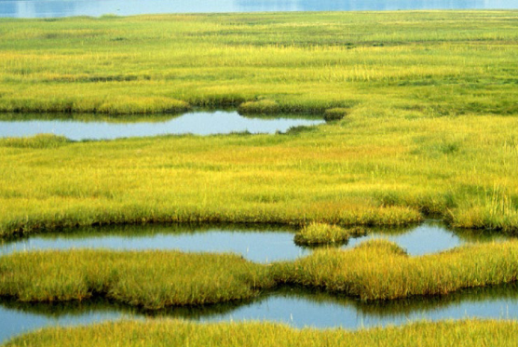
Staying within the Safe and Just corridor requires detailed models of how the Earth and Economy are linked
Impacts
Prior focus was on how humans impact the environment.
But we also need to understand how the economy is dependent on nature
e.g. Deforestation
Economy
Earth Systems
e.g. Ecosystem services (providing clean water)
Dependencies

Slide 9
We created a new model, GTAP-InVEST, to make this link explicit and policy relevant.
Hence our title for this talk “Integrated Assessment Model with natural capital depletion (ecological IAM)”
Impacts
e.g. Deforestation
e.g. Ecosystem services (providing clean water)
Dependencies

Slide 10
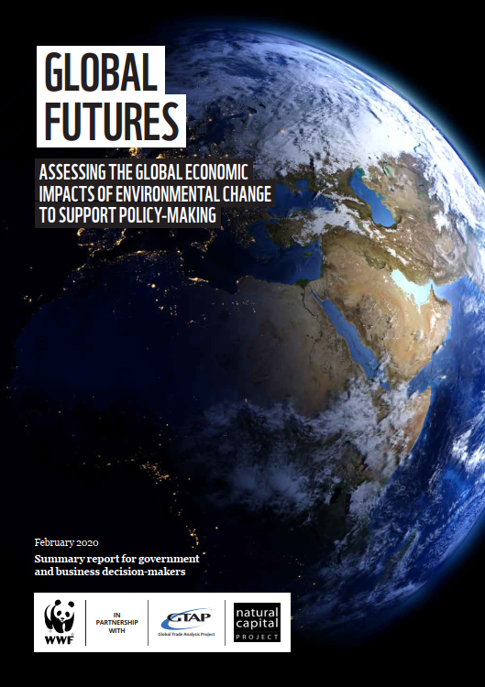
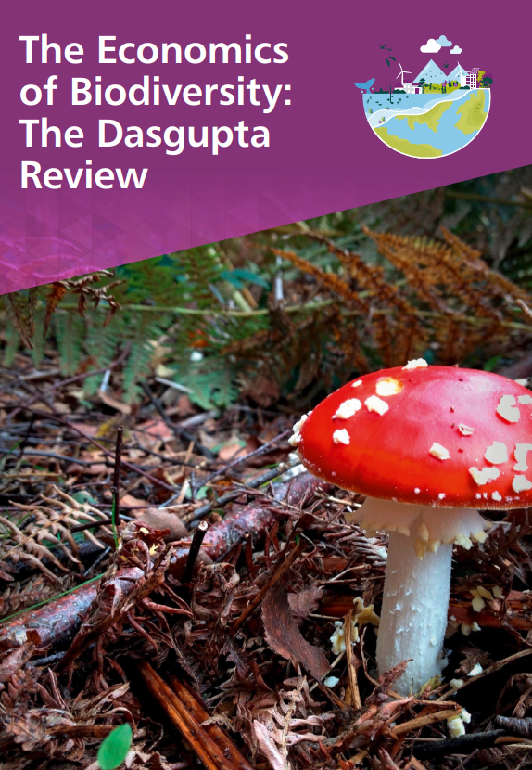
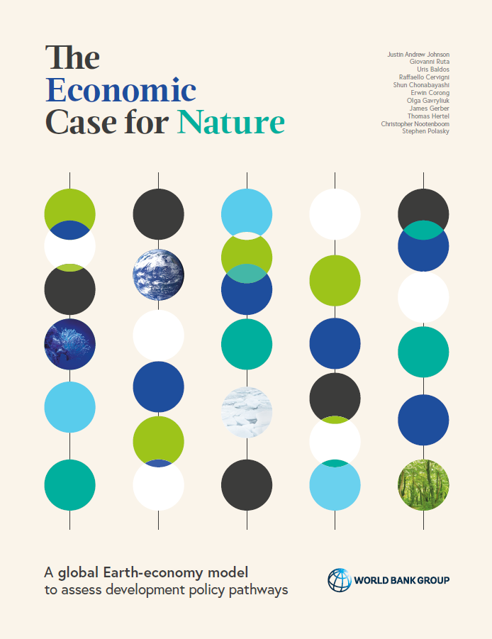
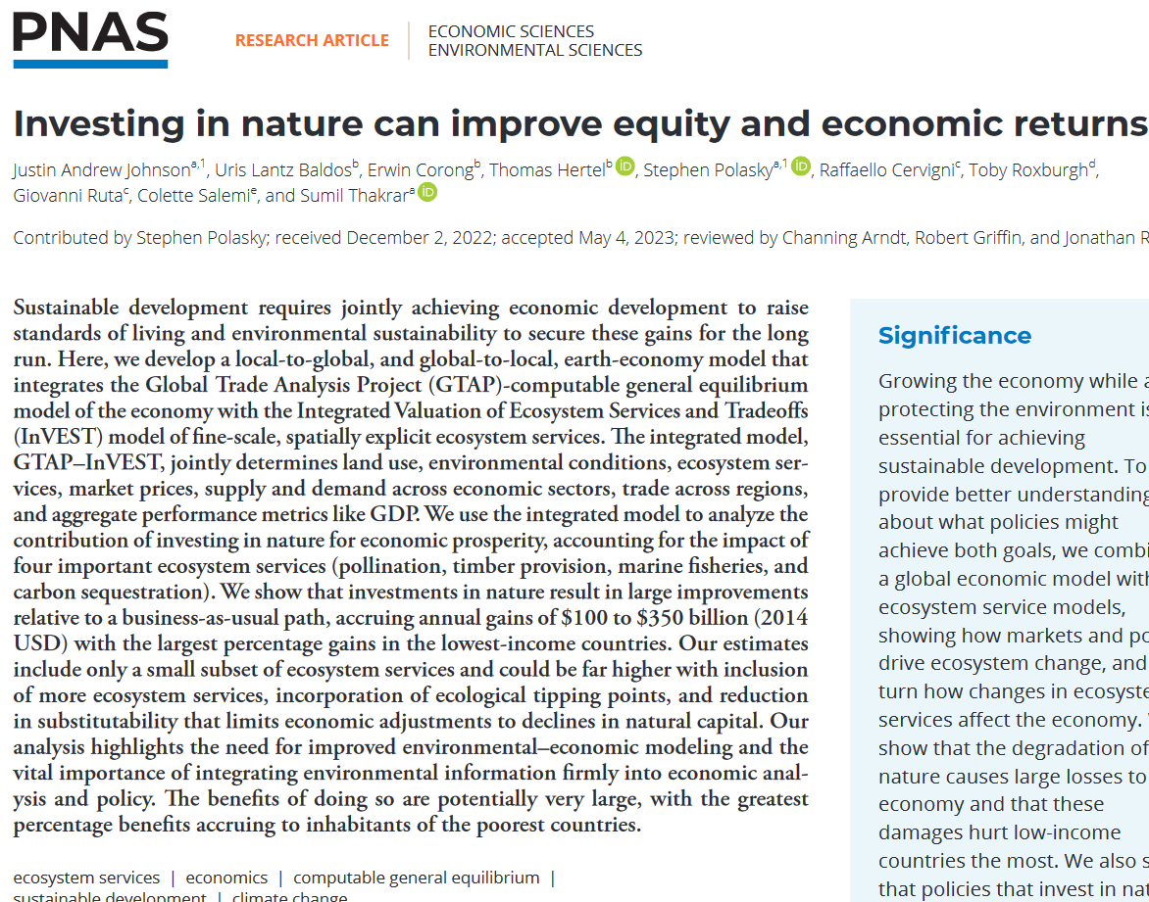
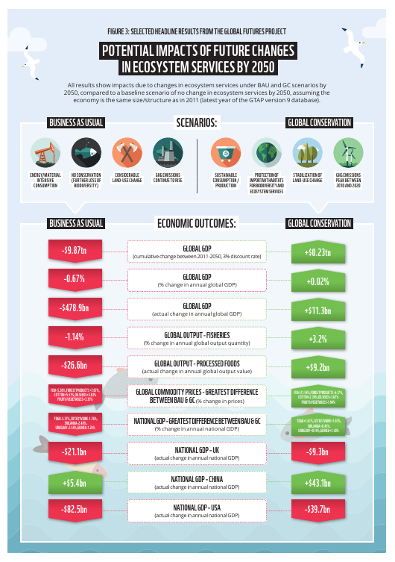
Series of papers to make an actionable model that fills out how to get to the Safe and Just corridor
Global Futures Project with the World Wildlife Fund
panda.org/globalfutures
The Dasgupta Review
Commissioned piece. See Box 14.3.
The Economic Case for Nature
https://www.worldbank.org/en/topic/environment/publication/the-economic-case-for-nature
20,000+ downloads!
Journal article
Johnson et al. 2023, PNAS
JustinAndrewJohnson.com/GTAP_InVEST

Slide 11
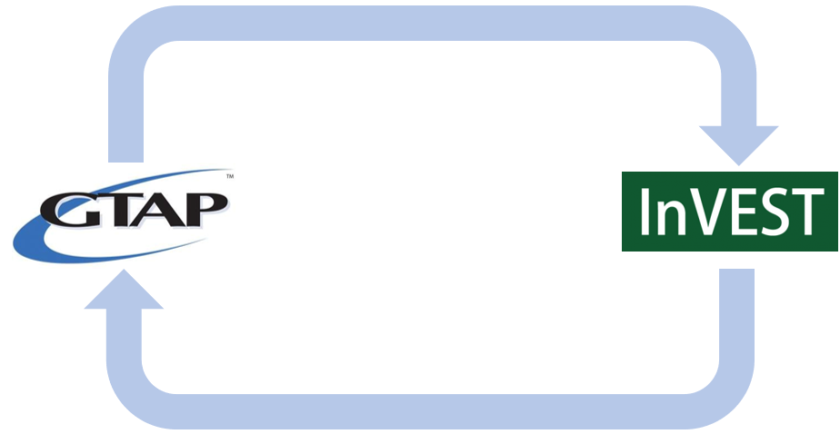
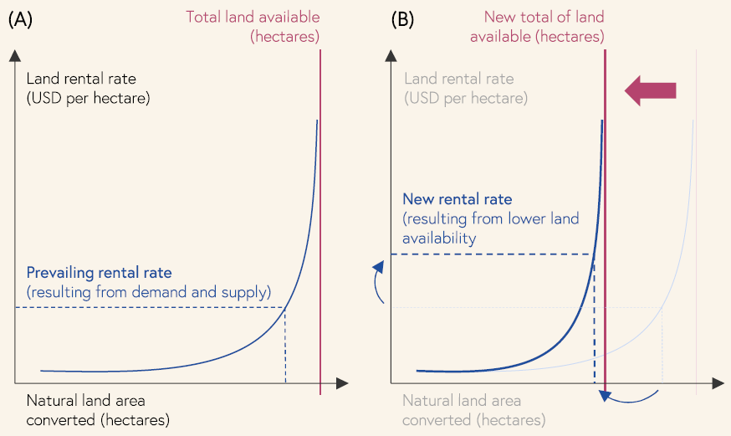
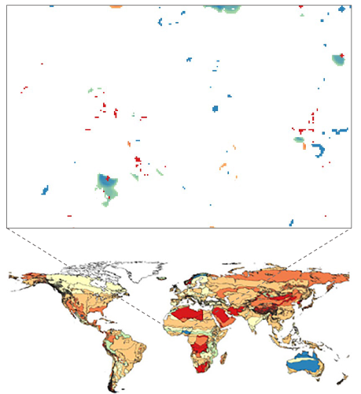
Overview of GTAP-InVEST: Four key parts
2. Downscales land-use change to 300-meters with SEALS (Spatial Economic Allocation Landscape Simulator)
1. Calculates economic impact and endogenous land-use change of GTAP-AEZ with 300+ AEZ/Region combinations
3. Computes 6 global ecosystem services
Sediment retention
Climate Regulation
Pollination of crops
Timber Production
4. Upscales Ecosystem Services changes as economic shocks
Coastal Protection
Marine Fisheries
Land Supply curves parameterized for each AEZ

Slide 12
Step 1: Projecting the economy (including land-use change)
1. Calculates economic impact and endogenous land-use change of GTAP-AEZ with 300+ AEZ/Region combinations
Land Supply curves parameterized for each AEZ

Slide 13
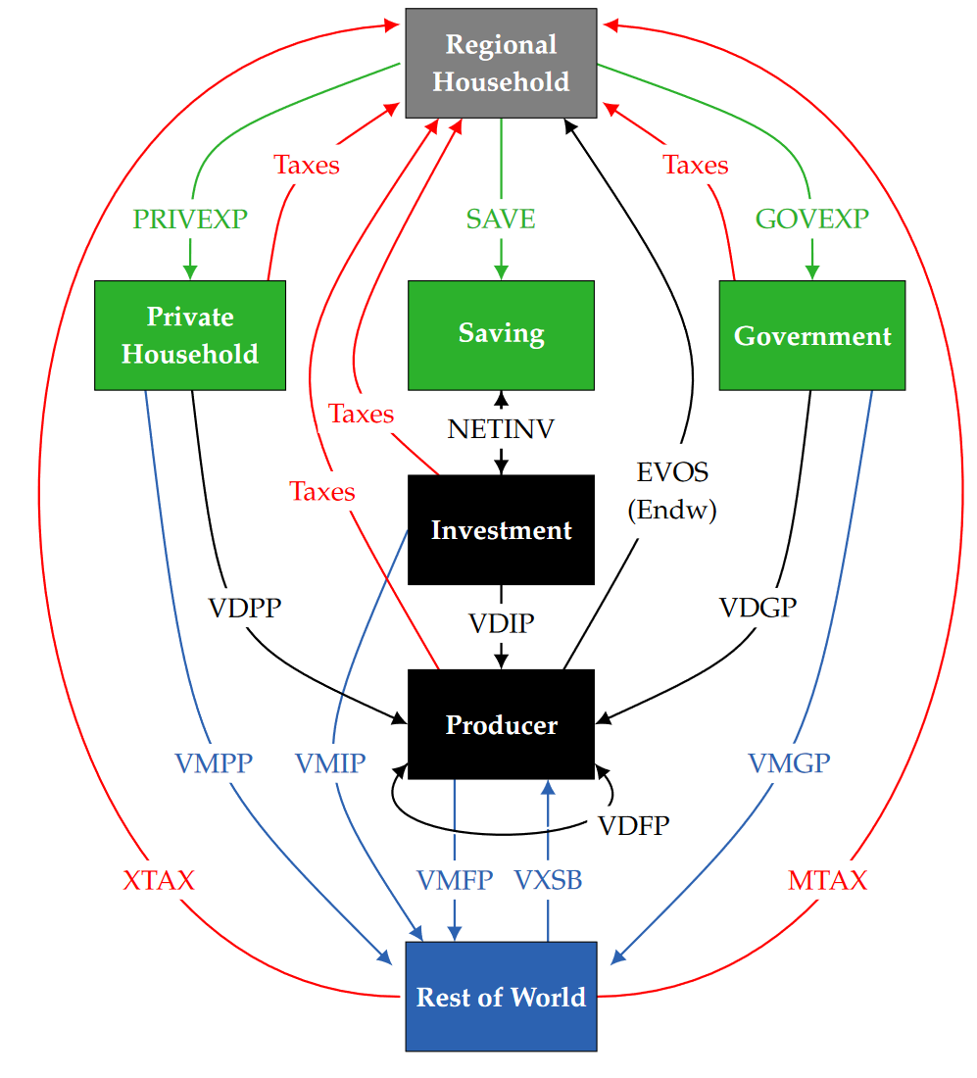
GTAP
Founded in 1992 one of our team members, Tom Hertel
Publicly funded with core support from GTAP Consortium (33 members)
International: World Bank, ADB, IDB, OECD, UNECA, UNESCWA, UNCTAD, WTO, IFPRI, FAO, IFPRI, EU Commission, etc.
National: Canada, Japan, Germany, Netherlands, UK, United States, China
20,000+ members from 174 countries
Two distinct components:
Global Trade Analysis Project
GTAP database
GTAP computable general equilibrium (CGE) model
Standardized, harmonized, curated and comparable database of key economic indicators.
160 regions, 65 sectors, 5 years (v.11): 2004, 2007, 2011, 2014, 2017
Notes:
Models entire economy (GDP endogenous) with exhaustive bilateral trade and transport ties, global savings and investment
Special purpose extensions include:
Energy, biofuels, emissions and climate change mitigation, global land use, global water use, poverty and food security
Foundation for most multi-sector integrated assessment models
Climate impacts
GHG mitigation: fossil fuels, land use change and non-CO2 emissions
Water scarcity
Captures trade-offs with food security and poverty

Slide 14
What are CGEs?
Computable
Can actually be computed in finite time
Sufficiently detailed (65 sectors, 160 regions, 25 input factors, etc.)
Linked to real world data (I/O, SNAs, SEEA)
General
ALL parts of the economy interact
Circular flow of products and payments through interlinked domestic and international markets
Equilibrium
Producers maximize profit, consumers maximize utility. Prices adjust so that supply equals demand.

Slide 15
GTAP-AEZ: Agro-Ecological Zones
Splits the world into 18 zones based on
Climatic zones (arid—humid)
Growing period (shorter—longer)
Combined with GTAP regions to have 1000+ Region-AEZ zones
Each zone uniquely defines a stock of land available for each production activity

Slide 16
AEZ-specific production structure
Like many such models, the production function is a Constant-Elasticity of Transformation (CET) or Substitution (CES) function
$Y_{i}=A_{i}{\left(\sum_{j}{α_{j}x_{j}^{\frac{σ_{j}+1}{σ_{j}}}}\right)}^{\frac{σ_{j}}{σ_{j}+1}}$
Firms optimally choose among inputs $j$ to produce output $Y_{i}$
Sigma captures the elasticity (technically is the MRT/MRS) between the different inputs

Slide 17
AEZ-specific production structure
To add realism, GTAP-AEZ uses nested production functions
Further elasticities determine which inputs are used in each nest
We calculate $σ_{AEZ}$ values for land in each zone
Based on detailed spatial data

Slide 18
New version of GTAP-AEZ with endogenous land expansion
The standard AEZ model assumes the amount of land is fixed
Sectors can compete over its use, like any other input, but the total amount cannot increase
This greatly limited analysis of land-use change (agricultural expansion).
We created a new version of GTAP-AEZ in which the land-supply functions determine endogenously how much land the economy will use
$$Y_{i}=A_{i}{\left(\sum_{j}{α_{j}x_{j}^{\frac{σ_{j}+1}{σ_{j}}}}\right)}^{\frac{σ_{j}}{σ_{j}+1}}$$
For $X_{land}$, we calibrate an upward-sloping supply function:
$X_{land}\left(p_{land}\right)=MaxLandAvailable −{\left(\frac{α}{p_{land}}\right)}^{β}$

Slide 19
Land supply curves graphically
Each AEZ is parameterized based on how much land is available for different methods of production.
Bringing more land into the economy requires a higher price, rising asymptotically with the limit
Shape of the curve determined by high-res suitability data.
Unique for each AEZ.

Slide 20
Necessary to calculate opportunity cost of protecting land
Protecting land (removing it from economic use) shifts the asymptote left
Drives up the price and reduces land conversion
Critical methodological point: this means that removing land from production is not “free”

Slide 21
Recursive-Dynamic Reformulation

Slide 22
The recent PNAS paper used a comparative-static formulation
Greatly limits what can be said on when projecting policies into the future
Working with the World Bank’s Changing Wealth of Nations team to switch to a recursive-dynamic formulation
Provide “policy-contingent” estimates of inclusive wealth
Relevant to other types of questions, including those related to economic growth, forecasting, and soft/strong versions of substitutability within inclusive wealth

Slide 23
Characteristics of GTAP-InVEST-RD model
Sequence of time-based comparative static equilibria (with myopic expectations)
Between period updates to:
Exogenous endowments (population, labor force)
Technology and Preferences
Policy
Endogenous capital accumulation to drive growth in capital stock, based on Stock-flow relation between investment and capital stock
Notes:
Facilitates analyses of adjustment paths and long-term scenarios

Slide 24
Conversion to Recursive Dynamic
Really quite easy:
We calculate this loop for each time step
Outputs of time $t$ are inputs to $t+1$
Impacts
e.g. Deforestation
e.g. Ecosystem services (providing clean water)
Dependencies

Slide 25
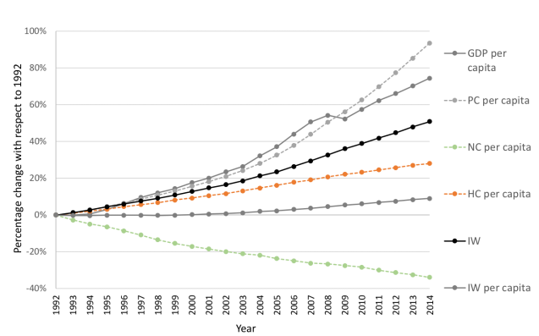
Increase the policy relevance of Inclusive Wealth
By design, inclusive wealth is backward looking (accounting)
Gives us great information about how we’ve been doing
“Way better” than GDP
But we might also want to know what policies improve future levels of inclusive wealth
Policy A
“Policy-contingent inclusive wealth estimates”
Policy B

Slide 26
Step 2: Downscaling land-use change to high resolution
2. Downscales land-use change to 300-meters with SEALS (Spatial Economic Allocation Landscape Simulator)

Slide 27
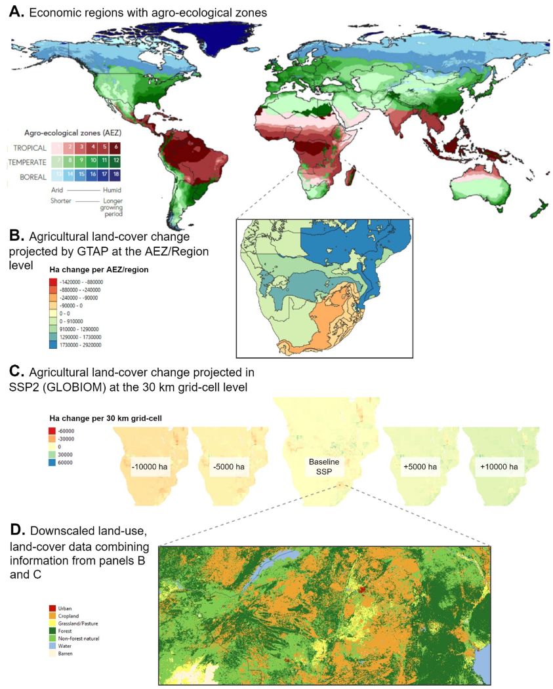
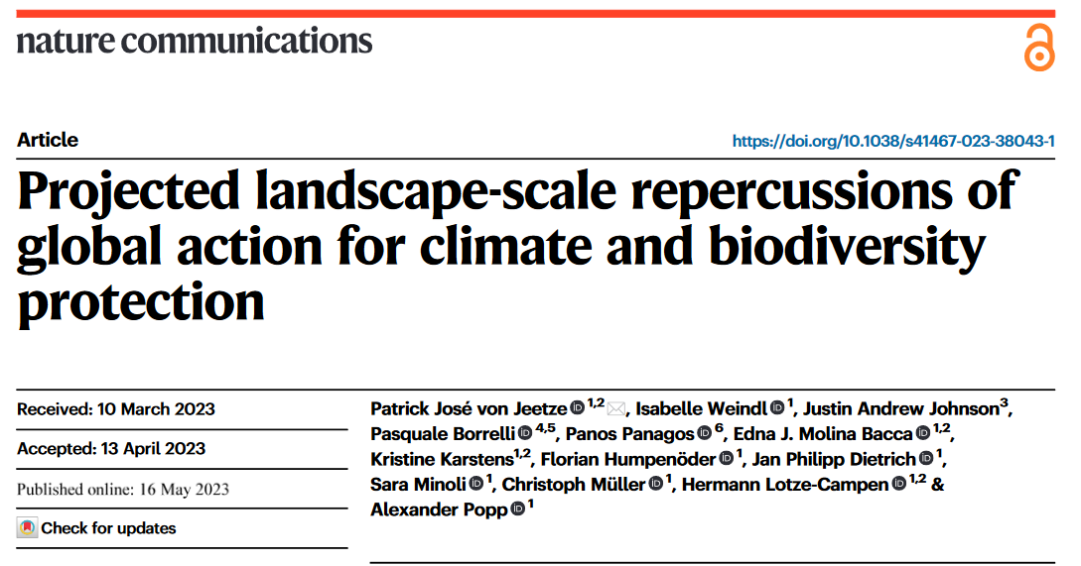
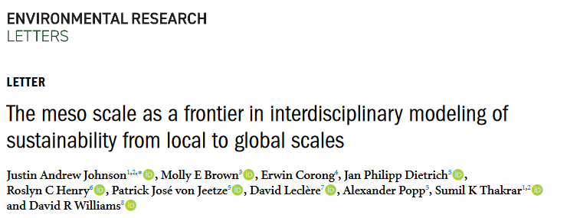
Downscaling land-use change
GTAP-AEZ gave us land-use change per AEZ-Region
We need to go from that change in land-use per (panels A-B)…
to high-resolution land-use, land-cover maps (C) needed for ecosystem service modeling
C.

Slide 28
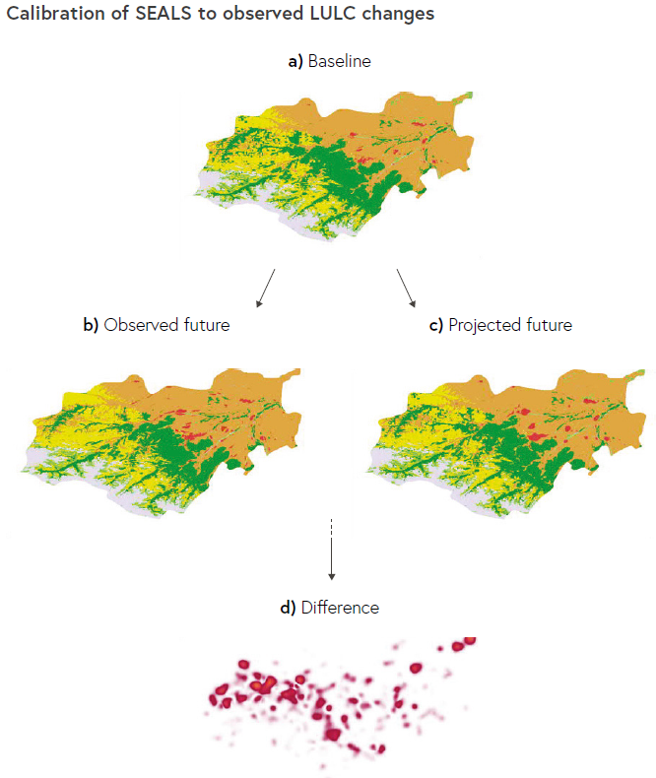
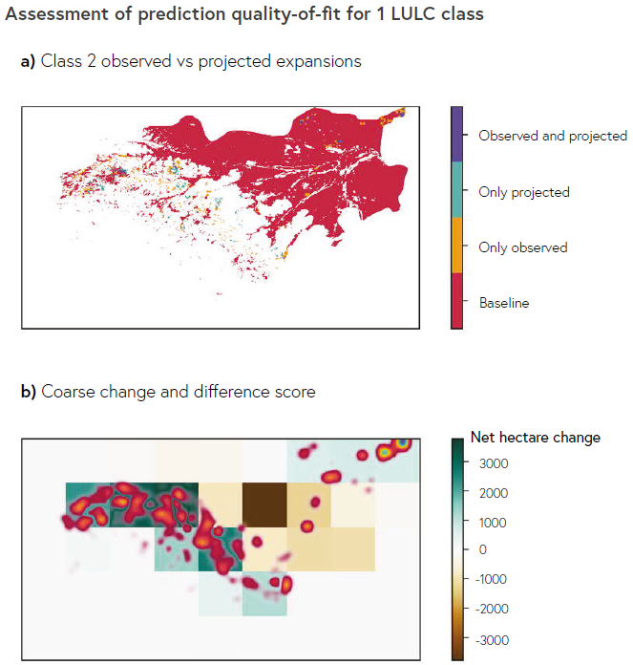
How was SEALS trained? Omitted today, but basically a spatial adjacency machine learning algorithm using cross-validation

Slide 29
Step 3: Running global ecosystem service models
3. Computes 6 global ecosystem services
Sediment retention
Climate Regulation
Pollination of crops
Timber Production
Coastal Protection
Marine Fisheries

Slide 30
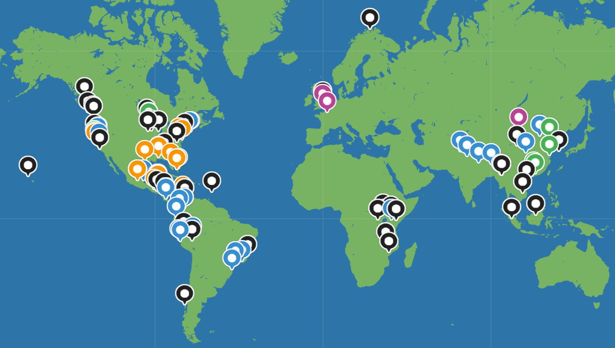
InVEST and The Natural Capital Project
Partnership of WWF, The Nature Conservancy, Stanford University, University of Minnesota and Chinese Academy of sciences
InVEST is an open-source software tool to estimate ~20 ecosystem services
Spatially-explicit, high-resolution, processed-based production functions, global extent
Notes:
Some of the strengths of InVEST models

Slide 31
Sediment retention on a very simple land-use land-cover map
Nutrient/sediment load
Flow direction
Corn
Forest
export
Wheat
Forest
retention
Stream
to reservoir

Slide 32
Transport/retention
This is calculated for EACH pixel on the landscape
Downslope path
(retention)
Hydrological routing on 30-meter elevation maps globally is computationally “challenging.”
Upslope area
(transport)
Pixel of interest
Stream
Notes:
Complete water cycle on the landscape. Transpiration is based on the plant type, leaf type, seasonality and root depth. Inflow is from upslope. Water availability is a soil property (PAWC). Final water yield is the result of all of these interactions.

Slide 33
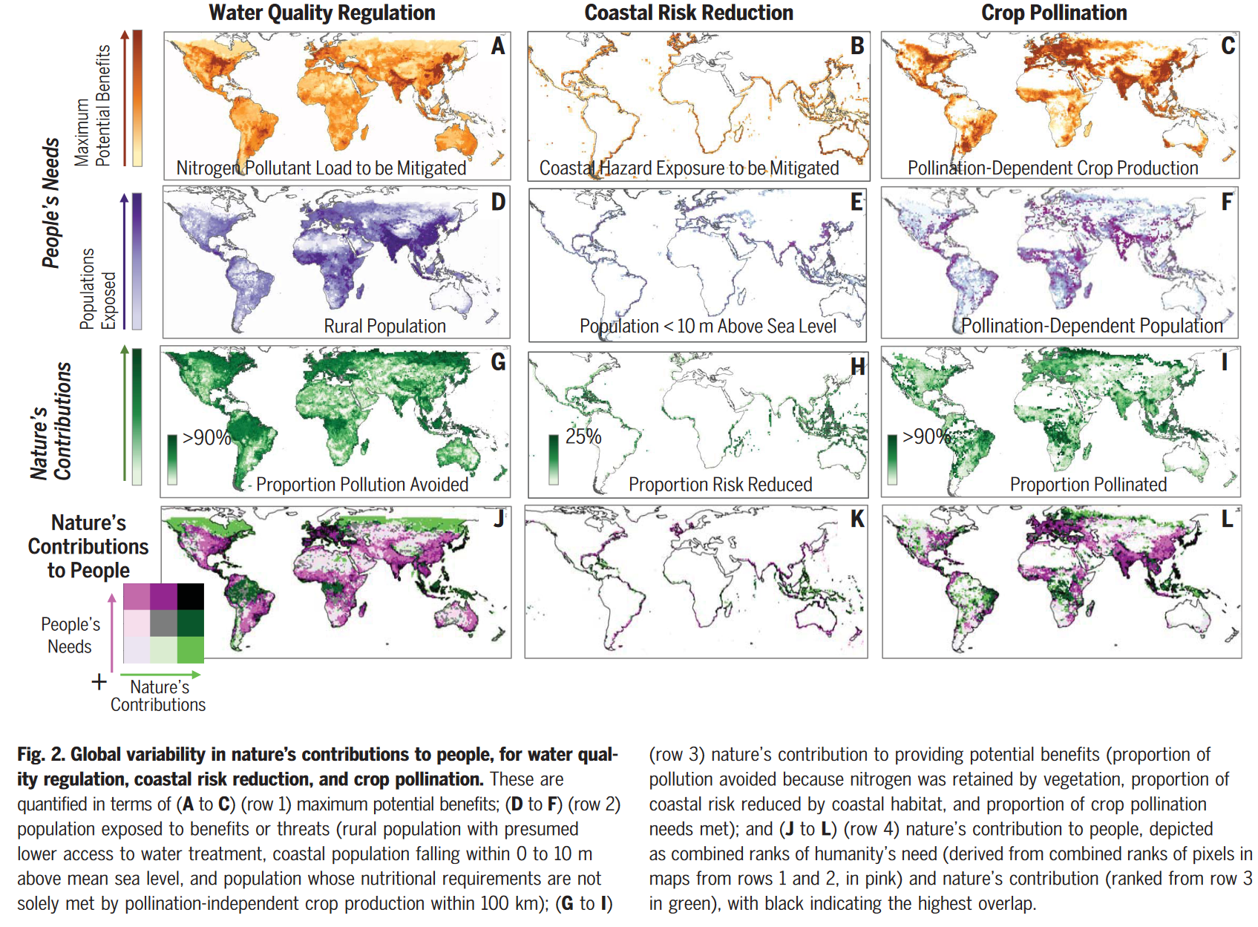
Only recently have we been able to run ecosystem service models at the global scale
Chaplin-Kramer et al. 2019, Science
More global applications:
Johnson et al. 2021, 2023
Chapin-Kramer et al. 2023
Neugarten et al. 2023
Damania et al. 2023
Polasky et al. (in submission)

Slide 34
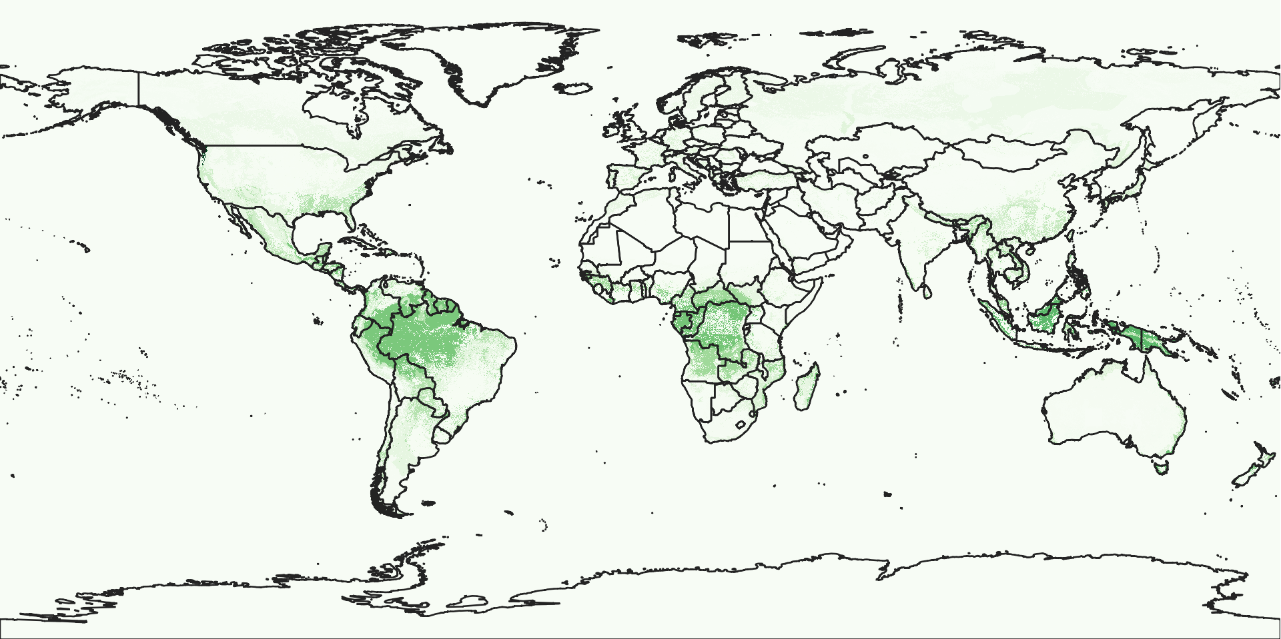
Carbon storage and timber ecosystem service provision
Tons carbon storage

Slide 35
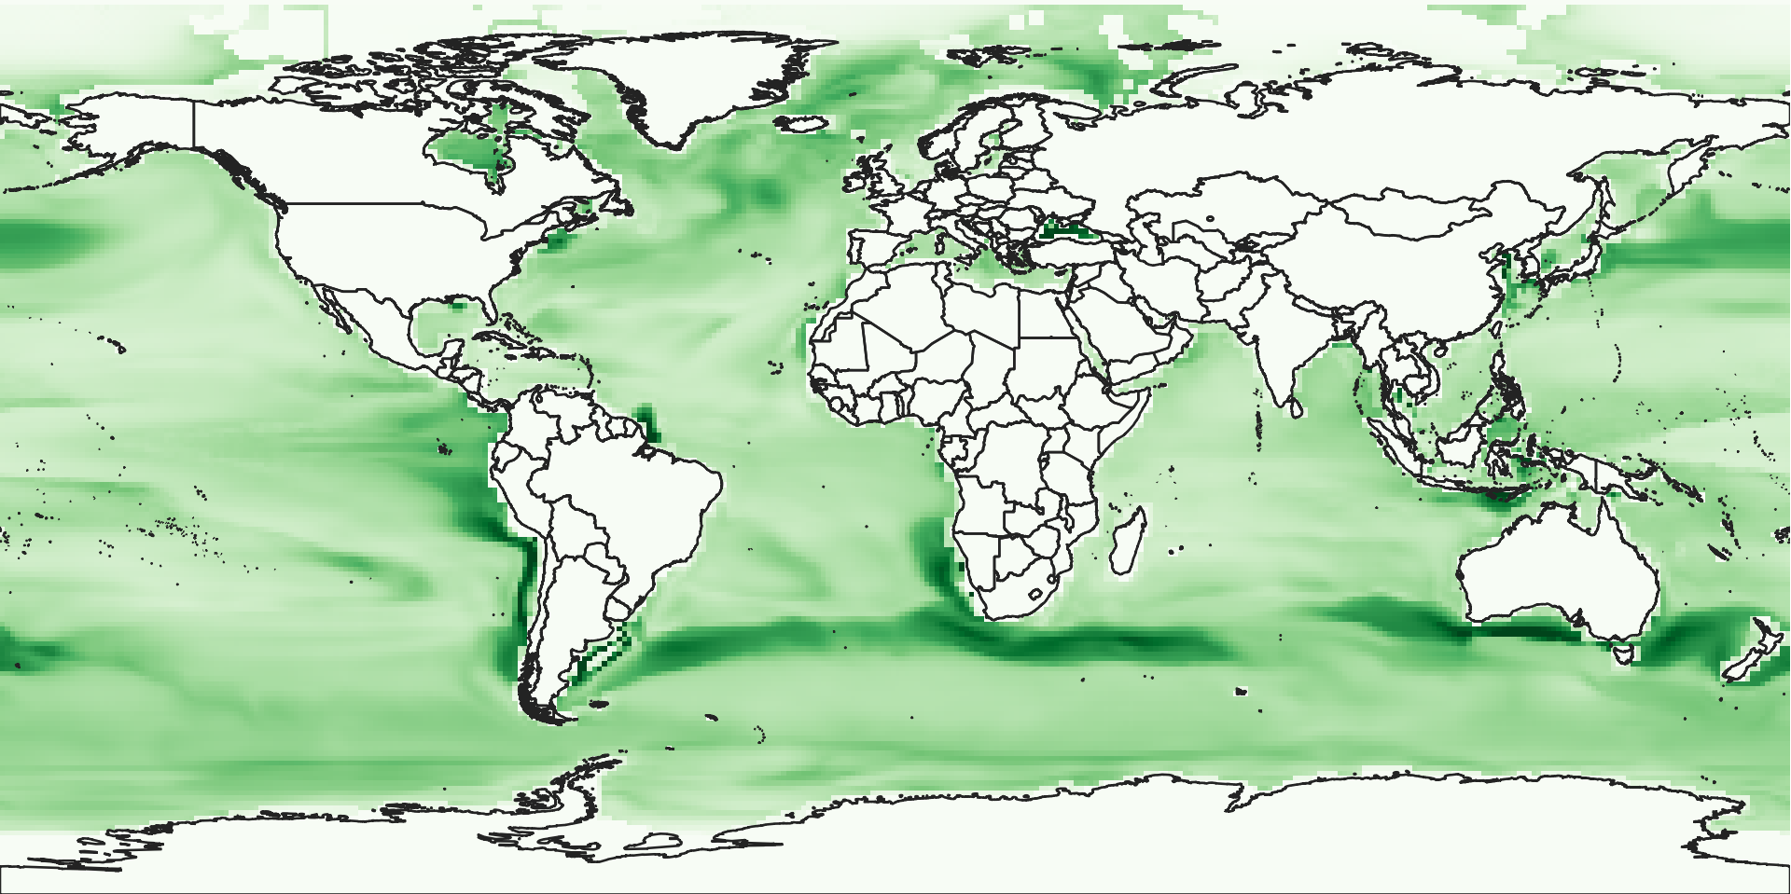
Marine fisheries ecosystem service provision
Total Catch Biomass (Kg/m2)
Note that the model does not have policies that affect marine fisheries directly, so the results are constant across scenarios.
However, this is a possible extension of the model.

Slide 36
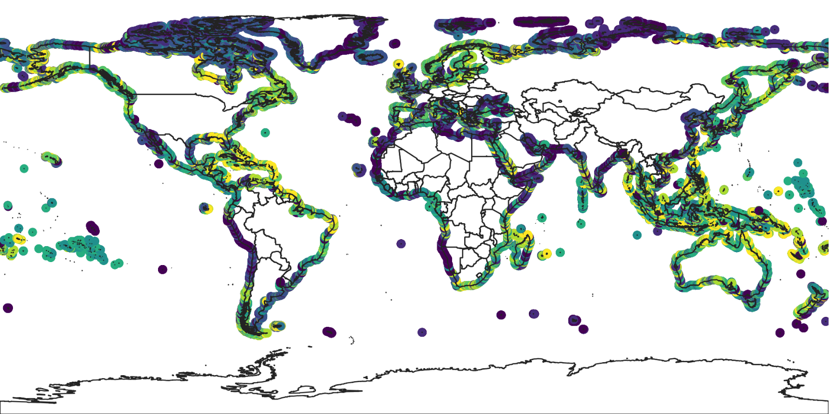
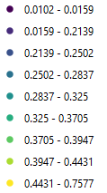
Coastal protection ecosystem service provision
Coastal vulnerability index

Slide 37
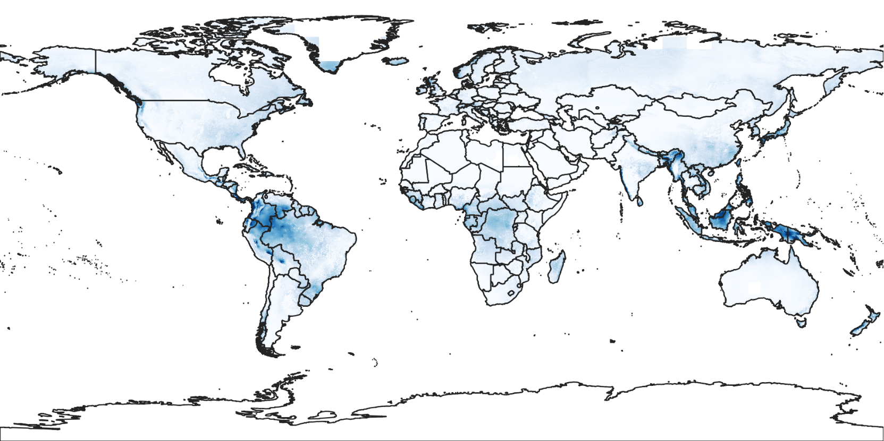
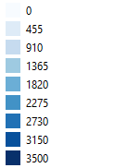
Water yield ecosystem service provision
mm precipitation

Slide 38
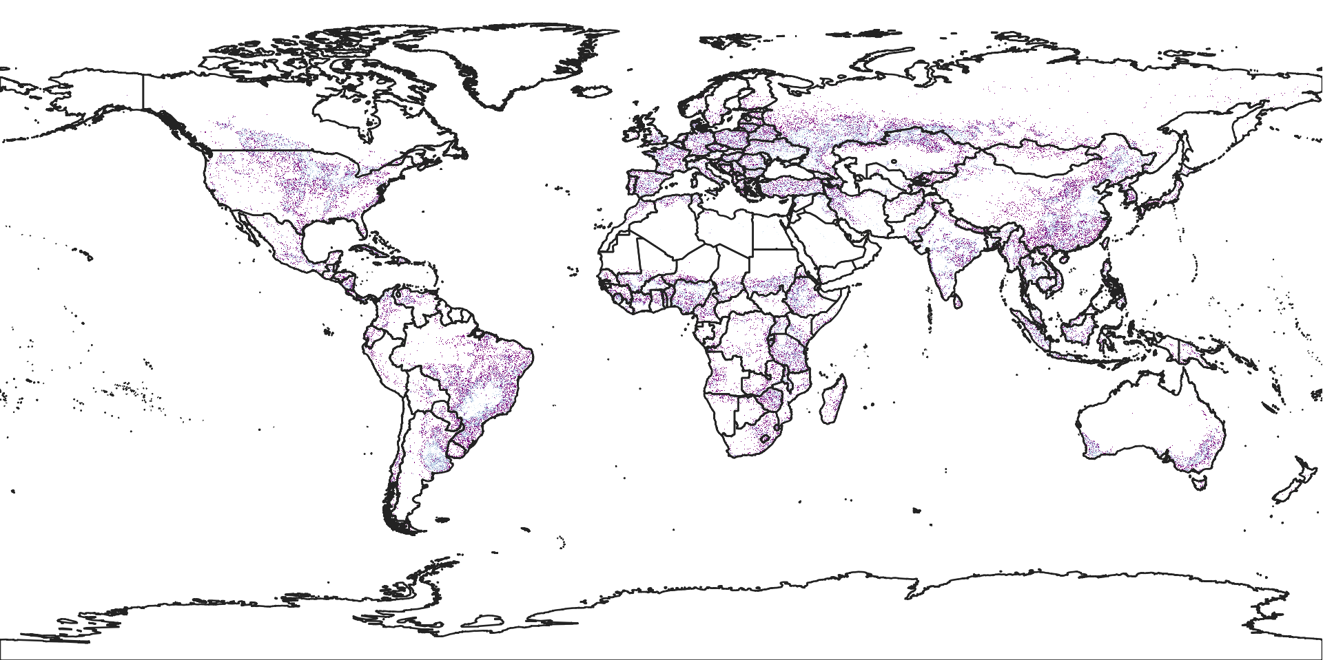
Wild pollinator ecosystem service provision
Pollination sufficiency

Slide 39
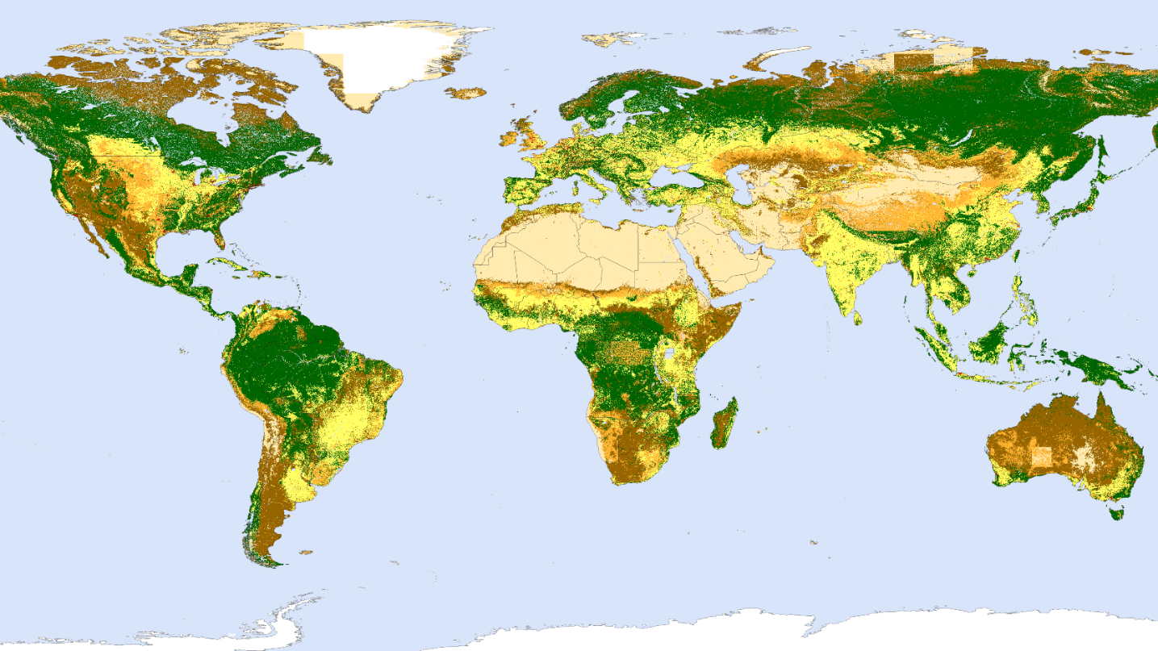
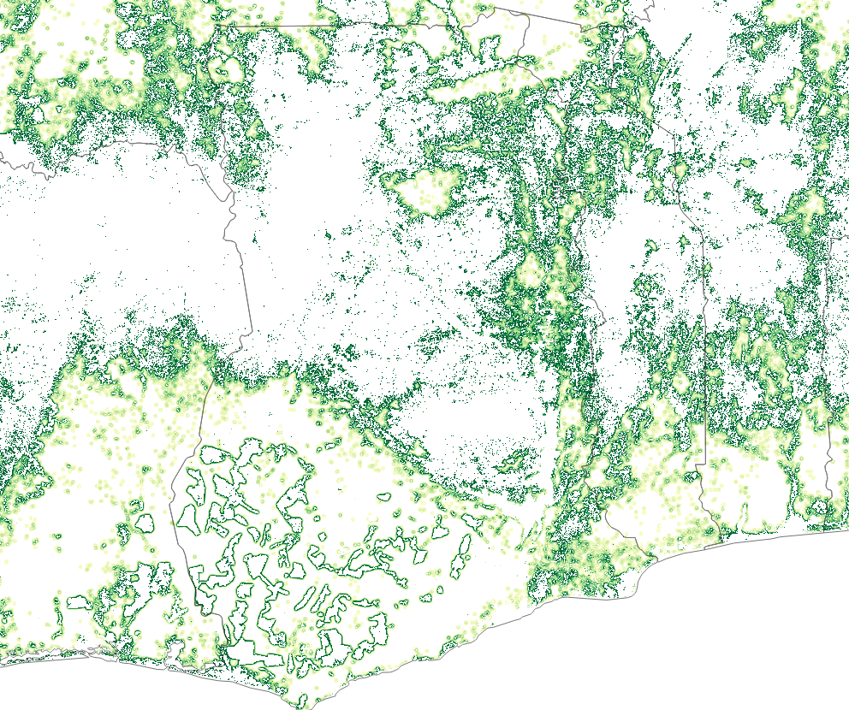
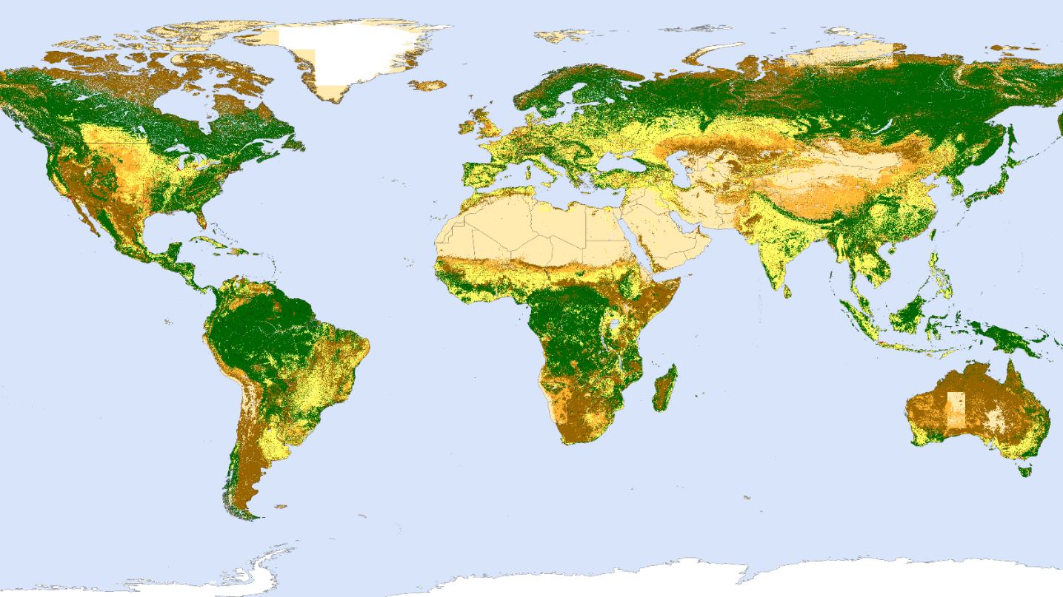
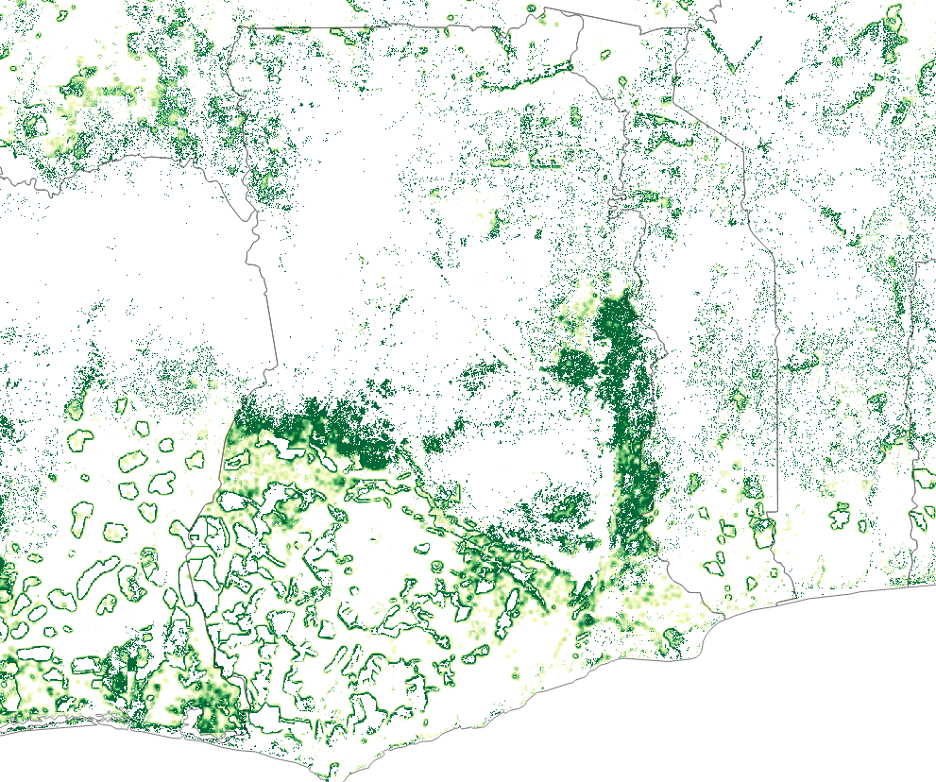
Land Cover Maps (300m) under BAU
Pollination Service under BAU
Land Cover Maps under Conservation Scenario
Pollination Service under Conservation Scenario
In this landscape, pollination services contribute ~60 billion more GDP per year than under BAU
Notes:
Justin: Need to work on color scheme for RHS

Slide 40
Step 4: Converting biophysical ecosystem services measures to economic inputs and upscaling to the economic region
4. Upscales Ecosystem Services changes as economic shocks

Slide 41
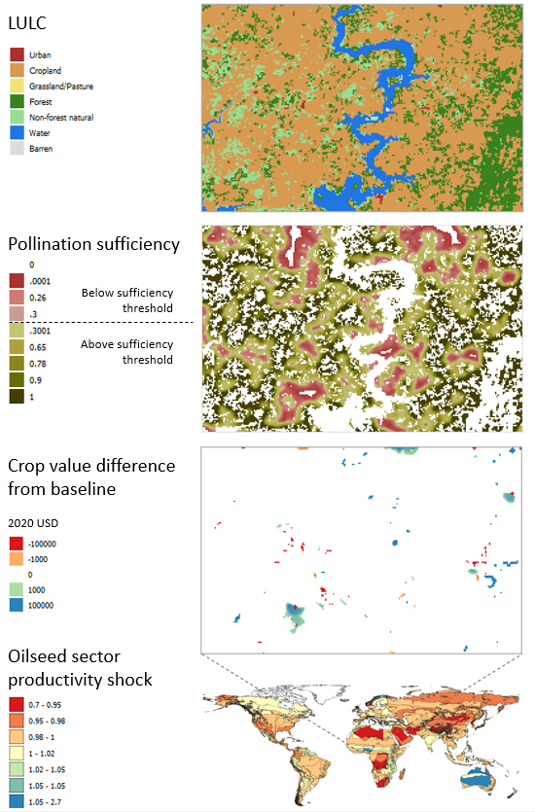
Pollination example of linking land-use change to economic performance
Key input to ecosystem service models: 300m global LULC maps from GTAP-derived regional land-use change predictions.
Then used these as inputs into InVEST.
Then used these as inputs (shocks) to GTAP specific to each crop and region.
Calculates macroeconomic impact from lost ecosystem services.

Slide 42
Results: two types
Marginal:
What if we implement a feasible (and thereby small) policy?
What happens when we include “projectable” ecosystem damages on business-as-usual (BAU)?
Tipping-point:
What if a bigger change happens?

Slide 43
Terminology
Four types of scenarios:
‘Baseline’: a scenario WITHOUT the impact of ecosystem service.
‘Business-as-usual’ (BAU): a scenario in which ecosystem services interact with the economy and can change with model variables, but no policy modifications.
‘BAU including rigidities’: like BAU, but with reduced ability of markets to adjust after shocks.
‘Policies’: scenarios that include ecosystem-economy interactions and which allow for policy modifications.
Baseline
Policy #1
BAU (with ecosystem services)
BAU (with ecosystem services)
GDP
BAU including Rigidities (with ecosystem services)
Policy #2
2021
2030
2021
2030
“Does nature matter?”
“How can we make things better?”

Slide 44
Marginal Results

Slide 45
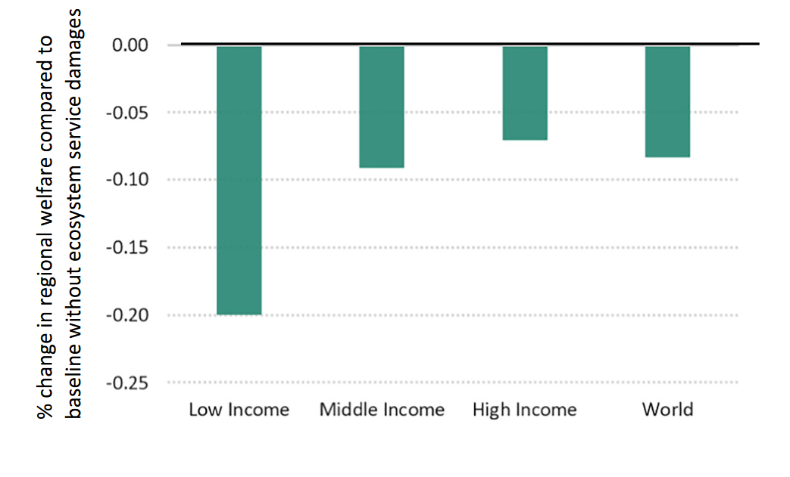
Nature matters, especially for low-income countries
Declining Ecosystem Services leads to Reduced GDP and regional welfare (equivalent variation
Impact greatest among low-income countries
We find that annual GDP is 75 billion (2014 USD) lower in 2030 when we include the negative impacts from reduced ecosystem services
This marginal estimate is an extremely conservative measure (not attempting to answer what is the value of nature):
Only ES that we can compute globally
Only ES with linkages to the economy that we can endogenize in a CGE
Only focused on small, “projectable” change in ecosystems

Slide 46
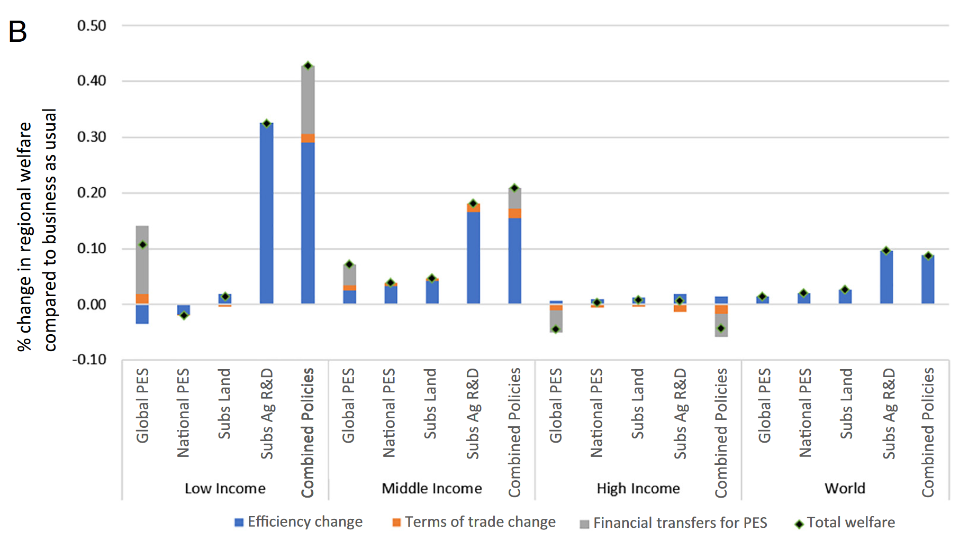
Policies to protect nature are good, especially for low-income countries
Analyzed four policies:
Repurposing agricultural subsidies as revenue-neutral transfers
Investment in Agricultural research and development
Global forest carbon payments
Local forest carbon payments
Combination of policies most effective
Global PES and Ag R&D best individual policies

Slide 47
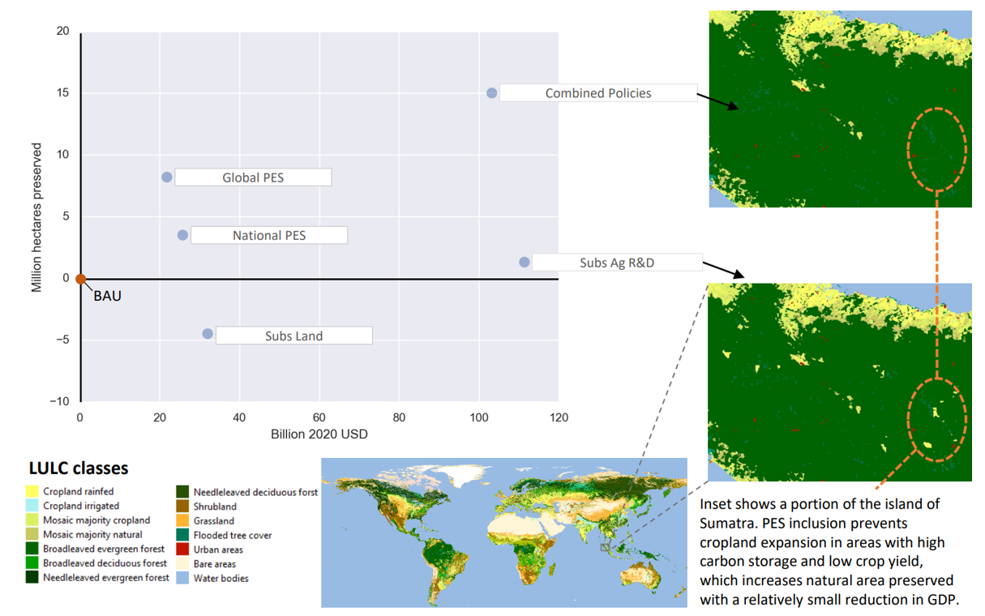
But important land-use tradeoffs exist

Slide 48
What happens when ecosystems collapse?
Passing tipping-points or triggering regime-changes causes $2.0 to $2.7 trillion GDP losses per year if it occurred in 2030.

Slide 49
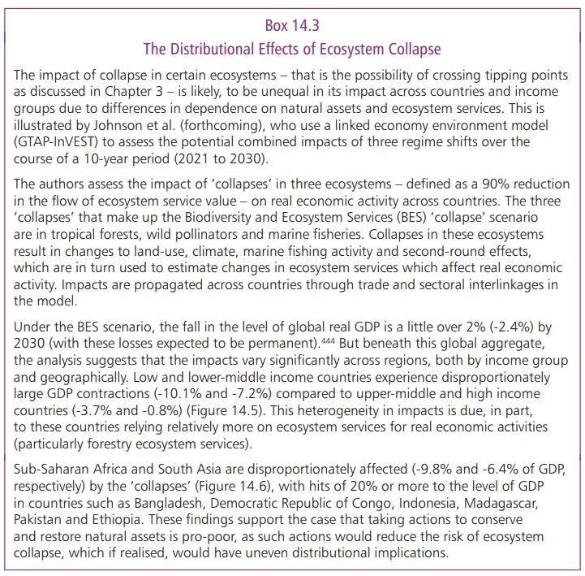
Commissioned us to ask:
What are distributional impacts of ecosystem collapse?
Found that again, low-income countries hurt most from degraded natural capital.
$2.7
trillion

Slide 50
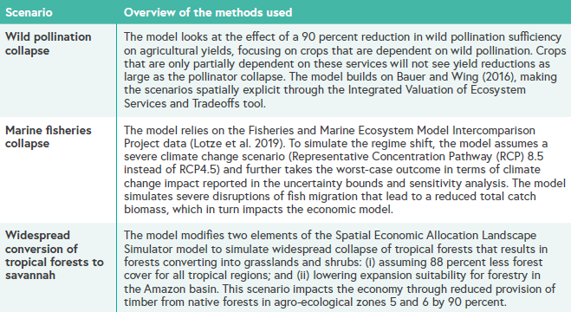
Definition of regime change
Looked at three possible collapses:
Wild pollination collapse
Marine fisheries collapse
Widespread conversion of the amazon to dryer ecosystems (savannah/shrubland)

Slide 51
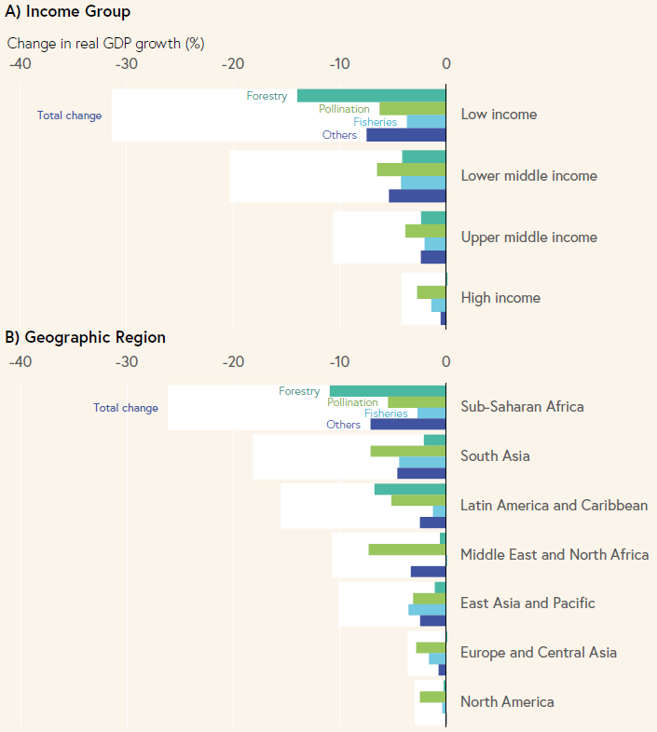
Effect on growth is very negative for low-income countries

Slide 52
Concluding thoughts and context
Earth-Economy modeling.

Slide 53
I think we are at a threshold in integrated ecosystem-economy modeling
Increasing computational power
plus greatly improved datasets from (e.g.) remote sensing
plus increasing rigor of open-source science
leads to a “new” type of modeling.
Within our research lab we’ve been referring to this as Earth-Economy modeling

Slide 54
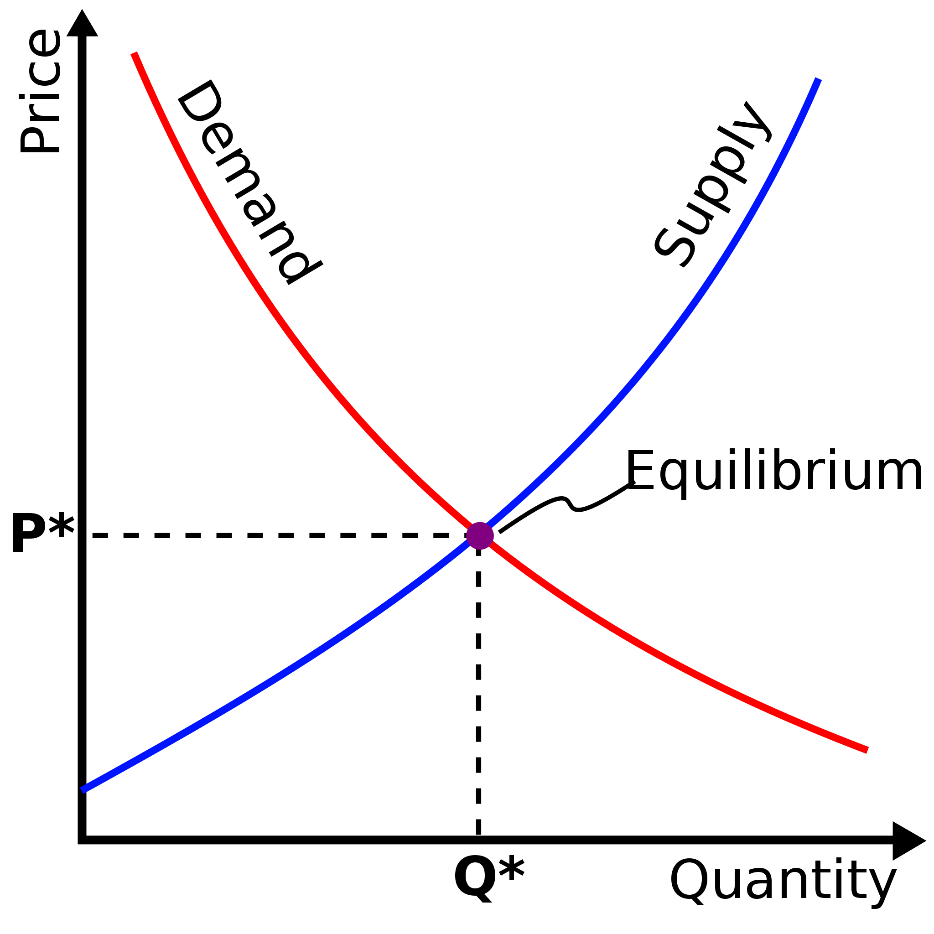
What is Earth Economy modeling? Bringing back the general to general equilibrium
Computable General Equilibrium
A global model that combines:
Global, economy-wide models (like CGEs)
Global, ecosystem-wide models (like ecosystem services and other earth-systems models)
Very high-resolution depiction of the “state variable” (the Earth)
Detailed enough for specific policy analysis
Land Cover maps (300m) used in to calculate InVEST globally
Notes:
Earth-Economy models are global, comprehensive models that combine Computable General Equilibrium (CGE) economic models with detailed ecological models, calculated at very high spatial resolution. Understanding important dependencies of human wellbeing on natural capital requires detailed location-specific information, for example, how mangroves provide coastal protection, natural vegetation prevents erosion and reduces yield losses from degraded soil, habitat for wild pollinators increases agricultural productivity, or healthy forests retain carbon and regulate climate. The continued provision of these services, however, depends on impacts from economy-wide interactions driven by global trade, shifting consumer demand, policies of local, regional and national governments along with international institutions, all of which are interconnected through markets and endogenous price changes. Including such interconnections allows for greater understanding of important spillover effects and unintended consequences. Examples include when the European Union attempted to encourage renewable energy resulting in expansion of oil palm plantations causing deforestation in Southeast Asia, when attempts to limit deforestation from oil palm expansion in Indonesia raised prices causing increased deforestation in neighboring countries, and when increases in protected areas causes local reductions in agricultural production leading to food price increases and shifts in the location of production.

Slide 55
New partners to push this frontier
Central Banks: expanding mandate to focus on stability
Financial sector and investors
Just about to publish an Asset Manager Perspective piece with the Norwegian Sovereign Wealth Fund on how to incorporate natural capital into fund valuation and investing strategy
AI-CLIMATE
New NSF-supported center just launched at the University of MN
Will apply modern AI and ML methods to solving earth-economy challenges
GLASSNET
Global-Local Analysis of Systems Sustainability Network
Focused on the cross-scale/global-scale modeling paradigm
NatCap TEEMs (The Earth-Economy Modelers)?
A new consortium to mainstream the use of Earth-Economy models?

Slide 56
Thanks!
jajohns@umn.edu
JustinAndrewJohnson.com

Slide 57
Appendix

Slide 58
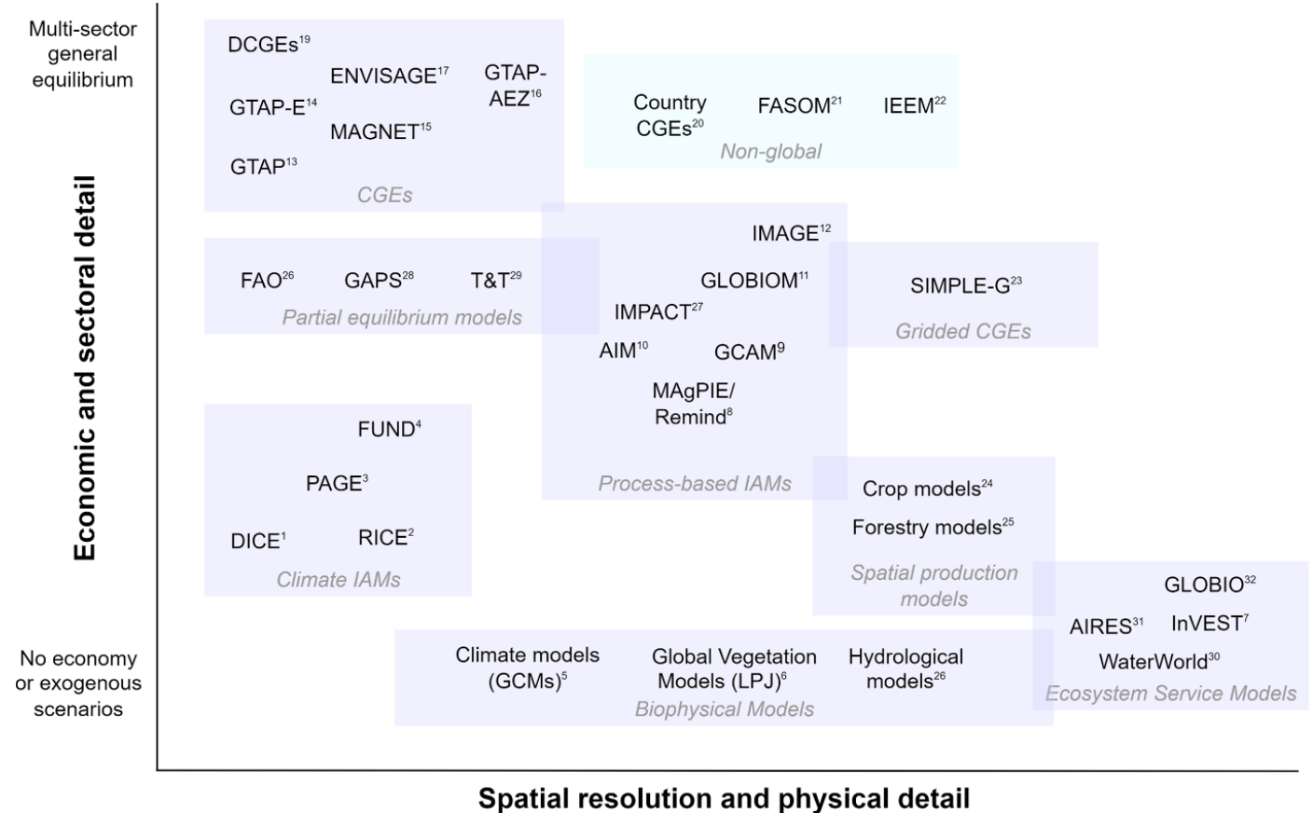
There are many models in this space
There exists a tradeoff between economic detail and physical detail.
It is possible to push the frontier (to the upper right)

Slide 59
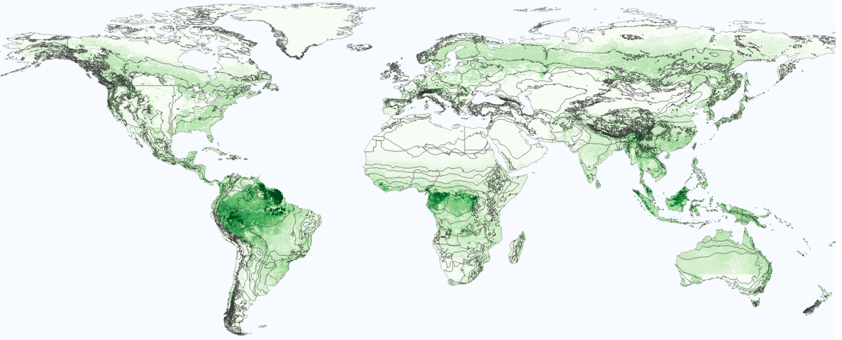
Protecting 30% of earth poses conflicts with agriculture
Top map: Conservation score based on a weighted sum of normalized carbon storage and biodiversity (darker green indicates higher conservation value)
Protecting the most valuable land would conflict with agriculture in areas mapped in the bottom map.

Slide 60
Protecting 30% of earth poses conflicts with agriculture
Top map: Current protected land (green) and one proposed map (magenta) to reach the 30 by 30 goal
Bottom map: New protection conflicts with agricultural expansion (orange)
Results in 1.93% reduction in GDP for low-income countries

Slide 61
New protected land to meet 30 by 30
Identified the best areas for protection based on conservation score.
New areas (purple) bring the global total to 30%.
Current protected land (green) and proposed new protected land (magenta) to reach the 30 by 30 goal while maximizing biodiversity and carbon storage

Slide 62
Poses conflicts with agriculture
Protection of land prevents agricultural expansion (orange areas).
We model the impact of this on the economy through reduced land available for production.
Shifts the land-supply curve.
Current protected land (green), newly protected land with no agricultural conflict (magenta), and newly protected land that displaces current or potential agricultural land (orange)

Slide 63
Results of implementing 30 by 30

Slide 64
Globally, the costs of achieving the 30x30 target are roughly offset by benefits from ecosystem service gains
There exist important geographic differences

Slide 65
Future research: Nesting country-level CGEs as meso-scales of the global GTAP model
Not a new idea
Becomes particularly important when local LULC effects are important
Approach:
Run country-specific models using inputs from the global model
Use improve nation-specific LULC and/or ecosystem service assessment
Plug this back in to the global model to keep consistency

Slide 66
Specific next-step 1: Embed country-specific models in global framework
Run country-specific central bank models based on inputs from the global model
Use improve nation-specific LULC and/or ecosystem service assessment
Plug this back in to the global model to keep consistency

Slide 67
Next-step 2: Report more relevant indicators than standard economic variables (e.g. GDP)
E.g., GEP (Gross Ecosystem Product) or other Systems of National Accounts information
E.g., Landscape efficiency

Slide 68
Next-step 3: Optimization of choices at multiple parts of the modeling loop
Identify policies that move towards the frontier
Payments for ecosystem services
Investments in Ag. R&D
Advance the frontier to higher economic value by, e.g., increasing prices in carbon markets
C. Obtain more economic and environmental value
Based on calculating the Tradeoff Frontier (e.g. Polasky et al 2008) but for specific landscapes and specific policies.
Alternative
Landscapes
Environmental value
Pareto Frontiers
A
B
Present landscape
C
Economic value

